Slide 1
GoGIN expert Christophe DELDIQUE

Slide 2
From the needs to YARIS

Slide 3
The Yaoundé declaration: strategic commitment and obligation
Article 1 - We, the Heads of State and Government of Central and West African States,
meeting on June 24-25, 2013 in Yaoundé…
Article 2.3 – Request ECCAS, ECOWAS and GGC, to reinforce activities aimed at cooperation, coordination, mutualisation and interoperability of resources between Member States by:
d. Establishing a common mechanism for information sharing and intelligence
Article 2.5 – Commit the Member States to:
a. Mutually collect and share information amongst themselves with regional coordination mechanisms and the support of strategic partners
Sharing maritime information: « a prerequisite placed at a strategic level »

Slide 4
Operational challenges of maritime security information sharing
Need of shared information to
Know the operating theatre, the methods and strategies of criminals (analysis of historical information)
Know the maritime situation in real time
Provide evidence to the judicial bodies
Cross-check information for verification
Anticipate: planning maritime operations to effectively deter and protect
Watch: detecting criminal acts as early as possible in order to quickly counter them
Decide and act: engage maritime forces effectively and prepare for legal handling of cases
In coordination with neighbour States because criminality has no border at sea

Slide 5
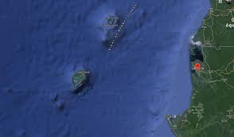
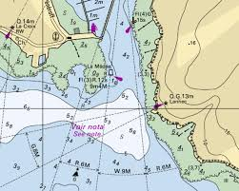
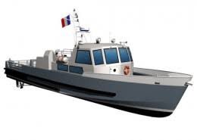
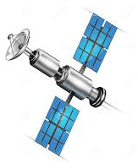
Varied, abundant, desynchronised maritime information
Need for an information collection tool allowing
to connect to numerous sources as needed
to connect to sources using different formats
Format
Type
Events
Environmental data
Kinematic and localisation elements
Real time or not
Administrative information
Need for an autonomous decision making tool to
Generate useful and reliable information
Synchronise the information
Synthesise and analyse relevant information
Providers
Collection sensors
Private sector
International Organisations
Own resources
States

Slide 6
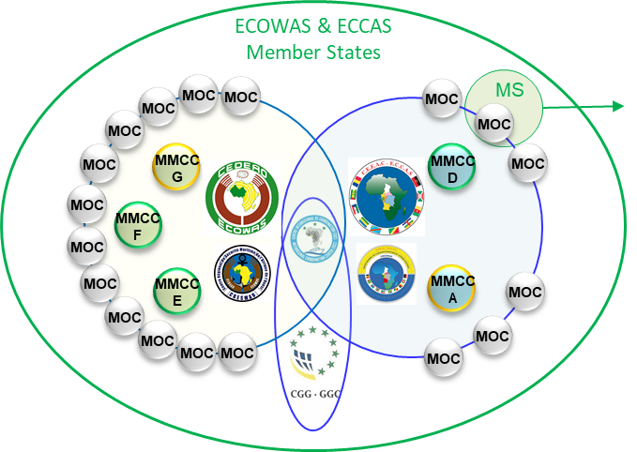
Gulf of Guinea, 19 maritime countries, around 6.000 km of coastline …
Numerous providers and users of maritime security information
Existing means for information sharing and analysis lack structure and security
Needs
Information sharing in a broad national and international inter-agency framework
Secure, permanent and interoperable channels of exchange
Control of information flows
Autonomy in information sharing and utilisation
National agencies (Customs, Navy, Fisheries, Transport, Justice…) with /without operational centres
----------------------------------------
Ports
----------------------------------------
Specific operational centres multinational-oriented (Fishery, MRCC…)
----------------------------------------
Maritime crisis management cells at various national levels
----------------------------------------
Assets of State action at sea
----------------------------------------
Sea users
Operational partners
Sea users
External systems of opportunity

Slide 7
YARIS, the response to information sharing and processing needs
Platform for maritime security information sharing and processing developed by EU GoGIN, with and for the Yaoundé Architecture
Integrating the needs mentionned above:
Connect « a minima » the Yaoundé architecture centres
Enables interoperability amongst subscribers for sharing and exchanging selected information
Enables information processing to anticipate, watch, decide and operate, in full autonomy
Secured environment enabling information controlling at all levels
But also:
An interface dedicated to training
Major advantages of YARIS
Autonomy
Anticipation
Reactivity
Flexibility
Security

Slide 8
YARIS : A set of modules offering various functionnalities
Share general information on centre events and news (portal)
Secure exchanges (videoconference, messaging)
Share operational information about events at sea
Integrate data from various sources, origin and formats (mapping data, geo referenced data and / or vessel tracking …)
Conduct analysis, on the spot or delayed, for better maritime domain awareness

Slide 9
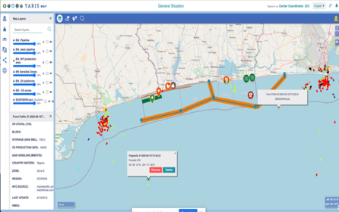
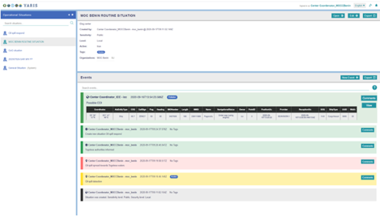
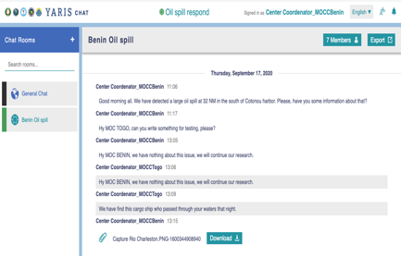
YARIS: Tool for managing routine or crisis situations
Situations (related to events), routine or crisis, are created by a centre which remains the owner, but can share it with others (group). Each situation is monitored using the 3 following complementary functions:
Advanced mapping
Visualisation of the situation at sea, by superimposing static and dynamic information layers (certified nautical maps, zones, data on ships, pollution slicks, etc.): information fusion
Log
Recording the event progress (chronology, orders given, kinematic positions, reports, etc.) that can be the basis for further legal investigations (proof) and hot-analysis (feedback based)
Chat
Instant and secure communication between partners monitoring the situation

Slide 10
YARIS: Guaranteed security of information and operational flexibility
Choice for each subscriber division to exchange, share or not with another division
Choice within a division to filter information according to authorisations and the need to know the operators
Encrypted information and protected channels (VPN)
Access to the central database (cloud hosting at this stage) restricted to administrators and the server maintenance company (company which can be changed easily at any time)

Slide 11
YARIS core and brain
Yaoundé architecture centres
(ICC, CRESMs, MMCCs, MOCs)
Political organisations
(ECOWAS, ECCAS, GGC, national and regional authorities )
Potential partners
(CSP, MRCC, EU, FR, UNODC, SWAIMS, PASSMAR, NAVAF, SEAVISION....)
Users
Administration
Core (Operational and training environments)
Infrastructure
Security
Monitoring
YARIS
Portal
Operational situation
Instant messaging
Log
Hot and cold analysis
Virtualisation
Virtual private network (VPN)
Ticketing
Storage
Firewall
Analytics
Networking
Digital certificates
User management
Web proxy
Jump
Redundancy
SSO authentification
In support
Backup
Antivirus
Services
Disaster recovery
Antispam
Mail messaging
Videoconference
Encryption

Slide 12
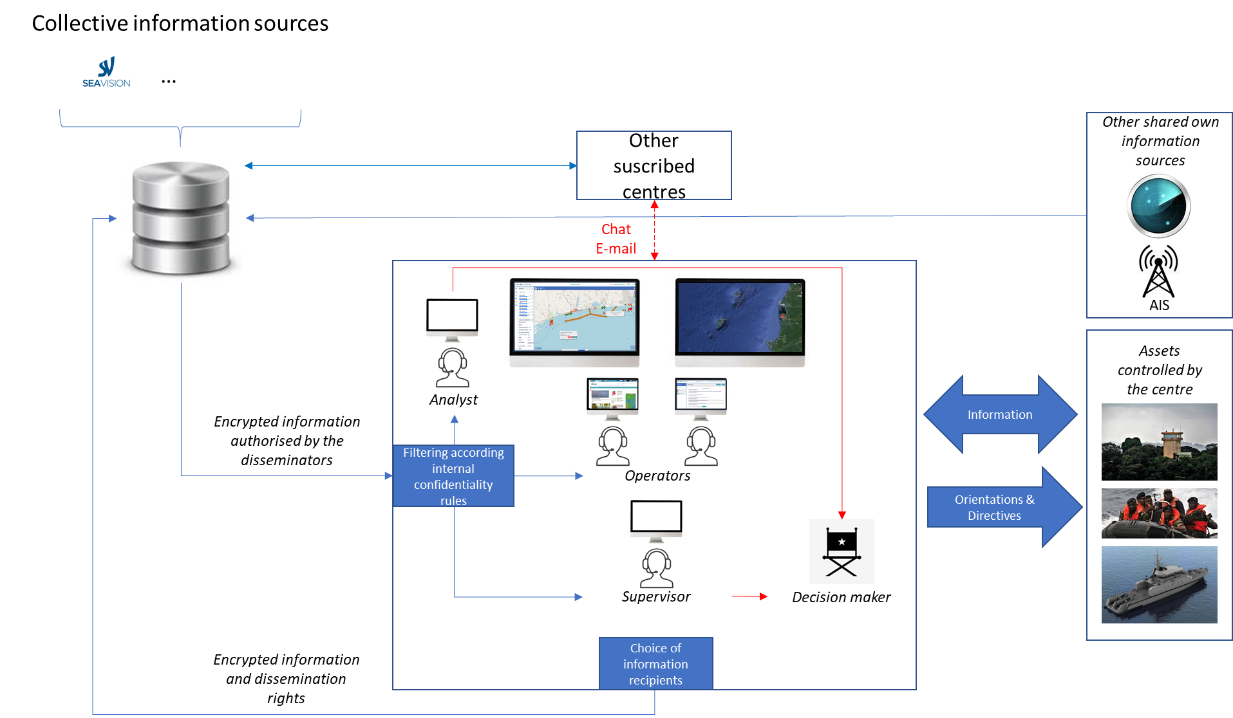
YARIS in practice, view of a center

Slide 13
Current YARIS operational network
MOC Luanda
MMCC A
MOC Banana
56 %
MOC Pointe-Noire
CRESMAC
MOC Libreville
MOC Port-Gentil
COGC Sao Tome
MMCC D
MOC Malabo
COSCO Douala
ICC
Nigeria (TBD)
MMCC E
MOC Cotonou
PREMAR Bénin
MOC Lomé
MOC Accra
MOC Abidjan
MOC San Pedro
Non-existing
CRESMAO
MMCC F
MOC Monrovia
Proposal to be done
MOC Freetown
Expected answer
MOC Conakry
Planned
MOC Bissau
Connected
MOC Banjul
MMCC G
MOC Dakar
COSM Praïa

Slide 14
Questions ?
YARIS
Developped by
Hosted (server) by
Maintained by developpers and website host
With support of
Funded by EU (880 000 €)

