Slide 1
YAOUNDÉ ARCHITECTURE REGIONAL INFORMATION SYSTEM

Slide 2
YARIS
THE TOOL MSA -MAP

Slide 3
Plan
Overview
Organization of information
Map Window Organization
Map tools
Layers management
Object management

Slide 4
MAP
OVERVIEW

Slide 5
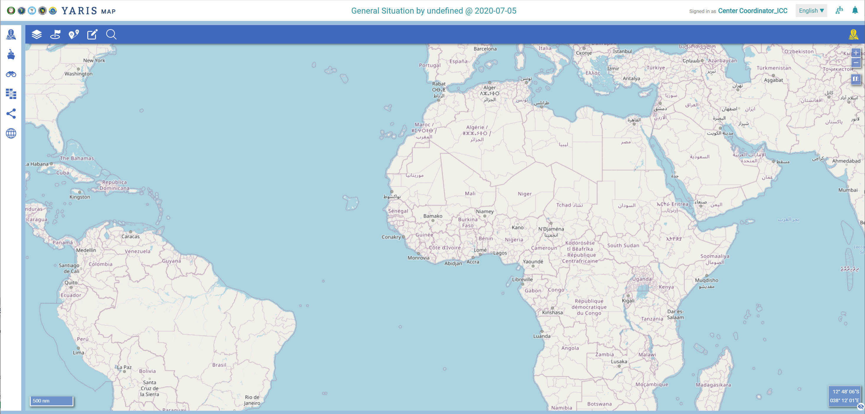
MAP: Goal
Purpose
Dispose and management of a common maritime information picture concerning an operational situation
Share georeference information (and associated data), according to the following criterias:
Level – geographical criteria
Sensitivity – confidentiality criteria
Notes:
Comments:
First point Users ... have automatic access to a Instant messaging environment, not at a Instant messaging
second point: within the this environment...

Slide 6
YARIS /MAP - GOAL Resume - Basic Principles
Aggregate Information
(complementary not replacement)
SEAVISION
Radar Information
AIS
3th party layers (Nautical Charts,…)
Human sources
Information processing
Operational Analysis
Merge/Fuse
Validate
Support Decision
Information dissemination
Need to know principle
User with the right profiles

Slide 7
MAP: Basics
Basics
A MAP is linked to a given operational situation
It contains layers of information related to, or that can be available to support, a given operational situation
A layer is composed by objects
An object as properties
Layers are accessible to users who meet both the criteria (level and sensitivity) of the situation and of the layers and that are invited to share with
Notes:
Comments:
First point Users ... have automatic access to a Instant messaging environment, not at a Instant messaging
second point: within the this environment...

Slide 8
MAP
ORGANIZATION OF INFORMATION

Slide 9
Organization of the information Concepts
Information based on concepts of:
Layer: group of objects ... With level and sensitivity criteria
Object: vessel, point, area,…. Default and / or specific parameters
And which allows:
An exchange and sharing among controlled and dedicated centers / users, in accordance with the type of information, the need to know and the will of the owner of the information

Slide 10
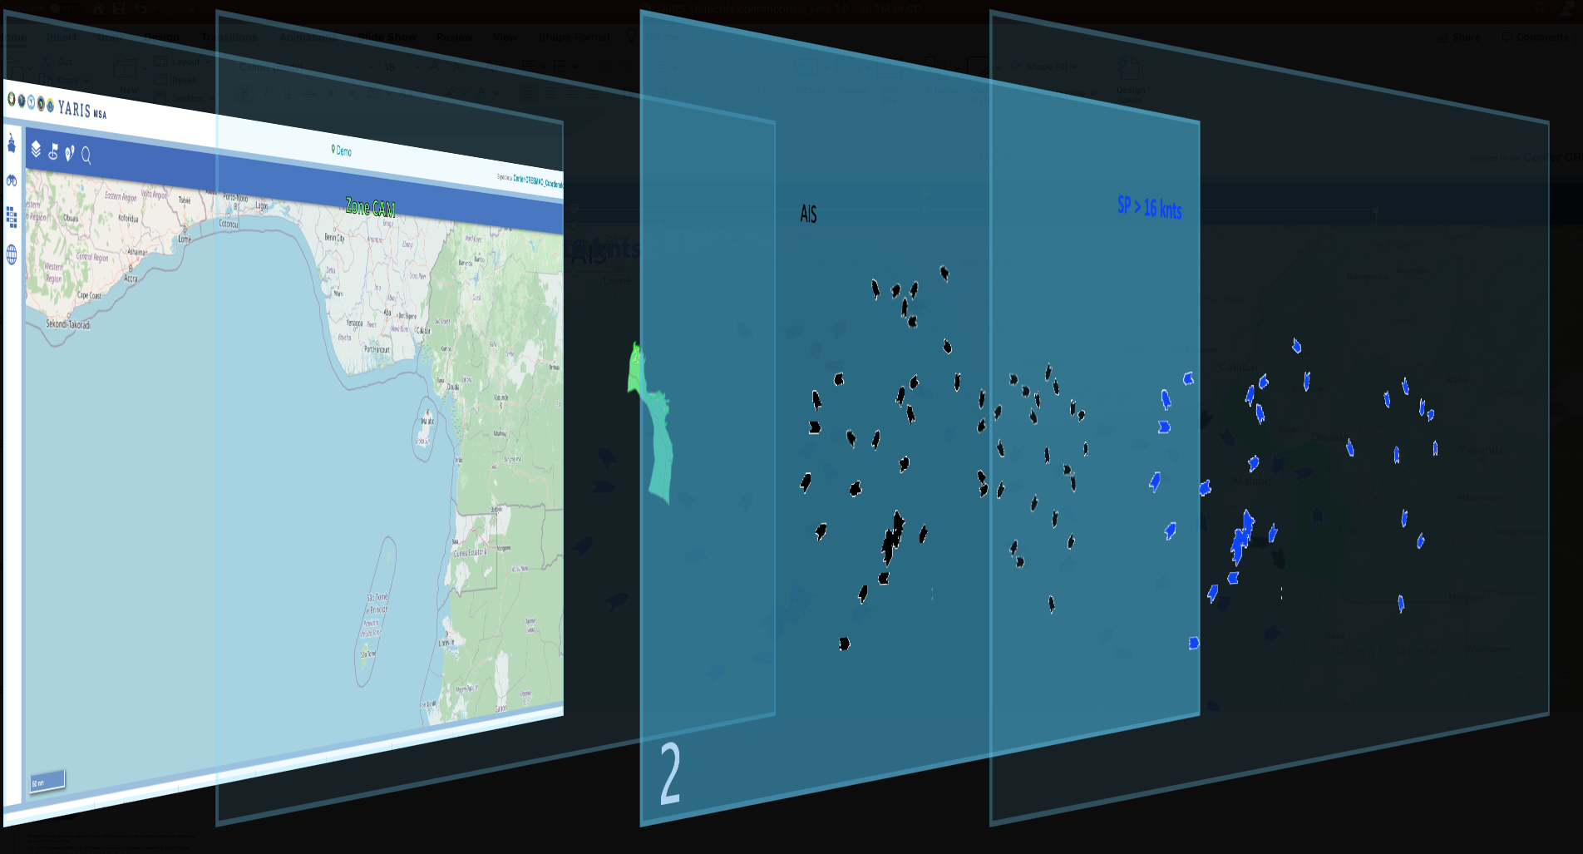
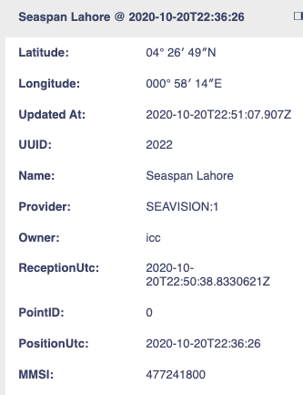
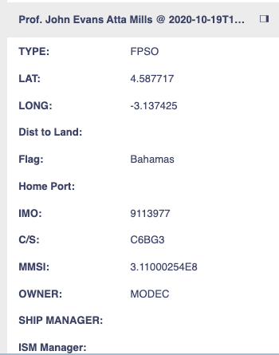
Organization of the information Concepts
Basic Map
Cameroon EEZ
AIS
AIS + SOG > 16
Map Visualization
Set of layers stacked on top of each other
Layer
Group of elements constituting the set and is transparent elsewhere
Object
Generic term, designating anything that could be materially represented in a given reality
Subdivided into categories or classes of objects (eg: ship, track, areas of interest)
Each class has essential characteristics that distinguish its objects from those of other classes
These characteristics are called properties of the object

Slide 11
Organization of the information Layer and object concept
Layer-object relationship
Layer - object
A layer is composed by objects (part of the information) and transparency (part without relevant information)
These objects can be of different classes
The base classes are
Point: element holding on a coordinate Ex: a ship
Line: connecting two points: Ex: a track
Polygons: closed set of lines Ex: an area of ​​interest (fishing area, etc.)

Slide 12
Organization of the information Reminder – Basic layers settings
(Main) Settings
Local
National
Zone
Regional
Interregional
International
Public
Private
Secret
+
OWNER
LEVEL
SENSITIVITY
TAG
SHARE
Owner
The one who created the layer
Level
Sets the geographic level at which layer is accessible
Sensitivity
Defines the level of confidentiality of layer
Tag
Layer’s theme
Share
Defines the type of sharing and with whom
Notes:
All information has a cleanliness, a geography and sensitivity. Others

Slide 13
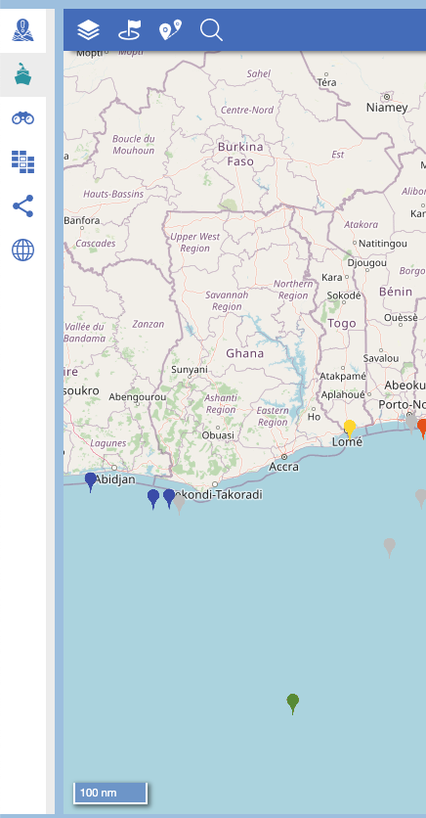
Organization of the information Type of layers
(Own) Information layers – Layers created by a center
Third Parties Layers – Layers from third parties
System Information Layers – Layers from the system (hardcoded in the system)
View layers - Comprise a selection of information based in the active layers in the user’s post and searching criterias defined by the user
Smart layers - Comprise content automatically selected by the system based on rules defined by the user.
Yaoundé (Shared) Layers – Own information layer made available with the YS
Situation (Added) Layers - Layers that were added by a user to an operational situation

Slide 14
Organization of the information Type of layers
(Own) Information layers – Layers created by a center
Third Parties Layers – Layers from third parties
System Information Layers – Layers from the system (hardcoded in the system)
View layers - Comprise a selection of information based in the active layers in the user’s post and searching criterias defined by the user
Smart layers - Comprise content automatically selected by the system based on rules defined by the user.
Yaoundé (Shared) Layers – Own information layer made available with the YS
Situation (Added) Layers - Layers that were added by a user to an operational situation
To agregate information in the system

Slide 15
Organization of the information Type of layers
(Own) Information layers – Layers created by a center
Third Parties Layers – Layers from third parties
System Information Layers – Layers from the system (hardcoded in the system)
View layers - Comprise a selection of information based in the active layers in the user’s post and searching criterias defined by the user
Smart layers - Comprise content automatically selected by the system based on rules defined by the user.
Yaoundé (Shared) Layers – Own information layer made available with the YS
Situation (Added) Layers - Layers that were added by a user to an operational situation
Layers always present in the system

Slide 16
Organization of the information Type of layers
(Own) Information layers – Layers created by a center
Third Parties Layers – Layers from third parties
System Information Layers – Layers from the system (hardcoded in the system)
View layers - Comprise a selection of information based in the active layers in the user’s post and searching criterias defined by the user
Smart layers - Comprise content automatically selected by the system based on rules defined by the user.
Yaoundé (Shared) Layers – Own information layer made available with the YS
Situation (Added) Layers - Layers that were added by a user to an operational situation
Selection of georefenced data based on the active layers and criterias defined by the user

Slide 17
Organization of the information Type of layers
(Own) Information layers – Layers created by a center
Third Parties Layers – Layers from third parties
System Information Layers – Layers from the system (hardcoded in the system)
View layers - Comprise a selection of information based in the active layers in the user’s post and searching criterias defined by the user
Smart layers - Comprise content automatically selected by the system based on rules defined by the user.
Yaoundé (Shared) Layers – Own information layer made available with the YS
Situation (Added) Layers - Layers that were added by a user to an operational situation
“Shared layers”

Slide 18
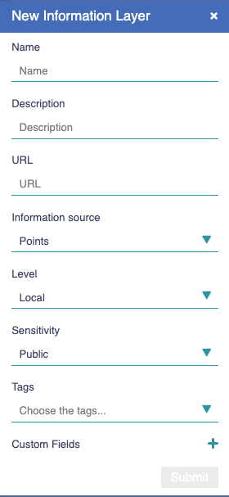
Layer and object concept Properties of a layer
When creating a layer, the following information will be required:
Name
Description
Url
Source type (Points, Geometry File, Image File)
Geographical accessing criteria (Level)
Clearance accessing criteria (Sensitivity)
Keywords (Tags)
Customs Fields to be defined by the user, if needed/wanted
Automatically, the system adds the following properties:
Author
Date of creation
These properties can be used later as search / selection criteria

Slide 19
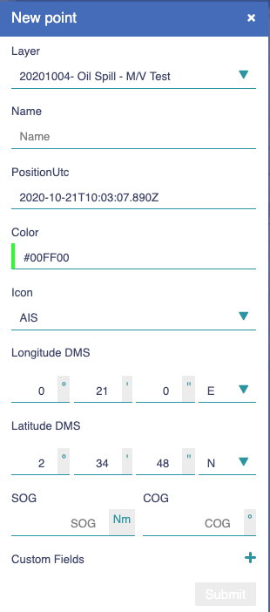
Layer and object concept Properties of an object
When importing a layer, all the data associated to object is imported, eg:
In pict 1, Imported information related to a vessel
In pict 2, Imported information related to an oil platform
When creating an object to be added to a layer, the following information is requested:
Layer
Name
Position
Color
Icon
Position
Speed and Course
Customs Fields to be defined by the user, if needed/wanted
These properties can be used later as search / selection criteria

Slide 20
Organization of the information Access to the layers
1
2
3
Property
Ownership
Invitation
Layer Level
(Geographic criteria)
Local
Users with the appropriate permission
National
Zone
Regional
Interregional
International
Sensitivity of the layer
user permissions
Secret
Private
Public
Secret
Private
Public
Private
Public
Public

Slide 22
THE TOOL MSA -MAP
Map Window Overview

Slide 23
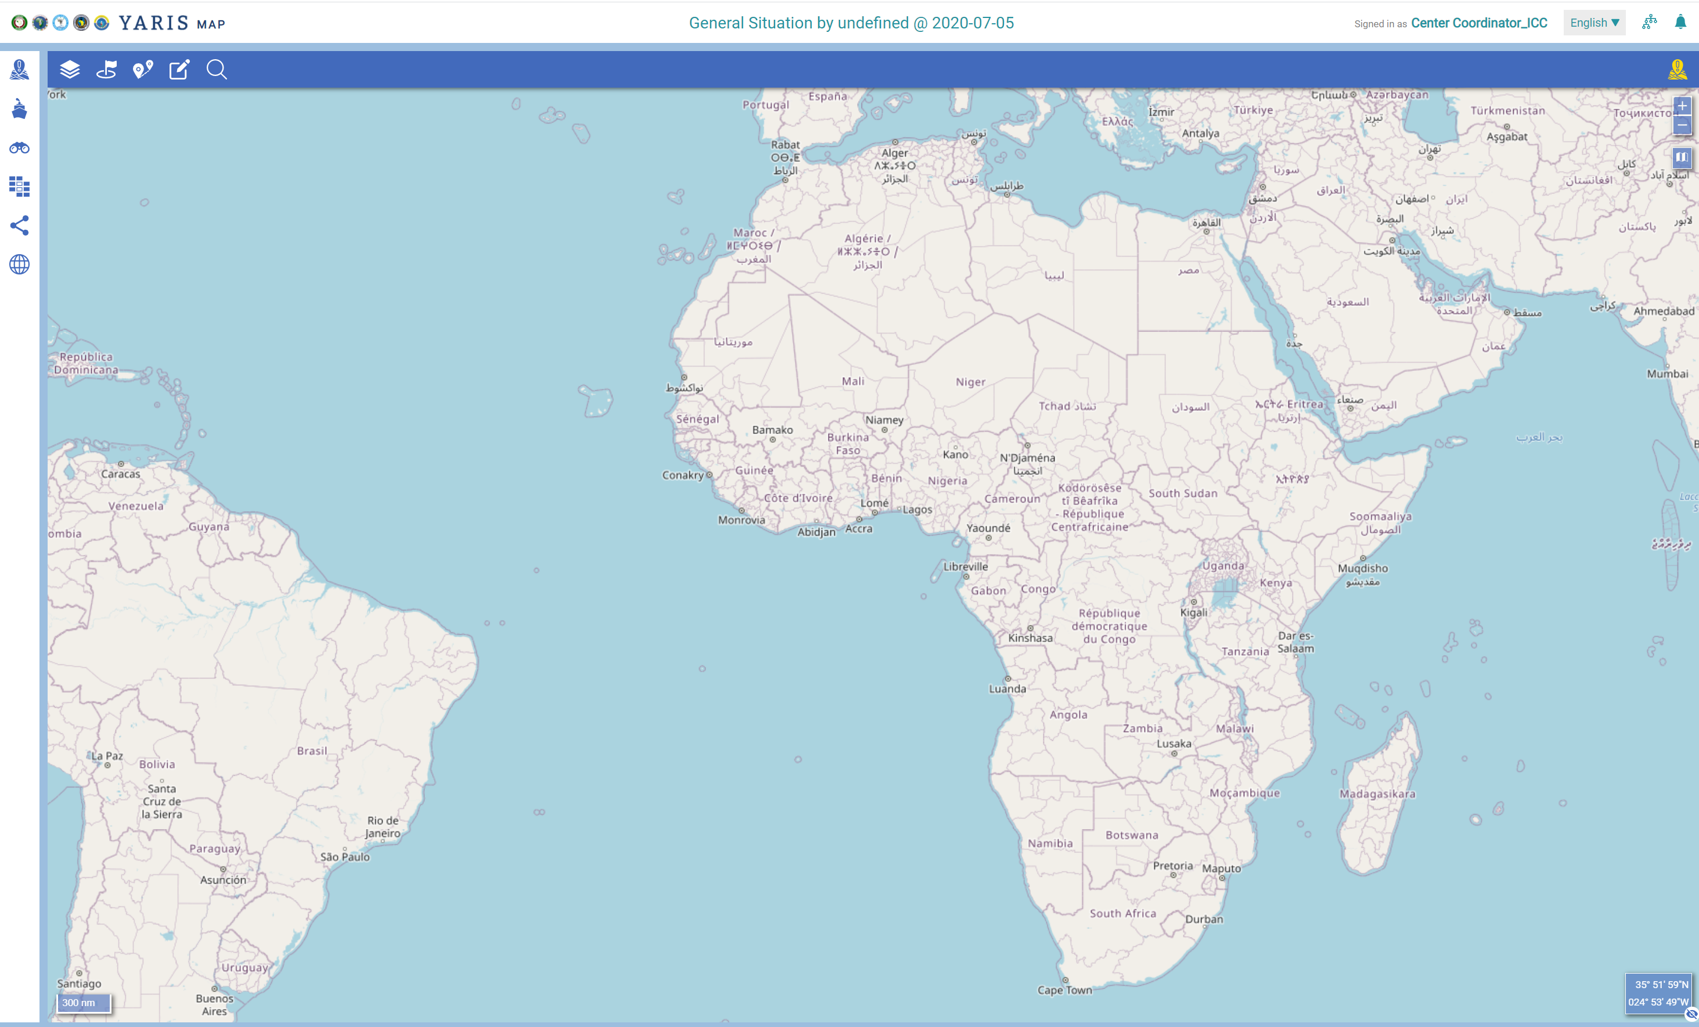
Map Overview
1
Global information and notification alert
Identifies the situation concerned, the user, the centers connected to YARIS
Alert and access to system notifications
MAP
Visualization of the situation
Workspace
Horizontal Menu
Options for:
Create an operational situation from the map
Work on the map
Side Menu
Layers Creation, management and display options on the map
3
1
2
2
4
3
4

Slide 24
THE TOOL MSA -MAP
Global information and notification alert

Slide 25
Main features Reminder
Access to notifications – system notifications (create layers, share layers, new center active/disable,….)
User’s preferences:
Language parameters – by default or local
Internet connexion – by default
Receiving the Notifications log – to receive the notifications by email at the end of the day
Auto-refresh Session – to maintain the session always connected even if there is no interaction with the system
Administration Board – available only to the Administrators to control the overall parameters of the application
Identification of the Operational Situation and its level and sensitivity criterias
Access the Portal – it opens the Portal browser

Slide 26
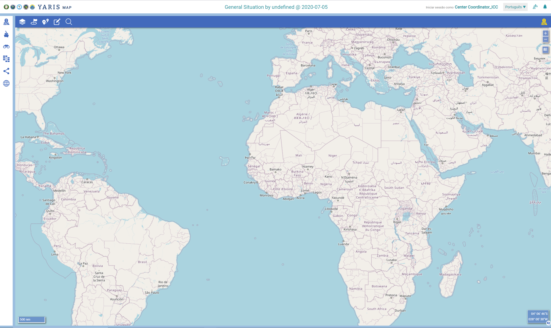
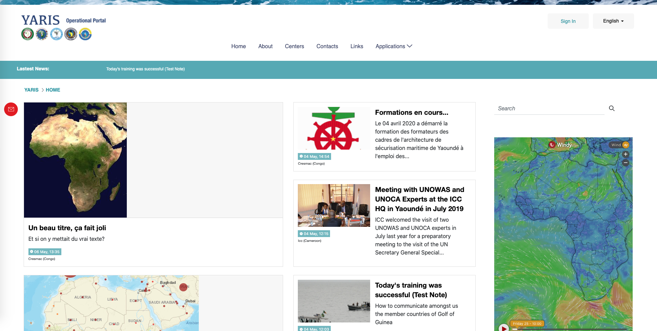
Map window overview Global information and notification alert
1
3
4
5
2
6
1
Link to the Portal
By clicking it opens a new tab with the public window of the portal
Situation Identification
User Id and preferences
Window language
Active Centers in Yaris
Notification alert
2
3
4
5
6

Slide 27
THE TOOL MSA -MAP
The Chart

Slide 28
Map window overview The Chart
1
Zoom
Zoom in
Zoom out
Map source
Cursor coordinates on the map
Latitude
Longitude
The eye (lower right corner of the coordinates box) allows you to hide / display the cursor coordinates
Distance scale
The width of the rectangle indicates the distance corresponding to the value shown
1
2
2
3
4
3
4

Slide 29
THE TOOL MSA -MAP
The Horizontal Menu

Slide 30
Main Features
Create a situation – by name or one another of its properties
Tools to work with the MAP – basic working tools to measuring distances and bearings, work with georeferenced information and search specific information in the map
How to measure Distance around a points
How to measure distances (and bearings) between points
Tools to create, edit and delete georeferenced points, lines, polygons and circles.
Search specific objects in the map
Open MAP Layer Windows – shows and allows the management of the current active layers in the post

Slide 31
Horizontal Menu Create a situation from the map
One of the two ways to create a new situation => see module MAP.SIT for the other one
Using this way to create a situation:
It heredits the level and sensibility of the initial situation
It is possible to specify layers to be included (this is a functionality that doesn’t exist on the other functionality)
Possible uses:
When the development of an operational situation becomes so complex (for example: domain of multiple threats) and it is advisable to "work" the situation by domains
When developing an operational situation, new situations arise in parallel

Slide 32
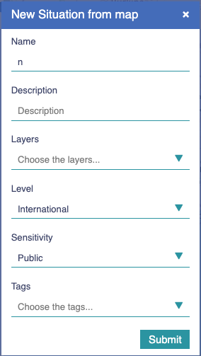
Horizontal Menu Create a situation from the map
1
Click on
A dedicated window opens
Fulfill the fields
Name – mandatory
Description
Layers
Level
Sensivility
Tags
Click on
1
2
2
Mandatory
Choose the basic layers that will be present in the new situation
3
Choose the basic tags associated with the new situation
3

Slide 33
Horizontal Menu Search objects (points)
Tool to find objects (points) present in the active layers
The search may be done by each one of the defined object properties, whatever their nature, and their value
Possible uses:
Search for a vessel by name, flag, type, and whatever other fields that where included
Search for an oil platform (if that information is imported in Yaris)

Slide 34
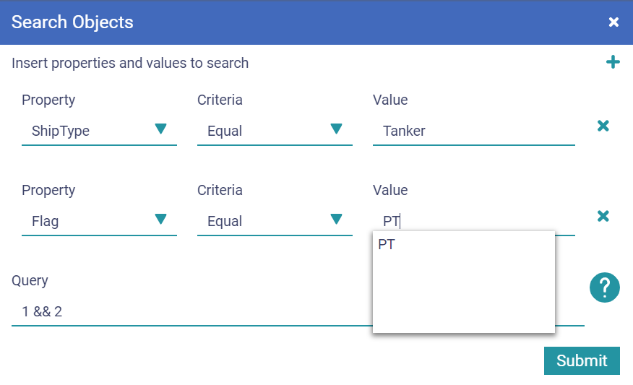
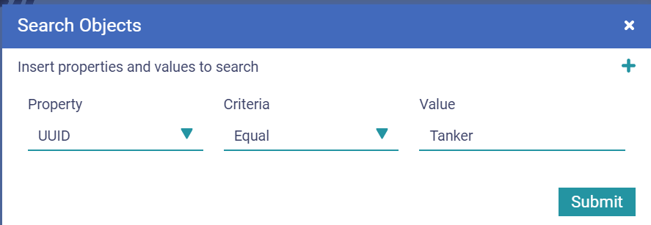
Horizontal Menu Search objects (points)
1
Click on
A dedicated window opens
Type the PROPERTY to search for
Click on the field/arrow to select
Type the CRITERIA to rule
Click on the field/arrow to select
Type the Value
As you start typing the system my suggest you some values
Click on to add another selecting criteria.
It assumes ”and” as logical operator
Define the rule in case of multiple selecting criterias
Click on
1
2
5
2
3
4
6
3
7
4
5
6
7

Slide 35
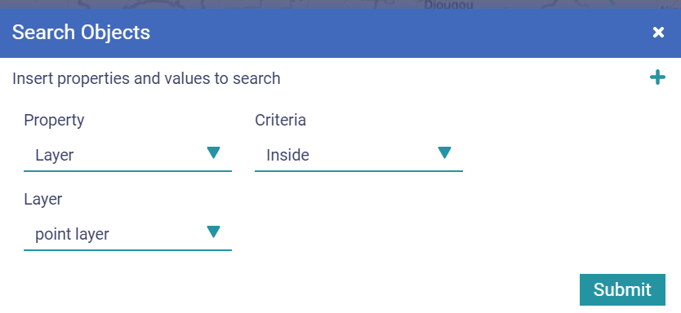
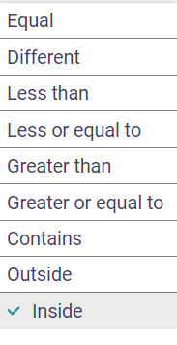
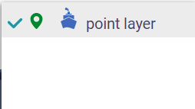
Horizontal Menu Search objects using an existing layer as the geographical criteria
1
Click on
A dedicated window opens
Select “Layer” as PROPERTY to search for
Click on the field/arrow to select
Select the CRITERIA to the rule from the values “Outside” or “Inside” in the list
Click on the field/arrow to select
Select the LAYER to the rule from the values in the list
Click on the field/arrow to select
Click on
1
2
2
3
3
4
5
4
5

Slide 36
Horizontal Menu Tools- Measure distances between 2 or more points
Two tools allowing to measure distances and bearing
Point to point method
Around a point method
The results may be exported as csv files
Possible uses:
Find distance and bearing betwen two points
Defined a route plan

Slide 37
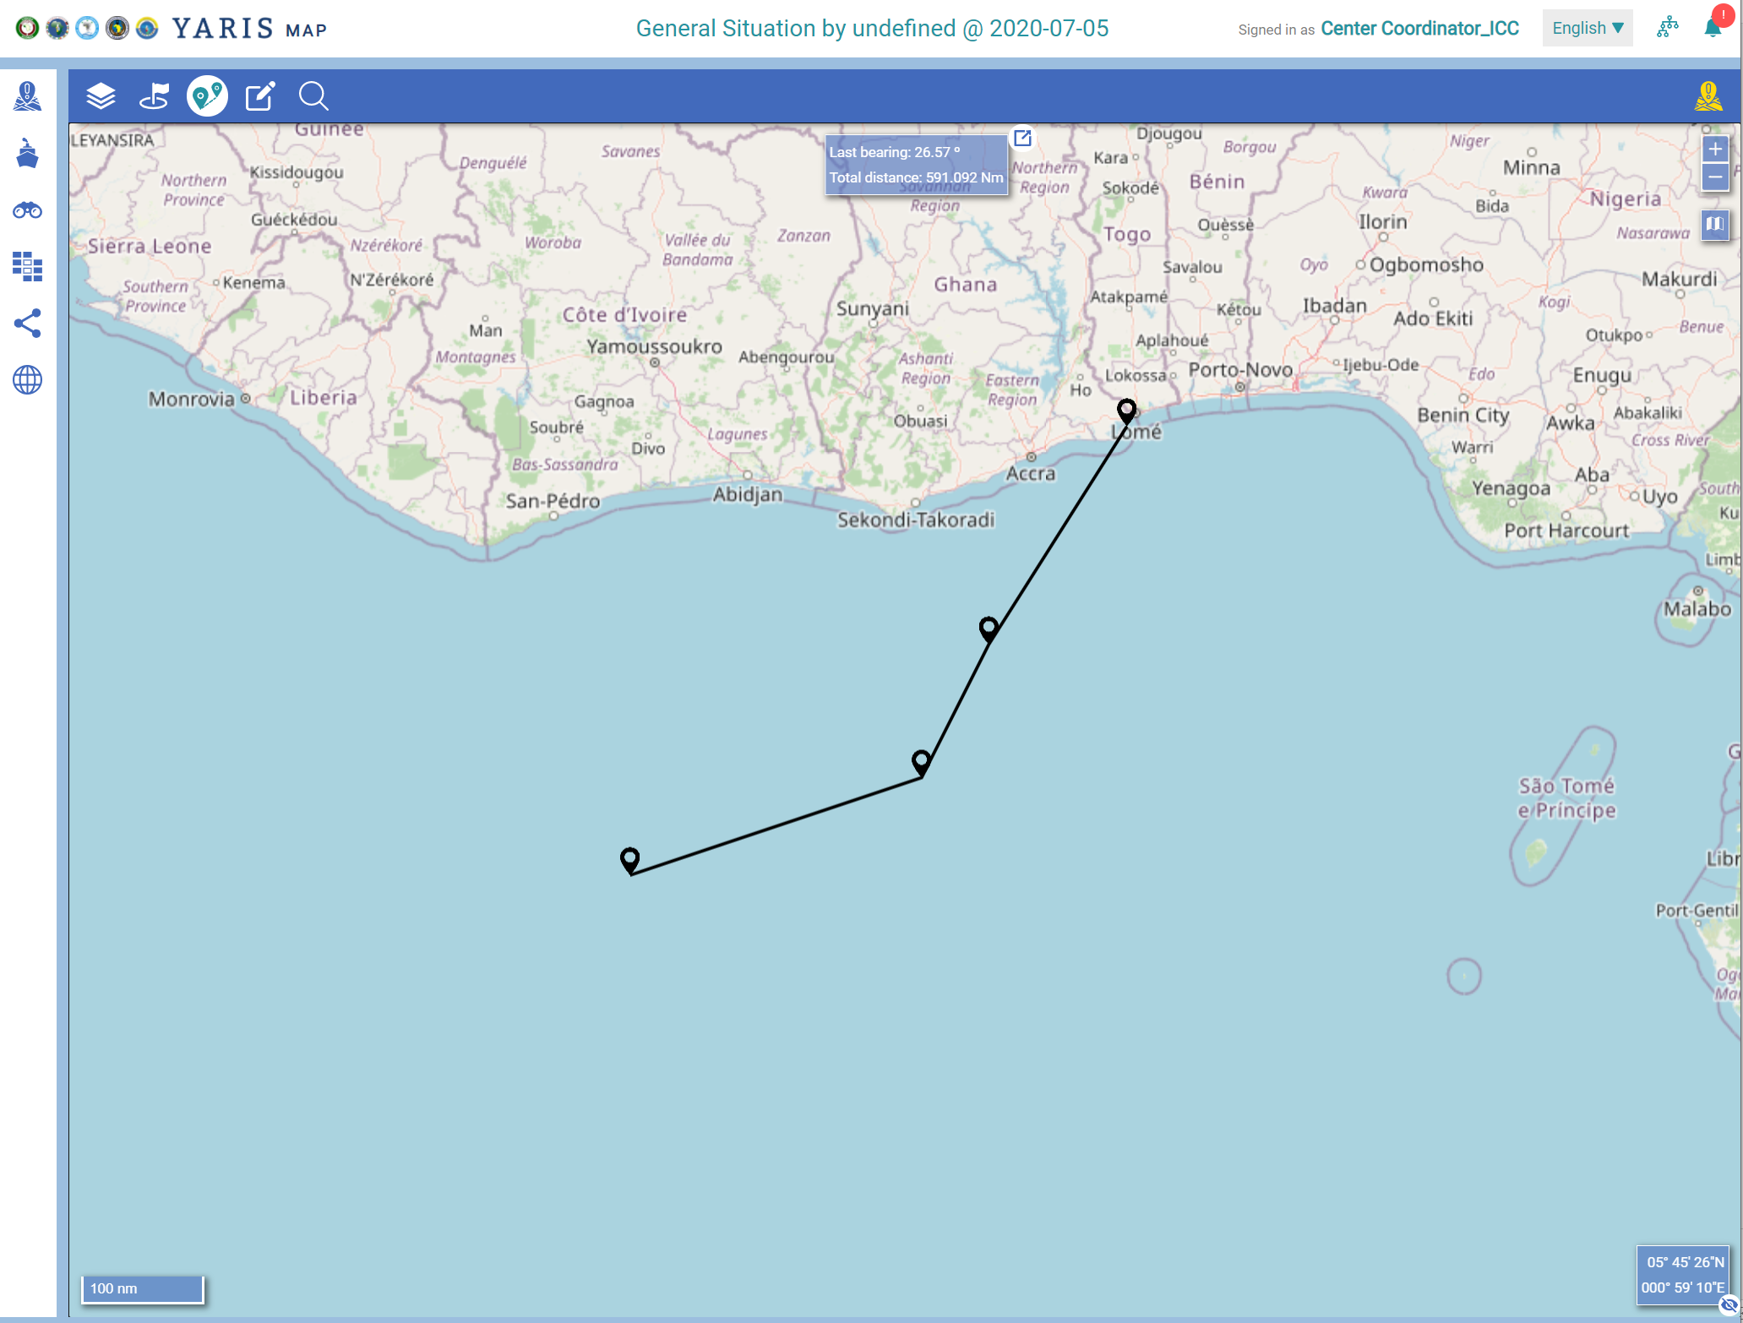
Horizontal Menu Tools- Measure distances (Met 1)
1
Click on
A dedicated window opens
Select the point of origine
Select the next point (s)
The data will be available on the reading box
(direction between the last points and total distance from the 1st point)
To delete a point click again on the point
1
2
3
3
3
2
3

Slide 38
Horizontal Menu Tools- Measure distances (Met 1)
1
4
Click on
A dedicated window opens
Select the point of origine
Select the next point (s)
The data will be available on the reading box
(direction between the last points and total distance from the 1st point)
To delete a point click again on the point
Click on to export the information in csv format
Into your machine in download or transfer dossier
1
2
3
4
2
3

Slide 39
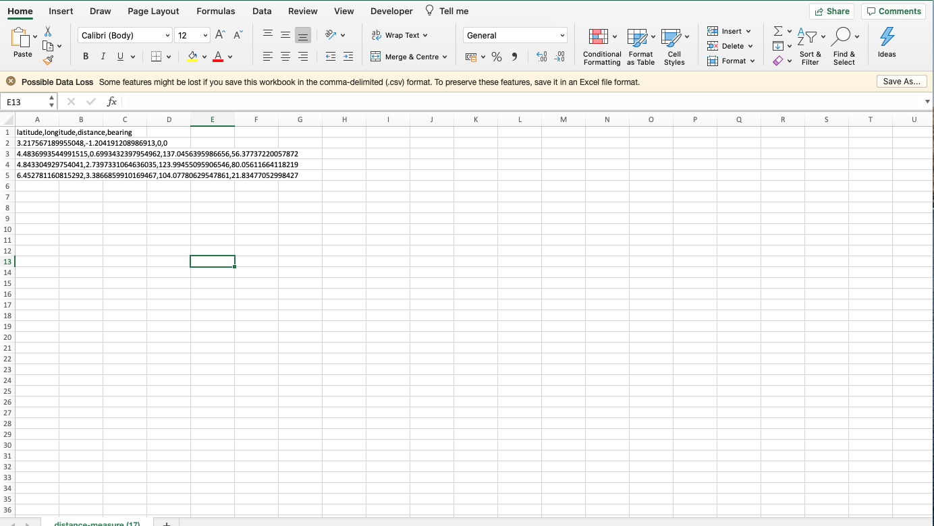
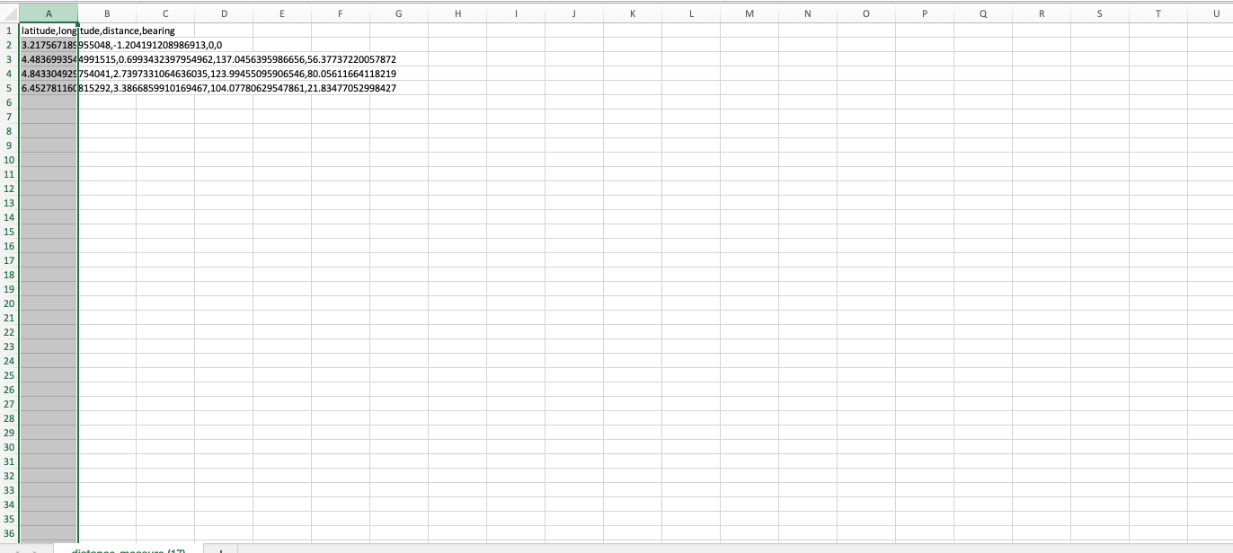
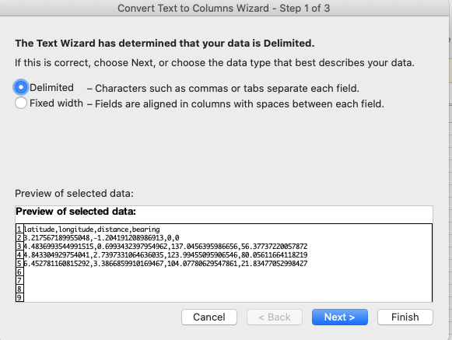
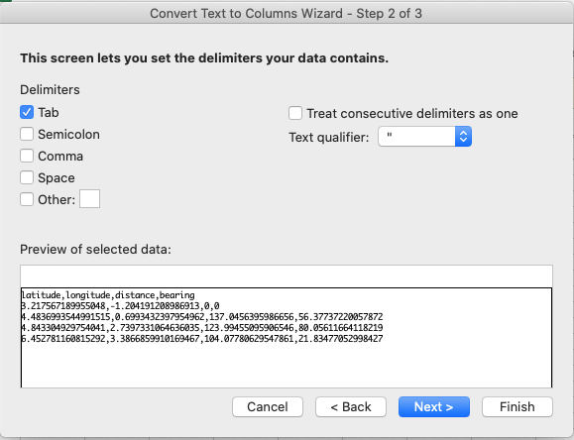
Horizontal Menu Tools - Measure distances (Met 1) - Export
Convert csv to Excel
1
Open the csv file with excel
Select all collom A
Select Data
Select Text to Columns
A dedicated box opens
Select Delimited
Click on Next
A dedicated box opens
Select Comma
Click on Next
3
4
2
3
2
4
5
5
7
6
6
7
8
8

Slide 40
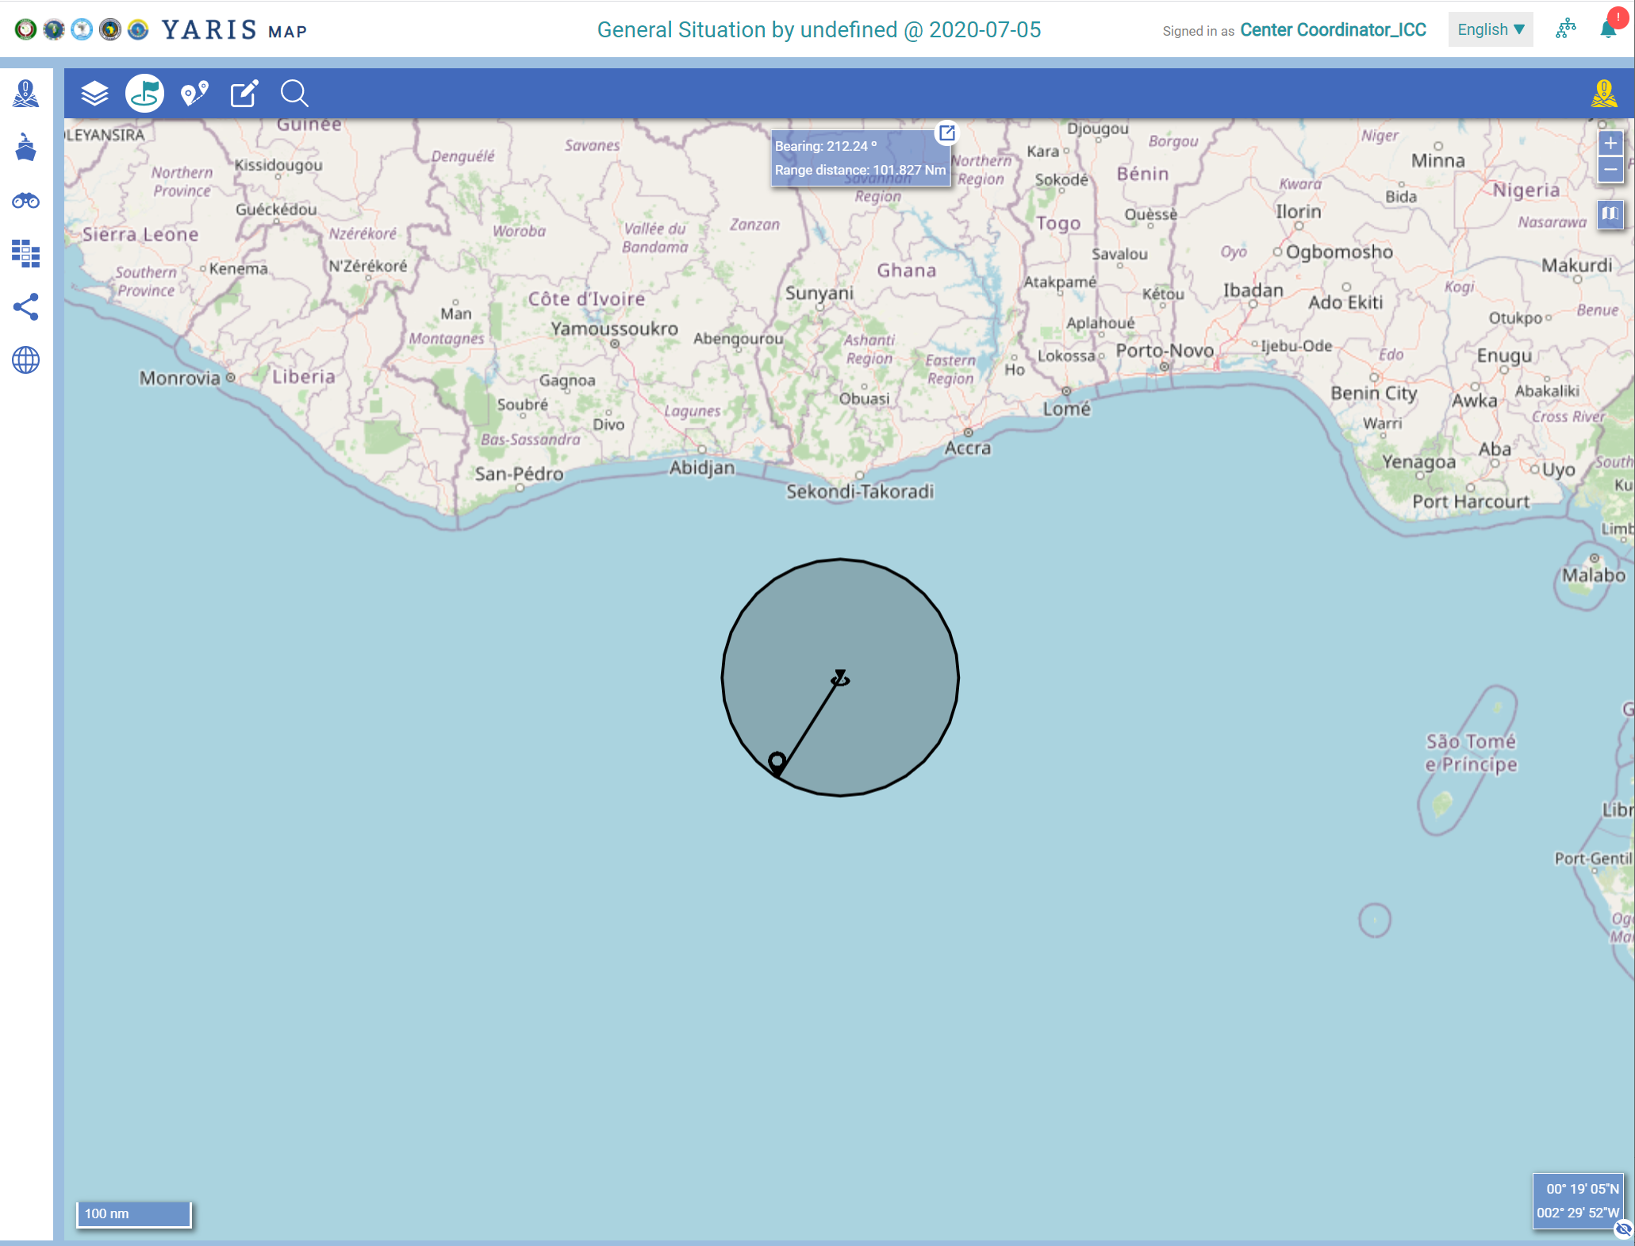
Horizontal Menu Tools - Measure distances (Met 2) - Export
1
4
Click on
A dedicated window is open
Select the point of origine
Select another point
The data will be available on the reading box
Click on to export the information in csv format
Into your machine in download or transfers dossiers
1
2
3
Measure the range around an object: the object is in the center, and the range is represented by the circle around the object
4
2
3

Slide 41
Horizontal Menu Tools – Tools to create, edit and delete georeferenced points, lines, polygons and circles
The drawing toolbar to be used requires that at least one information layer of “points” is active in the map
The geographical information may be exported as kml files
Possible uses:
Define point, lines, polygons and circles ad-hoc
Define areas related to the maritime information knowledge of the region database (supporting MDA)
Used as filters to select points

Slide 42
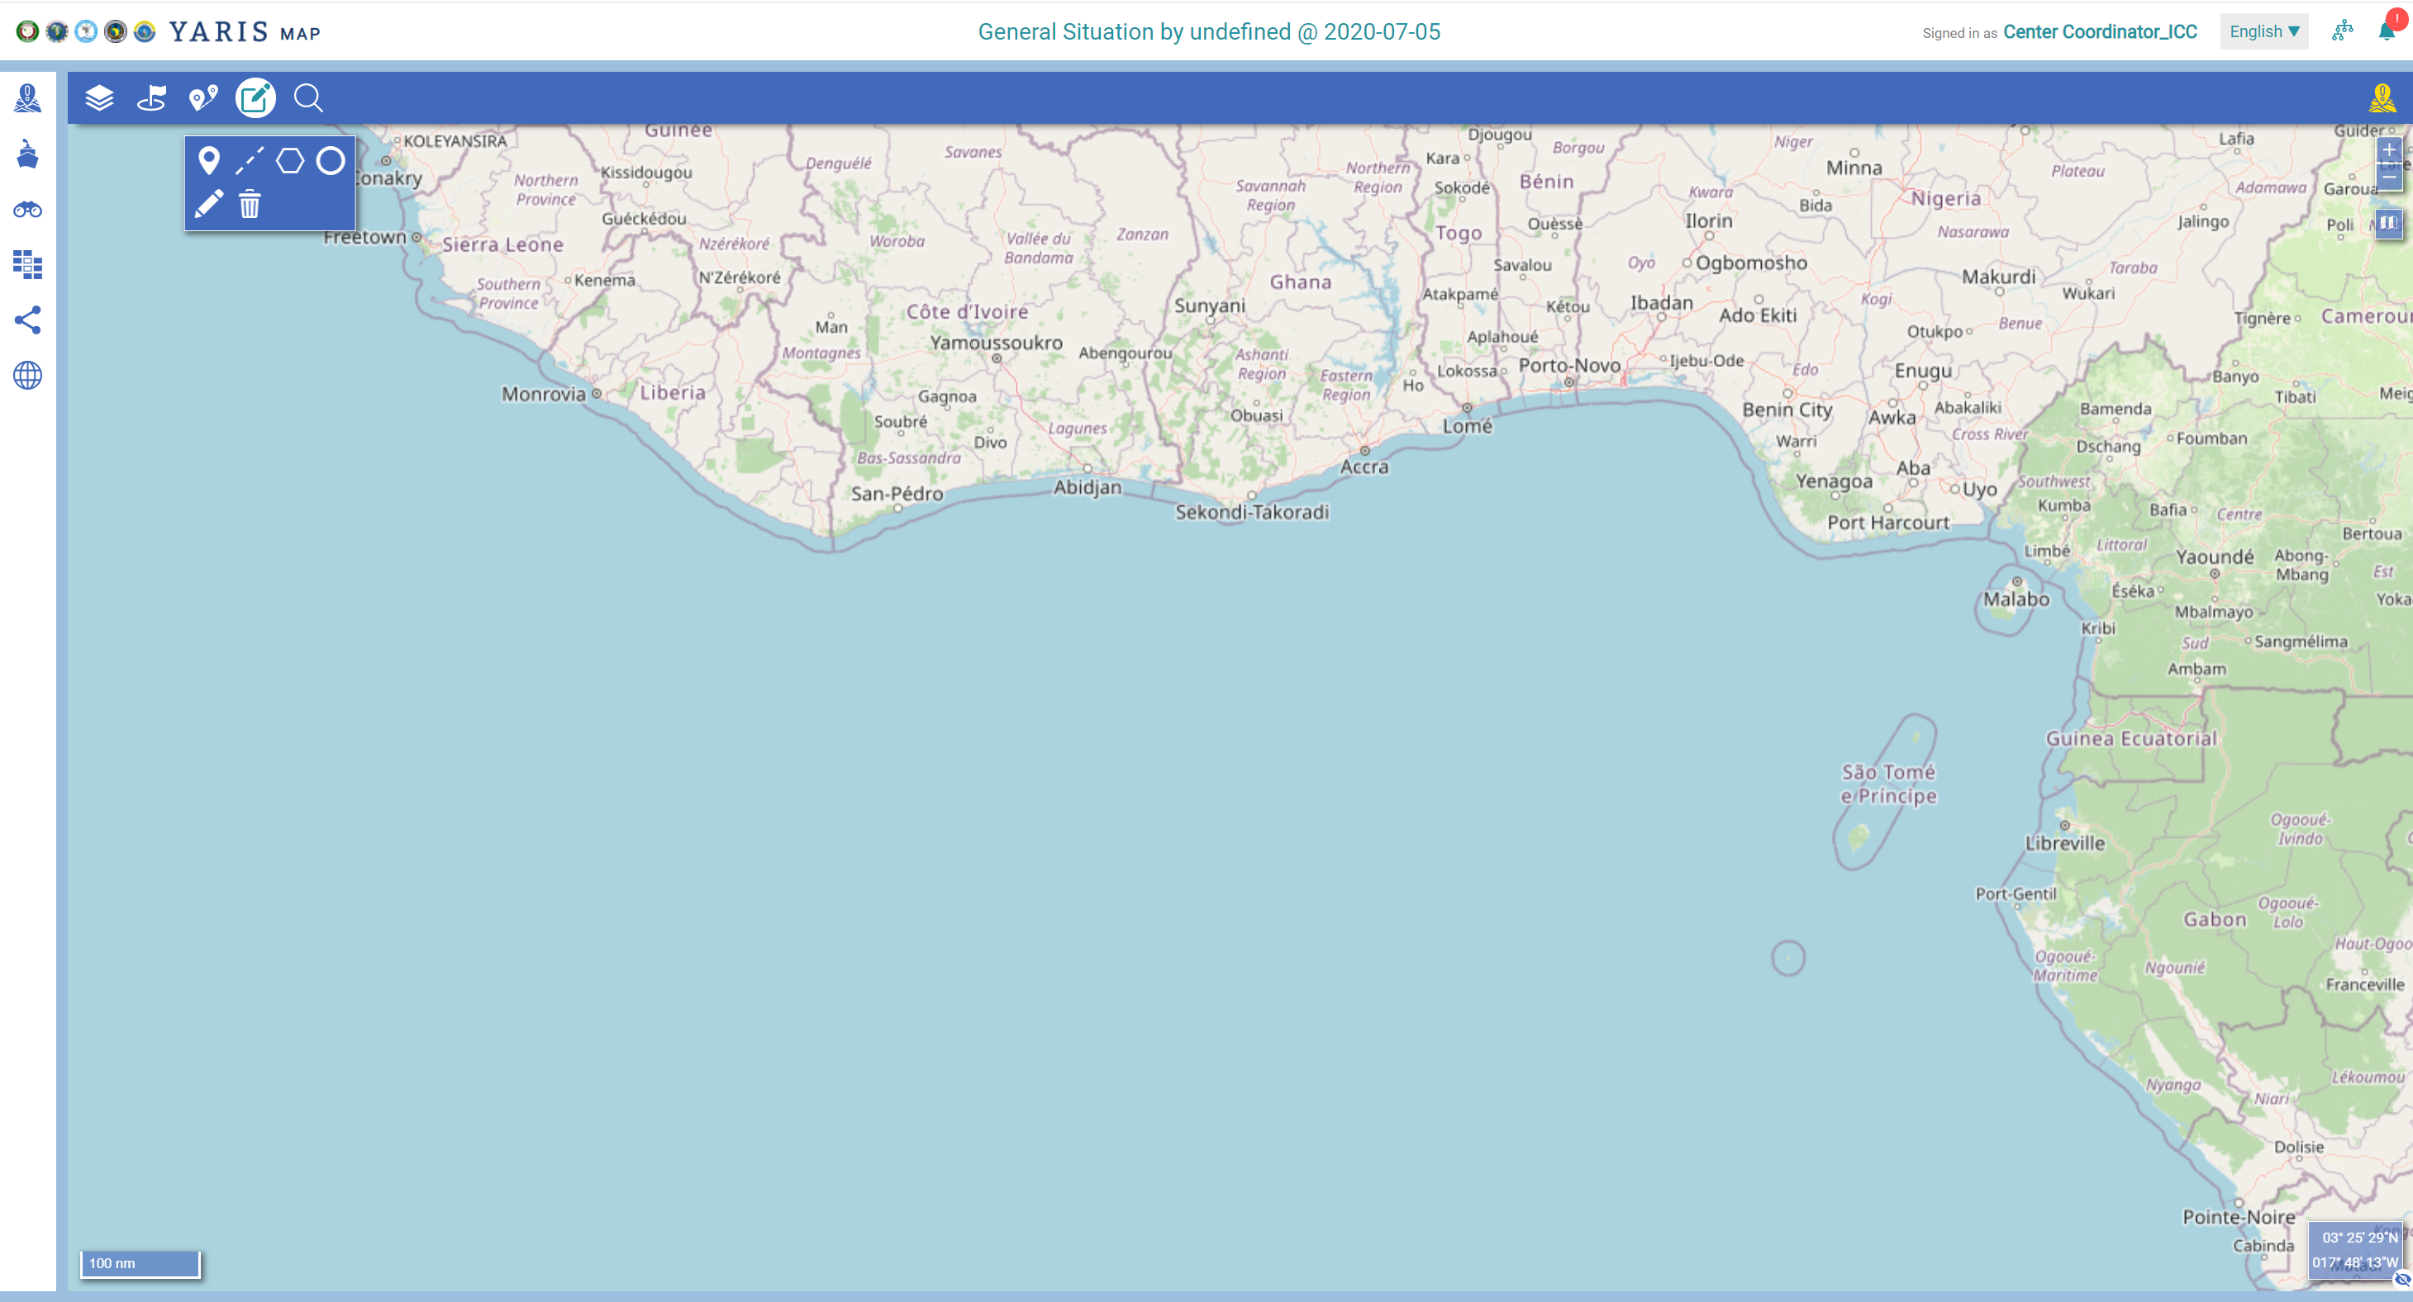
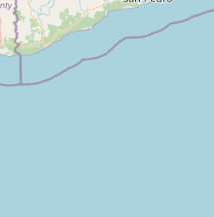
Horizontal Menu Tools - Tools to create, edit and delete georeferenced points, lines, polygons and circles
Activate at least one Information Layer of type “Points”
Click on
The drawing toolbar opens and the user can select one of the actions available:
Create Point
Create Line
Create Polygon
Create Circle
Edit Objects
Delete Objects
1
1
2
2
At least one own information layer must be active

Slide 43
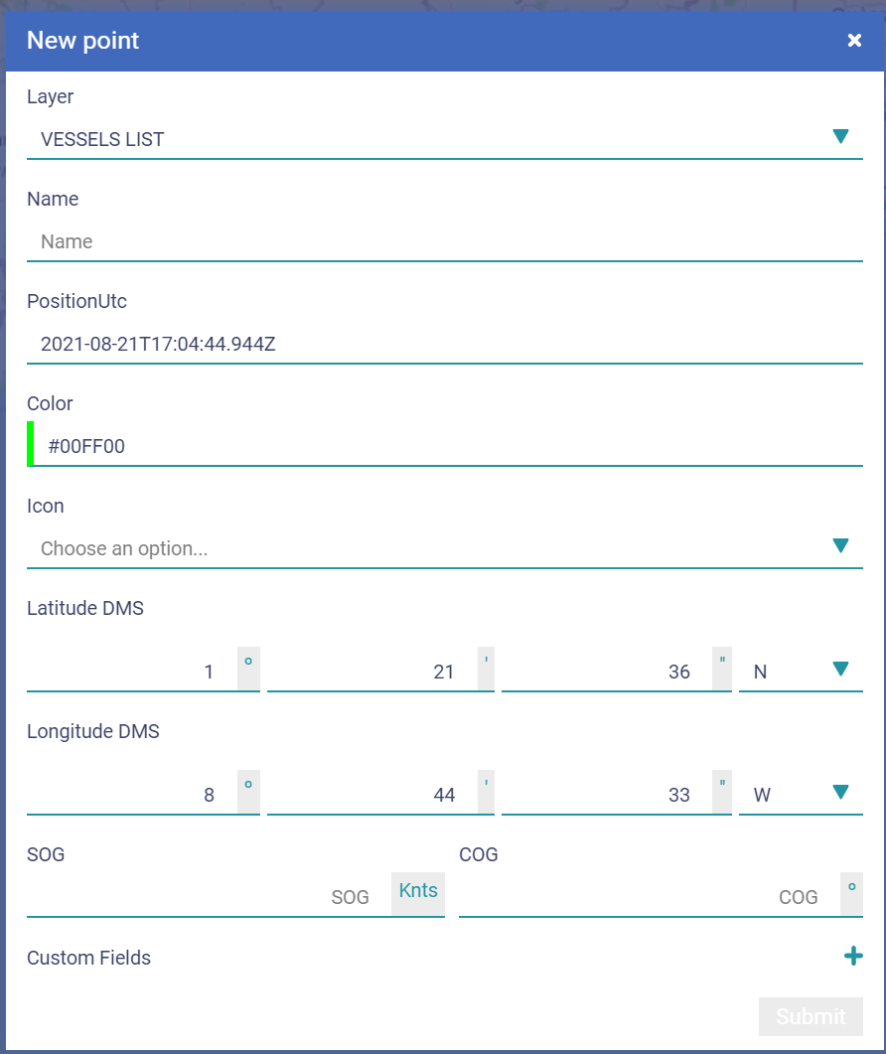
Horizontal Menu Tools - Tools to create, edit and delete georeferenced points, lines, polygons and circles
Activate at least one Information Layer of type “Points”
Click on
The drawing toolbar opens
Select one of the actions on the drawing toolbar:
Create Point
Create Line
Create Polygon
Create Circle
Edit Objects
Delete Objects
With the “Create Point” selected click on the point position in the map
Fulfil the fields
Layer -> mandatory
Name -> mandatory
PositionUTC -> mandatory
Description
Color -> mandatory
Latitude, Longitude -> mandatory
COG
SOG
1
2
1
2
3
3
5
4
5
4

Slide 44
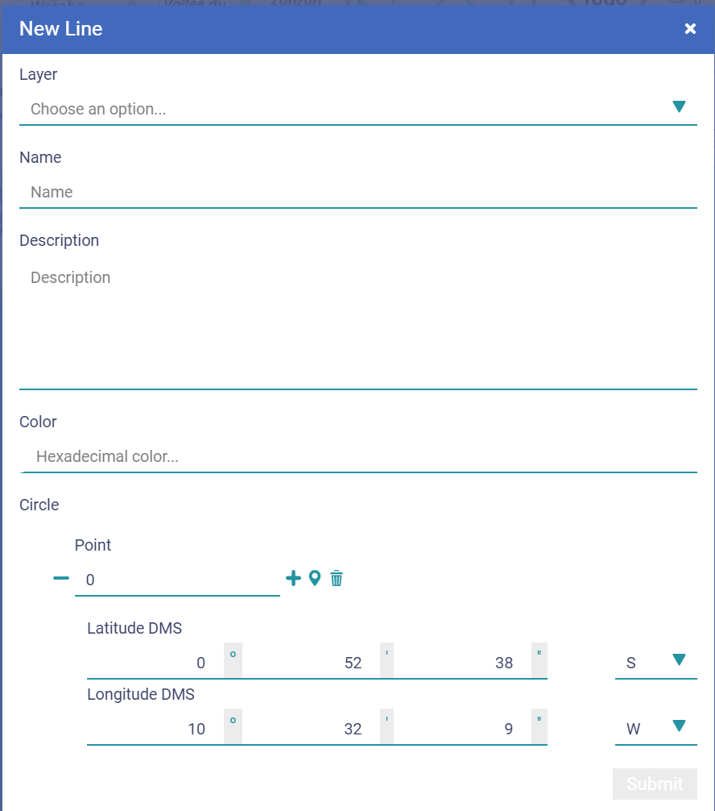
Horizontal Menu Tools - Tools to create, edit and delete georeferenced points, lines, polygons and circles
Activate at least one Information Layer of type “Points”
Click on
The drawing toolbar opens
Select one of the actions on the drawing toolbar:
Create Point
Create Line
Create Polygon
Create Circle
Edit Objects
Delete Objects
With the “Create Line” activated, click on the line positions in the map
Don’t repeat the first point
To remove the point, click again on the point
End with a “double click” in the map
Fulfil the fields
Layer -> mandatory
Name -> mandatory
Description
Color -> mandatory
Latitude, Longitude -> mandatory for each point
1
2
1
3
2
3
6
4
5
4
4
5
4
6

Slide 45
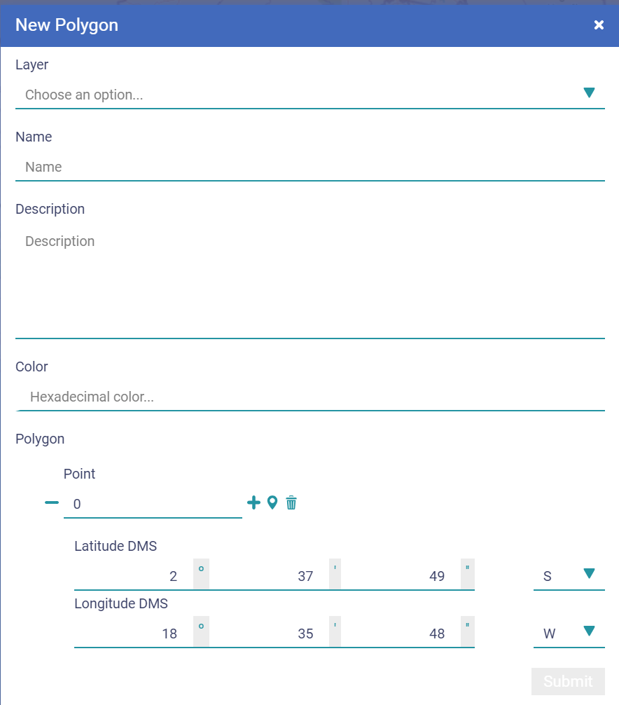
Horizontal Menu Tools - Tools to create, edit and delete georeferenced points, lines, polygons and circles
Activate at least one Information Layer of type “Points”
Click on
The drawing toolbar opens
Select one of the actions on the drawing toolbar:
Create Point
Create Line
Create Polygon
Create Circle
Edit Objects
Delete Objects
With the “Create Polygon” activated click on the polygon positions in the map
Don’t repeat the first point
To remove the point, click again on the point
End with a “double click” in the map
Fulfil the fields
Layer -> mandatory
Name -> mandatory
Description
Color -> mandatory
Latitude, Longitude -> mandatory for each point
1
2
1
3
2
3
6
4
4
4
5
4
5
6

Slide 46
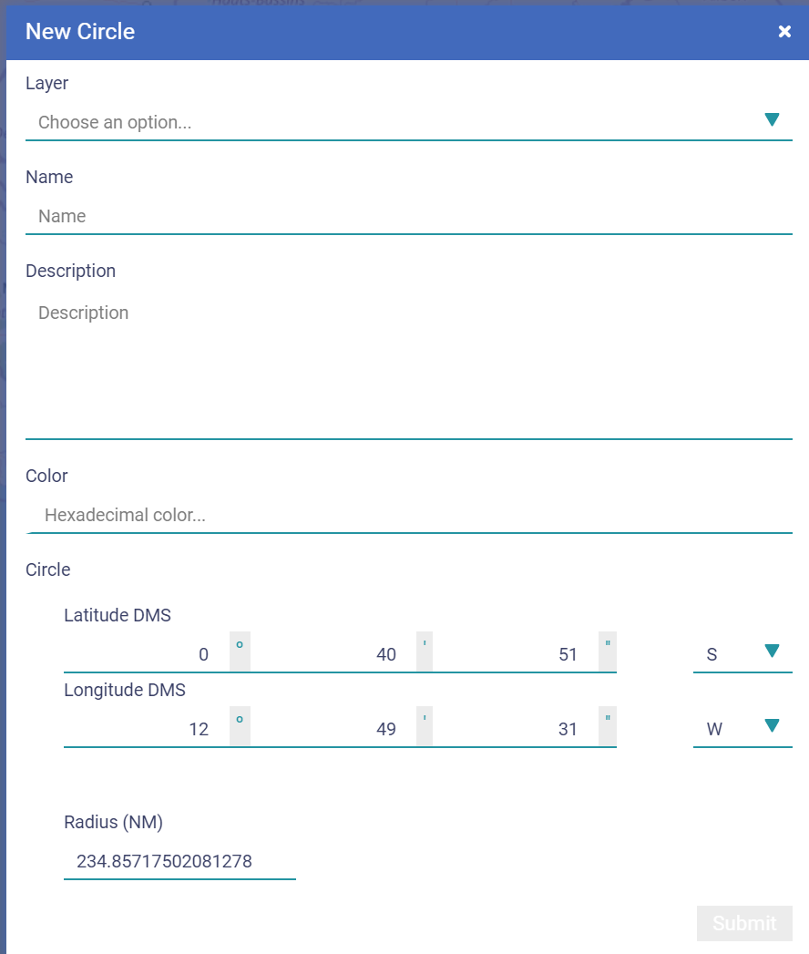
Horizontal Menu Tools - Tools to create, edit and delete georeferenced points, lines, polygons and circles
Activate at least one Information Layer of type “Points”
Click on
The drawing toolbar opens
Select one of the actions on the drawing toolbar:
Create Point
Create Line
Create Polygon
Create Circle
Edit Objects
Delete Objects
With the “Create Circle” activated click on the center position.
Don’t repeat the first point
To remove the point, click again on the point
End with a click on a position with the radius of the circle
Fulfil the fields
Layer -> mandatory
Name -> mandatory
Description
Color -> mandatory
Latitude, Longitude -> mandatory
Radius -> mandatory
1
2
3
1
2
3
6
4
5
5
4
6

Slide 47
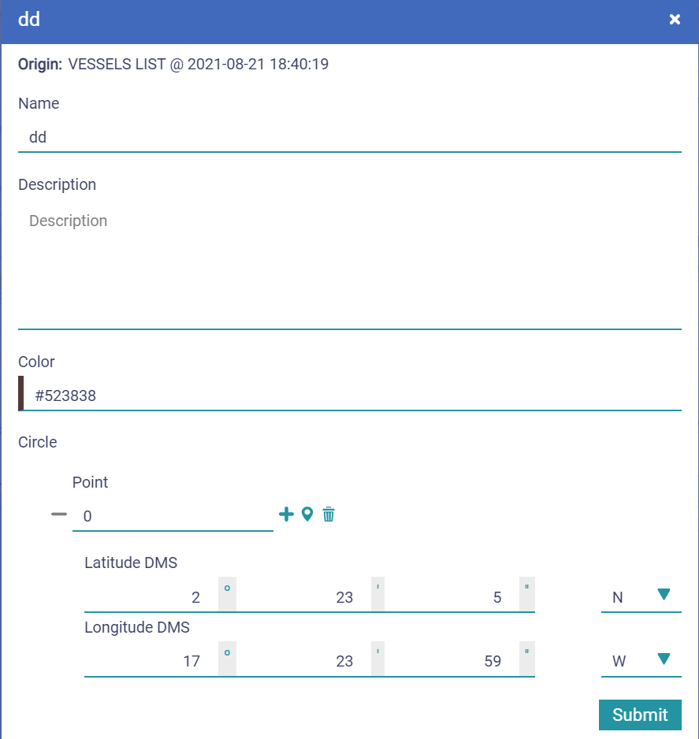
Horizontal Menu Tools - Tools to create, edit and delete georeferenced points, lines, polygons and circles
Activate at least one Information Layer of type “Points”
Click on
The drawing toolbar opens
Select one of the actions on the drawing toolbar:
Create Point
Create Line
Create Polygon
Create Circle
Edit Objects
Delete Objects
With the “Edit Object” activated click on any object in the map
Edit the fields
Click on
The fuctionality “Edit Object” stay active until the user deactivate it by clicking on
1
2
3
1
2
3
5
4
5
6
4
6

Slide 48
Horizontal Menu Tools - Tools to create, edit and delete georeferenced points, lines, polygons and circles
Activate at least one Information Layer of type “Points”
Click on
The drawing toolbar opens
Select one of the actions on the drawing toolbar:
Create Point
Create Line
Create Polygon
Create Circle
Edit Object
Delete Objects
With the “Delete Object” activated click on the object to be deleted in the map
Click on
The fuctionality “Delete Object” stay active until the user deactivate it by clicking on
1
2
3
1
2
3
4
5
4
5

Slide 49
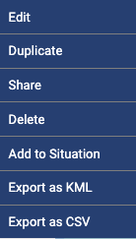
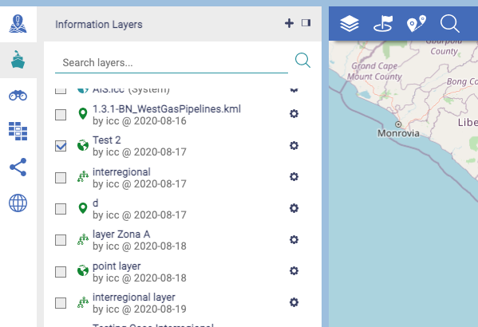
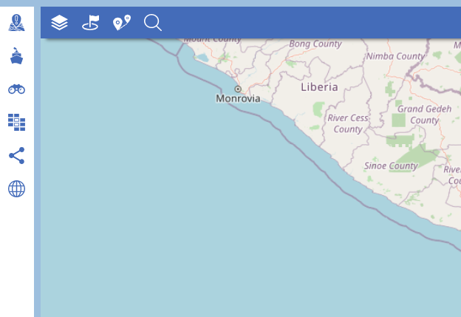
Horizontal Menu Tools - Basic georeferenced Areas - Export
Select the layer where the area was saved
Click on
It opens the list of the own layers
Click on the tool icon of the respective layer
It opens the dedicated menu
Click on
1
1
A
A
B
B
2
2

Slide 50
Horizontal Menu MAP Layers window (active layers)
Shows the layers (whatever its type or source) that are active on the MAP
Allows their management concerning their visibility in the MAP, namely: to change their order, hide a layer, change its transparency, disable it or to do the focus of the MAP on a specific layer
Possible uses:
Highlight and analyse a particular information, maintain all the rest of information active but in a 2nd plan (eg: hided, faded..)

Slide 51
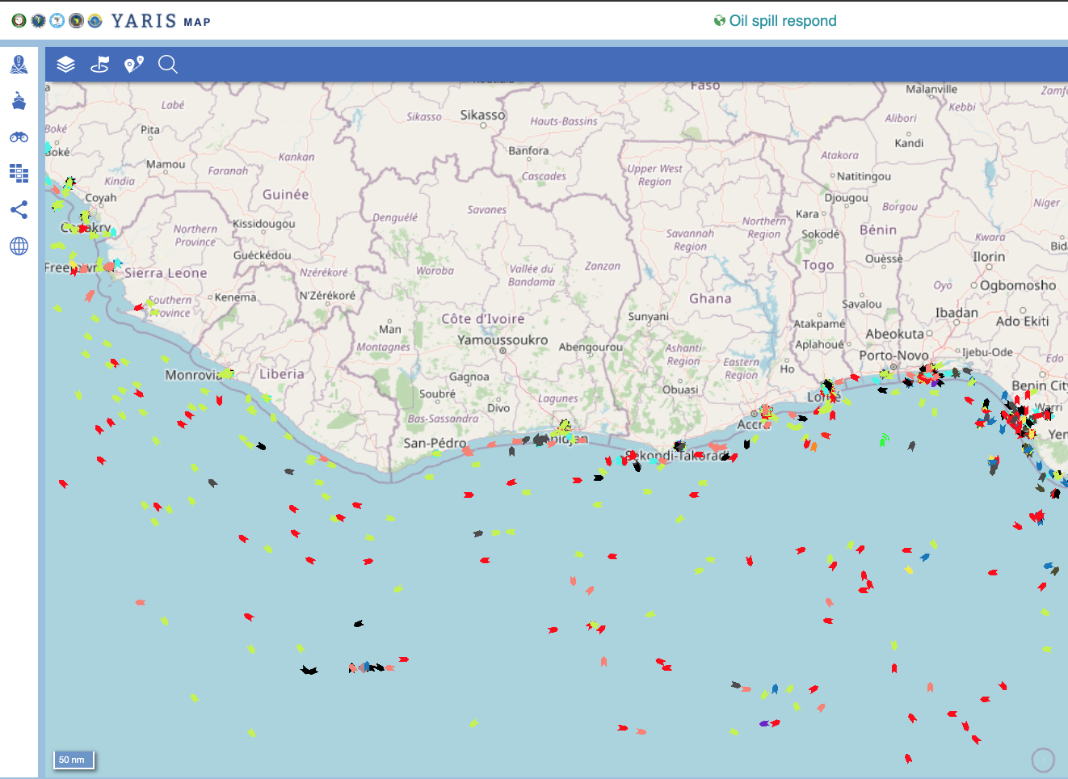
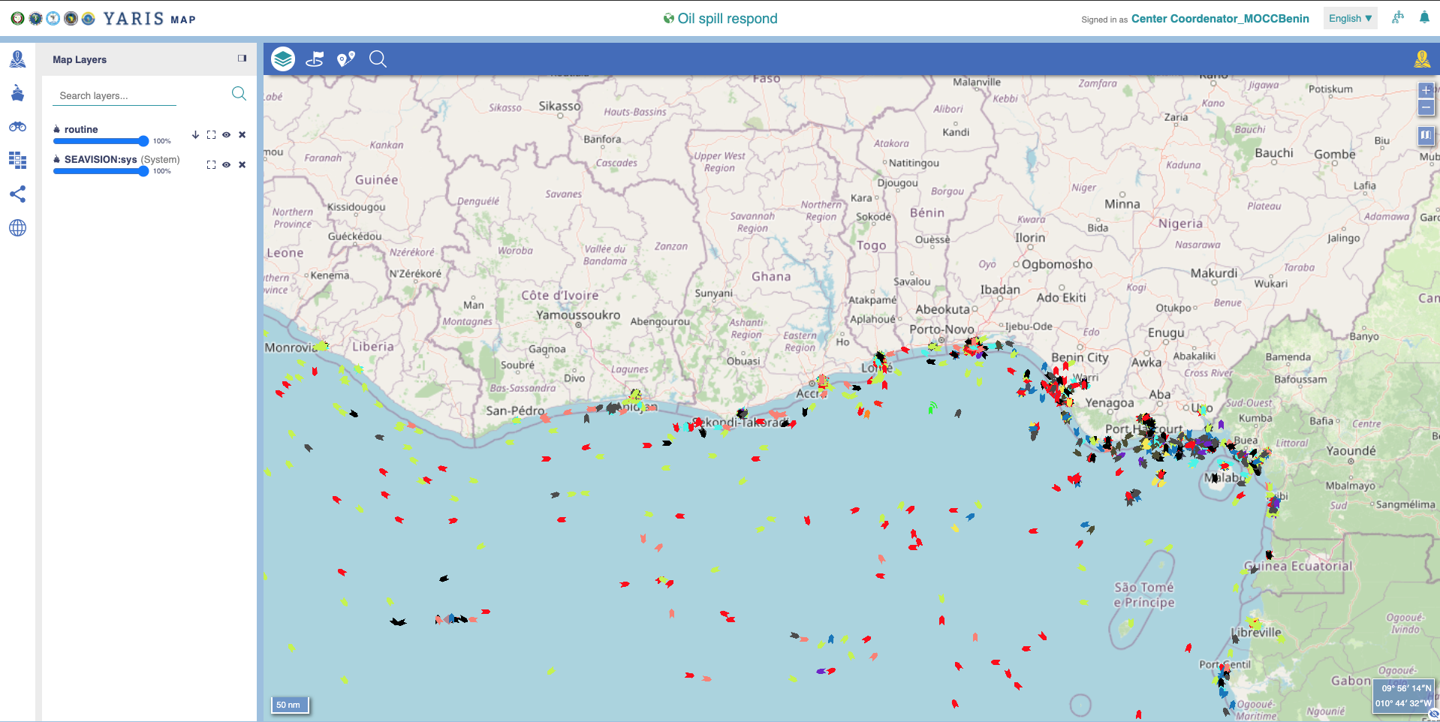
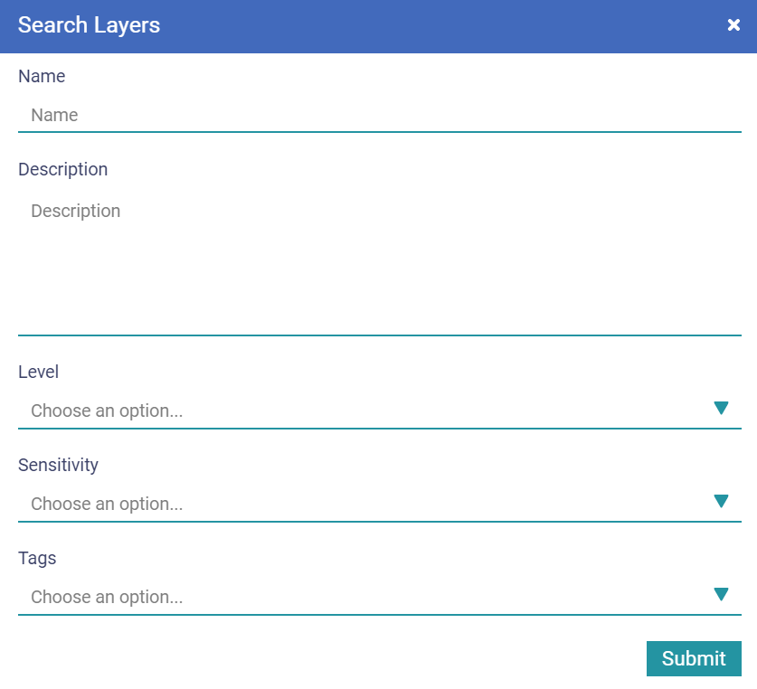
Horizontal Menu MAP Layers – Active layers on the post of the current operator
Click on
It opens the MAP Layer Window
Search a layer by name
It opens the MAP Layer Window
Search a layer by other properties
A dedicated window is open
Name
Description
Level
Sensitivity
Tags
Click on
1
1
2
3
3
2
A
B
A
C
B
D
E
C
4
D
E
4

Slide 52
Horizontal Menu MAP Layers – Managing the active layers
Click on
It opens the MAP Layer Window
Search a layer by name
It opens the MAP Layer Window
Search a layer by other properties
A dedicated window is open
List of active layers on the post
The layers pane
Opacity
Layers order
Zoom around the objects of the layer
Show / hide layer
Disable the layer
1
Order the layers
De-activates the layer
2
4
3
5
4
Type and name of layer
5
Set the degree of opacity of each layer on the map
Show / hide layer on the map
Zoom around the objects of the layer

Slide 53
Horizontal Menu MAP Layers – Managing the active Layers
Click on
It opens the MAP Layer Window
Find a layer by name
It opens the MAP Layer Window
Find a layer by other properties
A dedicated window is open
List of active layers on the post
The layers pane
Opactity
Layers order
Zoom around the objects of the layer
Show / hide layer
Disable the layer
Adapt the width of the Layers Map Window
On the right limit, press the left button of the mouse and change it to the right or left
Close the Layers Map Window
1
7
2
3
4
6
5
6
7

Slide 54
THE TOOL MSA -MAP
The Side Menu – Managing the Available Layers

Slide 55
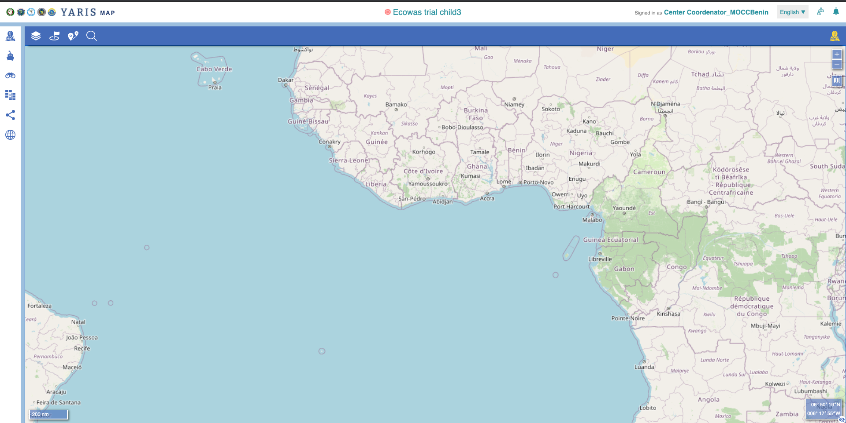
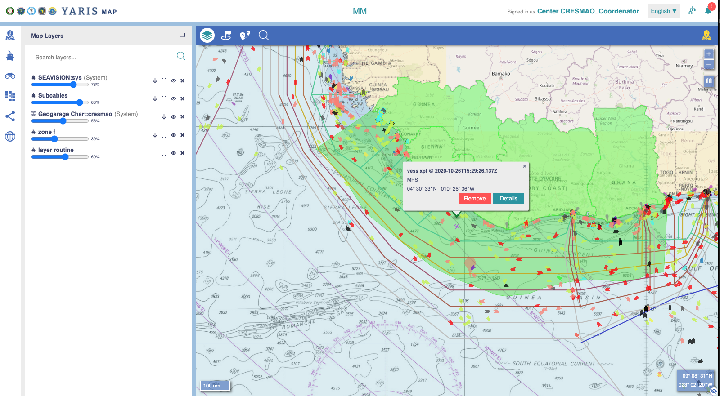
Managing the available layers Goal
Goal
Build up a maritime picture with the pertinent information and be able to share it with who we want
Basic Principle
Create, add, show, hide layers in accordance with the relevance of their information…. Knowing that a layer is a group of objects and the object it is the small piece of information to be shown in the MAP ( a vessel, a zone, a line…)

Slide 56
Managing the available layers Goal
Goal
Build up a maritime picture with the pertinent information and be able to share it with who we want
This means that:
An object can only be seen if included in a layer, and if that layer is selected to be shown

Slide 57
Main Features The Side Menu – Managing the available layers
The side menu allows to access the existing layers (according to their type /source) available to be activated in the MAP
Different centers will have different available layers
Different users in a center may have different available layers
Access to a layer may include tools for creating, editing, managing, viewing and deleting layers, depending on the type of layer and permissions
Layers are grouped
by type – Information layers; view layers; smart layers; 3th parties layers
and by sharing availability : YS (shared) layers; Situation (added) layers
A Situation layer is automatically a YS layer
Reminder: System layers :
Special type of layers (own, YS, third-party) of geospatial information hardcoded in the system, which users cannot add, remove or change
Nonetheless, other functions are possible, such as sharing viewing, hiding, adding and removing from operational situations.
They are considered as international level and public sensitivity criteria layers;
They can be “transversal” to all centers or belong to a center only

Slide 58
Managing the layers Typical process
The MAP window allows to list all the active layers and to hide/show them
1
2
3
Agregate Information
Work with Information
Share your own information
Select layers from the available information layers:sys
The source of system integrated contacts to be shown: SEAVISION, AIS, Radar, Fusion….)
Create / select layers information layers you own
Import relevant maritime georeferenced information as zones, infrastructures, services… or images you own
Layers for manual adding of new objects (namely vessels)
Select layers that are shared with you within YS
Layers shared by other YS centers
Create /select 3th party layers
Import relevant maritime georeferenced information from providers outside of YS
Create, and select, new layers containing selected objects from the source layers
Based on the criteria and analysis done
Create, and select, view layers based on selecting criteria
One-time automatic object selection based on the defined criteria by the user
Objects from information layers may be manually added to a view layer
Create, and select, smart layers based on automatic layers
Permanent automatic selection of contacts based on defined criteria by the user
Choose individually the layers you want to share with other centers and permissions associated
By invitation
Always based on geographical and information sensitivity criteria
Permission to see, to edit and to reshare

Slide 59
Managing the available Layers Information Layers

Slide 60
Managing the Layers (Own) information Layer
Own information layers - Information created and managed by each organization. This information can be online, being provided by a system external to YARIS (e.g. AIS), or offline, that is, created once and updated only when needed. Own information layers include:
Simple (points) layers - Simple layers are sets of georeferenced points that are associated to relevant information.
Complex (points, lines, polygons and circles) layers - Complex layers are sets of georeferenced geometrical objects that are associated to relevant information.
Image layers - Image layers comprise one or more images (e.g. satellite image, orthophoto).
Reminder:
Each layer:
Has a set of standard fields, including its name, description, author, date/time of creation, a URL pointing to information available, geographical and sensitivity criteria
A user may create customized fields, as needed
Has sharing properties, that is, who can do what with the layer
Notes:
Simple (points) layers - Simple layers are sets of georeferenced points that are associated to relevant information. Each layer has a set of standard fields, including its name, description, author, date/time of creation, and a URL pointing to information available either in the YARIS network or outside. A user may create customized fields, as needed. Each layer also has sharing properties, that is, who can do what with the layer.

Slide 61
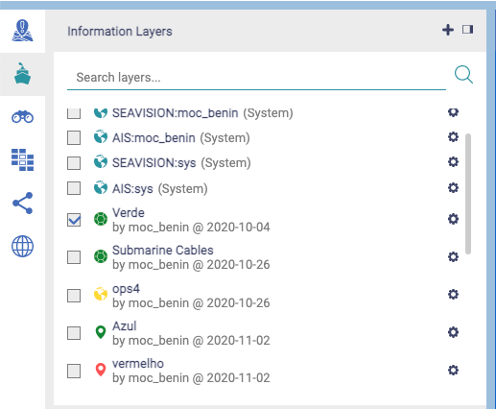
Managing the Layers Information Layer – List, activate and create
Click on
It opens the Information Layer Window
List of Information Layers belonging to a center
1
1
2
2
Layer LEVEL & SENSITIVITY

Slide 62
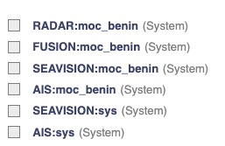
Layer and object concept Information Layer – system and own layer
Sys: available for all centers
or
moc_xxx : dedicated to a specific center (benin in the example)
Information Layer
System layer – Hardcoded information in the system
It is indicated by the word system in parentheses at the end of the layer name: ex: SEAVISION:sys (System)
Can only be changed by the general administrator of the system (IT Manager)
By default, all centers have the following system layers:
Data
:
owner
(System)
Ready for Integration of SEAVISION data received in Benin (if there is a specific agreement)
Integration of common SEAVISION data for all the YS (common layer)

Slide 63
Layer and object concept (Own) Information Layer
Information Layer
System layer – Hardcoded information in the system
It is indicated by the word system in parentheses at the end of the layer name: ex: SEAVISION:sys (System)
Can only be changed by the general administrator of the system (IT Manager)
By default, all centers have the following system layers:
Layer created by a center – editable and deletable layer
Can be changed by the user
New objects can may be manually added (depending on the type of source data)

Slide 64
Managing the Layers Information Layer - List, activate and create
Click on
It opens the Information Layer Window
List of Information Layers belonging to a center
1
1
2
2

Slide 65
Managing the Layers Information Layer - List, activate and create
Click on
It opens the Information Layer Window
List of Information Layers belonging to a center
It opens the MAP Layer Window
Check the box to make them active in your post
The selected ones will appear in the MAP layers windows (see Horizontal Menu)
Search a specific layer
By Name
By other layer property
1
4
A
B
2
3
3
4
A
B

Slide 66
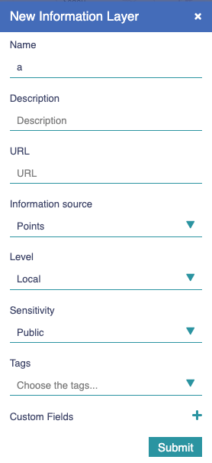
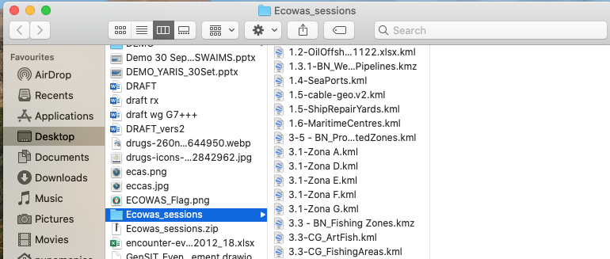
Managing the Layers Information Layer - List, activate and create
Click on
It opens the Information Layer Window
List of Information Layers belonging to a center
It opens the MAP Layer Window
Check the box to make them active in your post
The selected ones will appear in the MAP layers windows (see Horizontal Menu)
Search a specific layer
Add a new layer
A dedicated box appears
Fulfill the camps
Name – mandatory
Description
URL
Information Source
Level
Sensitivity
Tags
Custom Fields
Adapt the width of the Layers Map Window
On the right limit, press the left button of the mouse and change it to the right or left
Close the Layers Map Window
1
5
A
2
Mandatory
3
Where the information is
4
What type of information
5
A

Slide 67
Managing the Layers Information Layer - List, activate and create
Click on
It opens the Information Layer Window
List of Information Layers belonging to a center
It opens the MAP Layer Window
Check the box to make them active in your post
The selected ones will appear in the MAP layers windows (see Horizontal Menu)
Search a specific layer
Add a new layer
A dedicated box appears
Fulfill the camps
Click on
1
2
3
4
5
A
B
B

Slide 68
Managing the Layers Information Layer - List, activate and create
Click on
It opens the Information Layer Window
List of Information Layers belonging to a center
It opens the MAP Layer Window
Check the box to make them active in your post
The selected ones will appear in the MAP layers windows (see Horizontal Menu)
Search a specific layer
Add a new layer
A dedicated box appears
Close the Information Layers Window
1
6
2
3
4
5
6

Slide 69
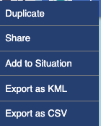
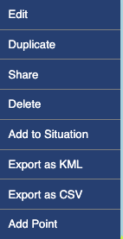
Managing the Layers Information Layer - Working Tools
Click on
It opens the Information Layer Window
Click on open the layer tools clicking
Edit - not available for system layers
Duplicate
Share – not available if it is a local level layer
Delete – not available for system layers
Add to Situation
Export as KML – to be used in other system/application, eg, google earth
Export as CSV
Add Point
1
Depending on the type of layer (system or not)
1
-
2
2
A
A
B
Note that the availability of some tools options also depends on users profile
B

Slide 70
Managing the Layers Information Layer - Working Tools
Click on
It opens the Information Layer Window
Click on open the layer tools clicking
Edit - not available for system layers
Duplicate
Share – not available if it is a local level layer
Delete – not available for system layers
Add to Situation
Export as KML – to be used in other system/application, eg, google earth
Export as CSV
Add Point – only available for own/shared information layers type “points”
1
2
Not available for system layers
Change the layer’s properties
Create a copy on the basis of which to make modifications
Define sharing parameters
Delete the layer
Add the layer to the Situation
The icon is shown before the name
Export the layer’s information
Add an object to the layer it its source are points
(see Object Management)

Slide 71
Managing the Layers Third party Layers

Slide 72
Managing the Layers Third Party Information Layers
Third Party Information Layers (eg: WMS) Sets of georeferenced information that is made available by an organization that does not belong to the Yaoundé architecture.
It can be an organization with which the Yaoundé governance structure has a cooperation agreement (eg. to exchange information), or an organization that published relevant information in the internet (eg. weather charts)
It can be a system layer or not
Reminder:
Each layer:
Has a set of standard fields, including its name, description, author, date/time of creation, a URL pointing to information available, geographical and sensitivity criteria
A user may create customized fields, as needed
Has sharing properties, that is, who can do what with the layer
Notes:
Simple (points) layers - Simple layers are sets of georeferenced points that are associated to relevant information. Each layer has a set of standard fields, including its name, description, author, date/time of creation, and a URL pointing to information available either in the YARIS network or outside. A user may create customized fields, as needed. Each layer also has sharing properties, that is, who can do what with the layer.

Slide 73
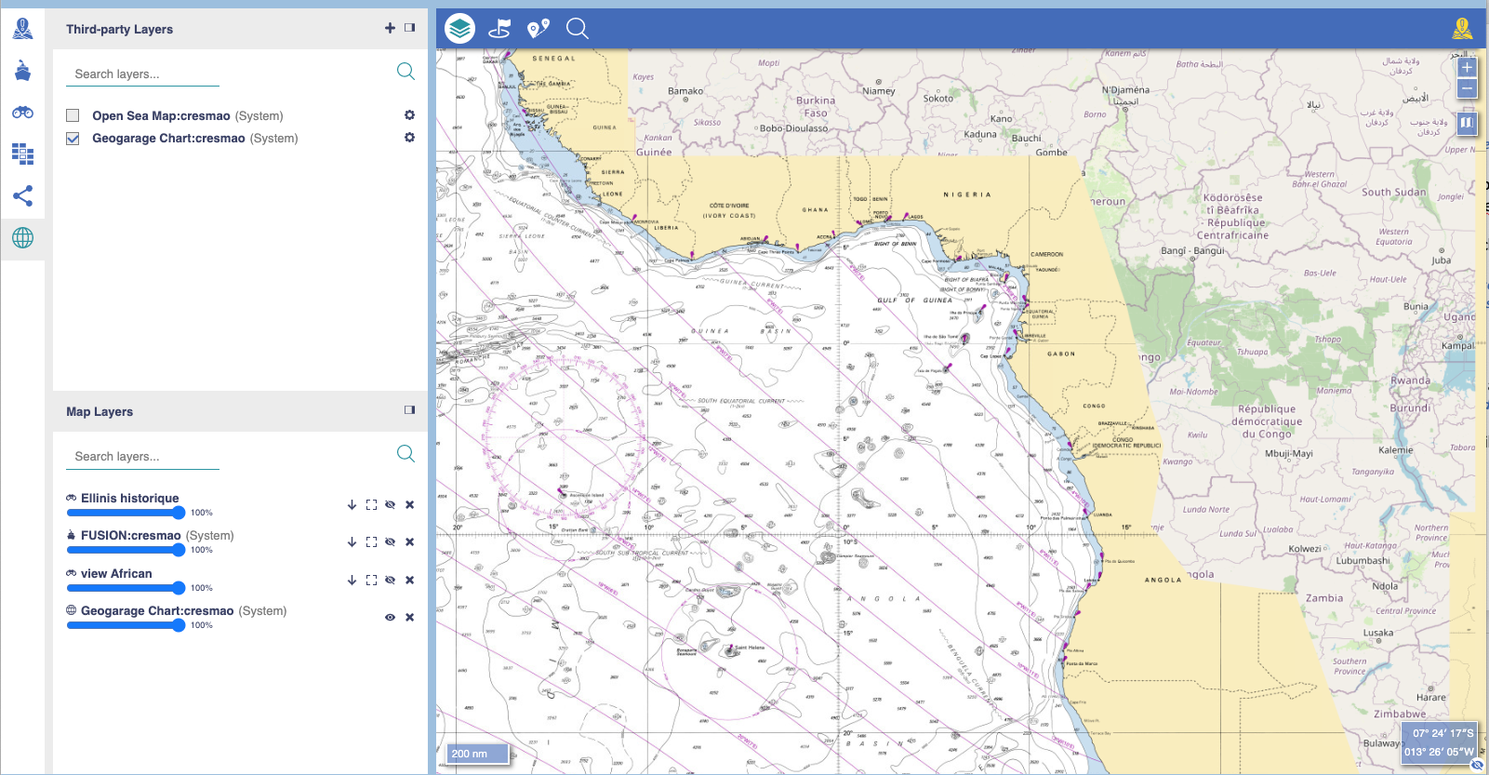
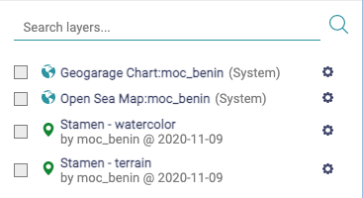
Managing the Layers Third party Layer - List, activate and create
Click on
It opens the Third-Party Layer Window
List of Third-Party Layers belonging to a center
1
2
2
1

Slide 74
Managing the Layers Third party Layer - List, activate and create
Third Party Information Layers (eg: WMS)
System layer – Hardcoded information in the system
It is indicated by the word system in parentheses at the end of the layer name: ex: Open Sea Map:cresmao (System)
Can only be changed by the general administrator of the system (IT System Administrator)
By default, all centers have the following system layers:
Layer created by a center – editable and deletable layer
Can be changed by the operator

Slide 75
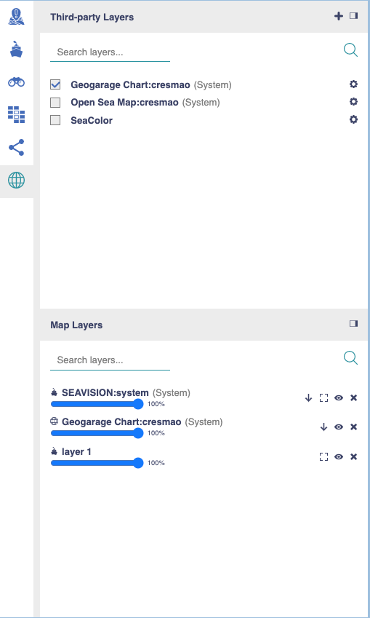
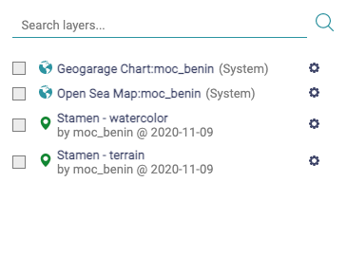
Managing the Layers Third party Layer - List, activate and create
Click on
It opens the Third Party Layer Window
List of Third-Party Layers belonging to a center
It opens the MAP Layer Window
Check the box to make them active in your post
The selected ones will appear in the MAP layers windows (see Horizontal Menu)
Search for a specific layer
By Name
By other layer property
1
4
A
B
2
3
3
4
A
B

Slide 76
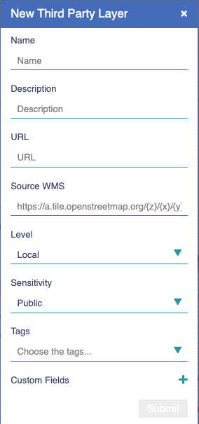
Managing the Layers Third party Layer - List, activate and create
Click on
It opens the Third-Party Layer Window
List of Third-Party Layers belonging to a center
It opens the MAP Layer Window
Check the box to make them active in your post
The selected ones will appear in the MAP layers windows (see Horizontal Menu)
Search for a specific layer
Add a new layer
A dedicated box appears
Fulfill the camps
Name – mandatory
Description
URL
Source WMS
Level
Sensitivity
Tags
Custom Fields
Adapt the width of the Layers Map Window
On the right limit, press the left button of the mouse and change it to the right or left
Close the Layers Map Window
1
5
A
2
Mandatory
3
4
5
A

Slide 77
Managing the Layers Third party Layer - List, activate and create
Click on
It opens the Third-Party Layer Window
List of Third-Party Layers belonging to a center
It opens the MAP Layer Window
Check the box to make them active in your post
The selected ones will appear in the MAP layers windows (see Horizontal Menu)
Find a specific layer
Add a new layer
A dedicated box appears
Fulfill the camps
Click on
1
5
2
3
4
5
A
B
B

Slide 78
Managing the Layers Third party Layer – List, activate and create
Click on
It opens the Third-Party Layer Window
List of Third-Party Layers belonging to a center
It opens the MAP Layer Window
Check the box to make them active in your post
The selected ones will appear in the MAP layers windows (see Horizontal Menu)
Find a specific layer
Add a new layer
A dedicated box appears
Close the Layers Map Window
6
1
2
3
4
5
6

Slide 79
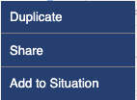
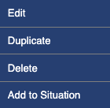
Managing the Layers Third party Layer - Working Tools
Click on
It opens the Third-Party Layer Window
Click on open the layer tools clicking
Edit - not available for system layers
Duplicate
Share – not available if it is a local level layer
Delete – not available for system layers
Add to Situation
Export as KML – to be used in other system/application, eg, google earth
Export as CSV
1
Depending on the type of layer (system or not)
A
2
A
B
1
2
Availability of the some tools also depends on users profile
B

Slide 80
Managing the Layers Third party Layer - Working Tools
Click on
It opens the Third-Party Layer Window
Click on open the layer tools clicking
Edit - not available for system layers
Duplicate
Share – not available if it is a local level layer
Delete – not available for system layers
Add to Situation
Export as KML – to be used in other system/application, eg, google earth
1
2
2
Not available for system layers
Change the layer’s properties
Create a copy on the basis of which to make modifications
Define sharing parameters
Delete the layer
Add the layer to the Situation
The icon is shown before the name

Slide 81
Managing the Layers View layers

Slide 82
Managing the Layers View Layers
View layers : Comprises a selection of information available (object-point) in any of the different layers the user has access to, to facilitate its tasks.
It is a one shot selecting objects (points). This means that new objects in the source layers complying with the selecting criteria won’t be considered in the view layer
Nonetheless, an existing object (point) from a layer may always be manually added to a view layer
A view layers does not really contain an object but a “link” to view that object in its original layer. The object remains attached to its original layer.
Data updating: Accessing the proprieties of an object in a view layer is the same than accessing the data in its original layer
If both an object is removed from its original layer or the layer becomes disable, that particular object is removed from the view layer
Reminder: Each view:
Has a set of standard fields, including its name, description, author, date/time of creation, a URL pointing to information available, level and clearance criteria and tag
A user may create customized fields, as needed
Has sharing properties, that is, who can do what with the layer
Notes:
Simple (points) layers - Simple layers are sets of georeferenced points that are associated to relevant information. Each layer has a set of standard fields, including its name, description, author, date/time of creation, and a URL pointing to information available either in the YARIS network or outside. A user may create customized fields, as needed. Each layer also has sharing properties, that is, who can do what with the layer.

Slide 83
Managing the Layers View Layer - List, activate and create
Click on
It opens the View Layer Window
List of View Layers belonging to a center
1
2
1
2

Slide 84
Managing the Layers View Layer - List, activate and create
Click on
It opens the View Layer Window
List of View Layers belonging to a center
It opens the MAP Layer Window
Check the box to make them active in your post
The selected ones will appear in the MAP layers windows (see Horizontal Menu)
Search a specific layer
By Name
By other layer property
1
4
A
B
2
3
3
4
A
B

Slide 85
Managing the Layers View Layer - List, activate and create
Click on
It opens the View Layer Window
List of View Layers belonging to a center
It opens the MAP Layer Window
Check the box to make them active in your post
The selected ones will appear in the MAP layers windows (see Horizontal Menu)
Search a specific layer
Add a new layer
A dedicated box appears
Fulfill the camps
Name – mandatory
Description
URL
Layers
Level
Sensitivity
Tags
Custom Fields
Adapt the width of the Layers Map Window
On the right limit, press the left button of the mouse and change it to the right or left
Close the Layers Map Window
1
5
A
2
3
Mandatory
4
Creating a view requires the layer(s) on which to work the view
5
A

Slide 86
Managing the Layers View Layer - List, activate and create
Click on
It opens the View Layer Window
List of View Layers belonging to a center
It opens the MAP Layer Window
Check the box to make them active in your post
The selected ones will appear in the MAP layers windows (see Horizontal Menu)
Search a specific layer
Add a new layer
A dedicated box appears
Fulfill the camps
Click on
1
5
2
3
4
5
A
B
B

Slide 87
Managing the Layers View Layer - List, activate and create
Click on
It opens the View Layer Window
List of View Layers belonging to a center
It opens the MAP Layer Window
Check the box to make them active in your post
The selected ones will appear in the MAP layers windows (see Horizontal Menu)
Search a specific layer
Add a new layer
A dedicated box appears
Close the Layers Map Window
1
6
2
3
4
5
6

Slide 88
Managing the Layers View Layer - Create a view layer from the map
Click on
It opens the Search Object box
Fulfil the fields Property and Value
It opens the MAP Layer Window
Click on
1
1
2
3
2
3

Slide 89
Managing the Layers View Layer - Create a view layer from the map
Click on
It opens the Search Object box
Fulfil the fields Property and Value
It opens the MAP Layer Window
Click on
The objects complying with the criteria are selected in the map (by a white border around the icon) and listed in a box in the side window (Selected Objects)
In the Selected Objects box, click on
A dedicated box is opened
Fulfil the fields
Click on
1
5
2
3
4
4
5
6
6

Slide 90
Managing the Layers View Layer - Add tracks to an existing layer
Click on
It opens the Search Object box
Fulfil the fields Property and Value
It opens the MAP Layer Window
Click on
The objects complying with the criteria are selected in the map (by a white border around the icon) and listed in a box in the side window (Selected Objects)
Activate the destination layer of the tracks in the map
The destination layer could be a point layer or a view layer.
In the Selected Objects box, click on
A dedicated box is opened
Select the destination layer
If an information layer (point) is selected for destination, tracks will be duplicated to the layer
Click on
1
2
4
3
6
4
5
7
5
6
7

Slide 91
Managing the Layers View Layer - Working Tools
Click on
It opens the View Layer Window
Click on open the layer tools clicking
Edit - not available for system layers
Duplicate
Share – not available if it is a local level layer
Delete – not available for system layers
Add to Situation
Export as KML – to be used in other system/application, eg, google earth
Export as CVS
1
2
2
1
Availability of the some tools depends with users profile

Slide 92
Managing the Layers View Layer - Working Tools
Click on
It opens the View Layer Window
Click on open the layer tools clicking
Edit - not available for system layers
Duplicate
Share – not available if it is a local level layer
Delete – not available for system layers
Add to Situation
Export as KML – to be used in other system/application, eg, google earth
Export as CVS
1
2
2
Change the layer’s properties
Create a copy on the basis of which to make modifications
Define sharing parameters
Delete the layer
Add the layer to the Situation
The icon is shown before the name
Export the layer’s information

Slide 93
Managing the Layers Smart layers

Slide 94
Managing the Layers Smart Layers
Smart layers : comprise content automatically selected by the system based on rules defined by the user, from selected layers
It is a way to evidence the set of objects, from selected layers available, that fit to a set of criteria. Each smart layer shall have a set of standard fields and customized fields, as needed. Each smart layer will also have sharing properties, that is, who can do what with the view.
It is a automatic selecting objects (points) procedure. This means that any new object in the source layers complying with the selecting criteria will be considered in the smart layer
A smart layers does not really contain an object but a “link” to view that object in its original layer. The object remains attached to its original layer.
Data updating: Accessing the proprieties of an object in a smart layer is the same than accessing the data in its original layer
If both an object is removed from its original layer, the layer becomes disable or the object stops complying with the selected criteria , that particular object is removed from the smart layer
Reminder: Each view:
Has a set of standard fields, including its name, description, author, date/time of creation, rules to be applied, level and clearance criteria and tag
A user may create customized fields, as needed
Has sharing properties, that is, who can do what with the layer
Notes:
Simple (points) layers - Simple layers are sets of georeferenced points that are associated to relevant information. Each layer has a set of standard fields, including its name, description, author, date/time of creation, and a URL pointing to information available either in the YARIS network or outside. A user may create customized fields, as needed. Each layer also has sharing properties, that is, who can do what with the layer.

Slide 95
Managing the Layers Smart Layer - List, activate and create
Click on
It opens the Smart Layer Window
List of Smart Layers belonging to a center
1
2
1
2

Slide 96
Managing the Layers Smart Layer - List, activate and create
Click on
It opens the Smart Layer Window
List of Smart Layers belonging to a center
It opens the MAP Layer Window
Check the box to make them active in your post
The selected ones will appear in the MAP layers windows (see Horizontal Menu)
Search a specific layer
By Name
By other layer property
1
4
A
B
2
3
3
4
A
B

Slide 97
Managing the Layers Smart Layer - List, activate and create
Click on
It opens the Smart Layer Window
List of Smart Layers belonging to a center
It opens the MAP Layer Window
Check the box to make them active in your post
The selected ones will appear in the MAP layers windows (see Horizontal Menu)
Search a specific layer
Add a new layer
A dedicated box appears
Fulfill the camps
Name – mandatory
Description
URL
Smart Rules – improvement underway
Layers – underway
Level
Sensitivity
Tags
Custom Fields
Adapt the width of the Layers Map Window
On the right limit, press the left button of the mouse and change it to the right or left
Close the Layers Map Window
1
5
A
2
3
Mandatory
4
5
A

Slide 98
Managing the Layers Smart Layer - List, activate and create
Click on
It opens the Smart Layer Window
List of Smart Layers belonging to a center
It opens the MAP Layer Window
Check the box to make them active in your post
The selected ones will appear in the MAP layers windows (see Horizontal Menu)
Find a specific layer
Add a new layer
A dedicated box appears
Fulfill the camps
Click on
1
5
2
3
4
5
A
B
B

Slide 99
Managing the Layers Smart Layer - List, activate and create
Click on
It opens the Smart Layer Window
List of Smart Layers belonging to a center
It opens the MAP Layer Window
Check the box to make them active in your post
The selected ones will appear in the MAP layers windows (see Horizontal Menu)
Find a specific layer
Add a new layer
A dedicated box appears
Close the Layers Map Window
1
6
2
3
4
5
6

Slide 100
Managing the Layers Smart Layer - Working Tools
Click on
It opens the Smart Layer Window
Click on open the layer tools clicking
Edit - not available for system layers
Duplicate
Share – not available if it is a local level layer
Delete
Add to Situation
Export as KML – to be used in other system/application, eg, google earth
Export as CSV
1
2
2
1
Availability of the some tools depends on users profile

Slide 101
Managing the Layers Smart Layer - Working Tools
Click on
It opens the Smart Layer Window
Click on open the layer tools clicking
Edit - not available for system layers
Duplicate
Share – not available if it is a local level layer
Delete
Add to Situation
Export as KML – to be used in other system/application, eg, google earth
Export as CSV
1
2
Change the layer’s properties
Create a copy on the basis of which to make modifications
Define sharing parameters
Delete the layer
Add the layer to the Situation
The icon is shown before the name
Export the layer’s information

Slide 102
Managing the Layers Share layers, Situation Layers and Yaounde Layers

Slide 103
Managing the Layers Sharing layers, adding to situation and Yaoundé Layers
Share layers - the act of sharing with other centers sets of georeferenced information owned by a center, or sets of georeferenced information from other center, having received permission to do it
Yaoundé information layers - Sets of georeferenced information, just like own information layers, made available under invitation through the YARIS system by other organizations in the network
Situation information layers : Layers that were added by a user to an operational situation. Individual invitation (Share) is still mandatory for the other centers to have access
The moment it becomes a share layer...
Rules:
Only the owner of a layer can share a layer (or centers with permission to do it)
Sharing a layer with one or more centers makes it automatically added within Yaoundé layers (to those centers)
Everyone may add a layer to situation (whatever is type), once engaged in the situation, if the one is the owner of the layer or the layer was shared with him
Adding to a situation does not ensure access to the layer by the other centers engaged in the situation. Individual invitation (Share) is mandatory
Regarding the users in a center, adding a situation allows the user to access the layer from the Situation layers pane
All the geographical and sensitivity criteria are respected
Notes:
Simple (points) layers - Simple layers are sets of georeferenced points that are associated to relevant information. Each layer has a set of standard fields, including its name, description, author, date/time of creation, and a URL pointing to information available either in the YARIS network or outside. A user may create customized fields, as needed. Each layer also has sharing properties, that is, who can do what with the layer.

Slide 104
Managing the Layers Share Layers
The sharing process: The sharing process is the same whatever the type of the layer
1
2
3
Choose the layer to share
Verify if its criteria are the adequated ones to the sharing
eg,
a local layer can never be shared – to do it its level should be verified
At what level it will be share
Notes:
Simple (points) layers - Simple layers are sets of georeferenced points that are associated to relevant information. Each layer has a set of standard fields, including its name, description, author, date/time of creation, and a URL pointing to information available either in the YARIS network or outside. A user may create customized fields, as needed. Each layer also has sharing properties, that is, who can do what with the layer.

Slide 105
Managing the Layers Share Layers
1
2
3
Choose the layer to share
Choose with whom to share
Must be in accordance
Verify if its criteria are the adequated ones to the sharing
Select what centers can access the layer
Be sure the layer criteria is the one adequated
eg,
A zonal level layer created by Zone D won’t be seen by Zone E, if its level is not changed to interregional or international
A secret layer will only be seen by user with secret clearance belonging to an invited center with the right geographical level
Notes:
Simple (points) layers - Simple layers are sets of georeferenced points that are associated to relevant information. Each layer has a set of standard fields, including its name, description, author, date/time of creation, and a URL pointing to information available either in the YARIS network or outside. A user may create customized fields, as needed. Each layer also has sharing properties, that is, who can do what with the layer.

Slide 106
Managing the Layers Shared Layers
The sharing process: The sharing process is the same whatever the type of the layer
1
2
3
Choose the layer to share
Choose with whom to share
Choose how to share
Verify if its criteria are the adequated ones to the sharing
Select what centers can access the layer
Be sure the layer criteria is the one adequated
View only
Edit (add, delete, … manage objects)
Share – permission to reshare
Owner
Not shared with
Shared, view only
Shared with edit permissions
Shared, with edit and share permissions
Notes:
Simple (points) layers - Simple layers are sets of georeferenced points that are associated to relevant information. Each layer has a set of standard fields, including its name, description, author, date/time of creation, and a URL pointing to information available either in the YARIS network or outside. A user may create customized fields, as needed. Each layer also has sharing properties, that is, who can do what with the layer.

Slide 107
Managing the Layers Yaoundé Layers - List, activate
Click on
It opens the Yaounde Layer Window
List of Layers (from other centers) shared with our own center
1
2
1
2

Slide 108
Managing the Layers Yaoundé Layers - List, activate
Click on
It opens the Smart Layer Window
List of Smart Layers belonging to a center
It opens the MAP Layer Window
Check the box to make them active in your post
The selected ones will appear in the MAP layers windows (see Horizontal Menu)
Search a specific layer
By Name
By other layer property
1
4
A
B
2
Owner of the shared layer
3
3
Owner of the shared layer
Owner of the shared layer
4
A
B
Owner of the shared layer
Owner of the shared layer

Slide 109
Managing the Layers Yauondé Layers - Working Tools
Click on
It opens the Yaoundé Layer Window
Click on open the layer tools clicking
It opens the Tools options
1
2
Availability of the some tools depends with permissions given by the owner
1
2
Availability of the some tools also depends on user profile

Slide 110
Managing the Layers Yauondé Layers - Working Tools
Click on
It opens the Yaoundé Layer Window
Click on open the layer tools clicking
It opens the Tools options
1
2
Change the layer’s properties
Create a copy on the basis of which to make modifications
Define sharing parameters
Add the layer to the Situation
The icon is shown before the name
Export the layer’s information

Slide 111
Managing the Layers Add to Situation
The adding to a situation process: The adding to a layer process is the same whatever the type of the layer
1
2
Choose the layer to be added to the situation
Share the layer
Click on Add to Situation
The layer will be visible in the Situation layer pane for users in the same center
The layer will not be visible in the Situation layer pane for the other centers involved in the situation, unless the layer has already been shared with them
Click on Share, define with whom and how, to share it
The layer will be visible in the Situation layer pane for users in the center invited
The layer will be visible in the Yaoundé Layers pane for users in the same invited
Centers invited to the situation, but not invited to access the layer won’t see

Slide 112
Managing the Layers Situation Layers - List, activate
Click on
It opens the Yaound´s Layer Window
List of Layers added to the situation
1
2
1
2

Slide 113
Managing the Layers Situation Layer - List, activate
Click on
It opens the Situation Layer Window
List of Layers added to the situation
opens the MAP Layer Window
Check the box to make them active in your post
The selected ones will appear in the MAP layers windows (see Horizontal Menu)
Search a specific layer
By Name
By other layer property
1
4
A
B
2
3
3
4
A
B

Slide 114
Managing the Layers Situation Layer - Working Tools
Click on
It opens the Yaoundé Layer Window
Click on open the layer tools clicking
It opens the Tools options
1
2
Availability of the some tools depends with permissions given by the owner
2
1
Availability of the some tools also depends on user profile

Slide 115
Managing the Layers Yauondé Layer - Working Tools
Click on
It opens the Yaoundé Layer Window
Click on open the layer tools clicking
It opens the Tools options
1
2
Change the layer’s properties
Create a copy on the basis of which to make modifications
Define sharing parameters
Remove the layer to the Situation
Export the layer’s information

Slide 116
Managing the Layers Sharing layers matrix

Slide 117
Managing the Layers Sharing layers, adding to situation and Yaoundé Layers
In the same situation
In other situation
User of the
same center
User of the
(Other) centre A
User of the
(Other) centre B
User of the
(Other) centre C
User of the
(Other) centre A
Layer
Example
Layer Example
---------------------
---------------------
---------------------
---------------------
Category pane
Local layer
---------------------
---------------------
---------------------
---------------------
---------------------
Situation layers pane
---------------------
---------------------
---------------------
---------------------
---------------------
Yaoundé layers pane
Layer Example
---------------------
--------------------
--------------------
---------------------
Category pane
Share with center B and C
----------------------
---------------------
---------------------
---------------------
---------------------
Situation layers pane
---------------------
---------------------
---------------------
---------------------
---------------------
Yaoundé layers pane
Layer Example
---------------------
---------------------
---------------------
---------------------
Category pane
Add to Situation
Layer Example
---------------------
---------------------
---------------------
---------------------
Situation layer pane
---------------------
---------------------
---------------------
---------------------
---------------------
Yaoundé layers pane
Layer Example
---------------------
---------------------
---------------------
---------------------
Category pane
Share with center A
Layer Example
---------------------
---------------------
---------------------
---------------------
Situation Layers pane
---------------------
---------------------
---------------------
---------------------
---------------------
Yaoundé layers pane

Slide 118
Managing the Layers Sharing layers, adding to situation and Yaoundé Layers
In the same situation
In other situation
User of the
same center
User of the
(Other) centre A
User of the
(Other) centre B
User of the
(Other) centre C
User of the
(Other) centre A
Layer
Example
Layer Example
---------------------
---------------------
---------------------
---------------------
Category pane
Not local layer
---------------------
---------------------
---------------------
---------------------
---------------------
Situation layers pane
---------------------
---------------------
---------------------
---------------------
---------------------
Yaoundé layers pane
Share with center B and C
Layer Example
---------------------
---------------------
---------------------
---------------------
Category pane
Layer Example
---------------------
---------------------
---------------------
---------------------
Situation layers pane
---------------------
---------------------
Layer Example
Layer Example
---------------------
Yaoundé layers pane
Layer Example
---------------------
---------------------
---------------------
---------------------
Category pane
Add to Situation
Layer Example
---------------------
Layer Example
Layer Example
---------------------
Situation layer pane
---------------------
---------------------
Layer Example
Layer Example
---------------------
Yaoundé layers pane
Layer Example
---------------------
---------------------
---------------------
---------------------
Category pane
Share with center A
Layer Example
Layer Example
Layer Example
Layer Example
---------------------
Situation Layers pane
---------------------
Layer Example
Layer Example
Layer Example
Layer Example
Yaoundé layers pane

Slide 119
Managing the Layers Stop Sharing layers and remove layers from a Situation Layers

Slide 120
Managing the Layers Stop Sharing layers and removing layers from a situation
To stop sharing a layer: The stop sharing process is the same whatever the type of the layer
Can be done from the Situation layer pane, the Yaoundé Layer pane (by the layer owner, or other center with sharing permission regarding the particular layer) or its Category pane (by the owner)
Changing a layer level to local stops its sharing automatically
To remove a layer from the Situation: The removing process are the same whatever the type of the layer
Can be done from the Situation layer pane, the Yaoundé Layer pane (by the layer situation owner, the layer owner (or other center with sharing permission regarding the particular layer)) and its Category pane (by the owner)
Stopping the share of a layer available in the Situation Layers pane for a centre, disables it automatically from the Situation Layer pane
Rules:
Only the owner of a layer can stop its sharing a layer (or centers with permission to do share to that particular layer)
Stopping the Share of a layer with a center removes it automatically from the Yaounde layers pane and Situation layers pane of that particular center
Only the owner of a situation and the owner of the added layer in a situation may remove it from a situation layers
Regarding other centers, removing a situation from the Situation layer pane does not change the sharing permission of that layer, only disables its access from the Situation Layer panel. Nonetheless it remains available, in the Yaoundé Layer pane, and in the Category pane (in the owner)
Notes:
Simple (points) layers - Simple layers are sets of georeferenced points that are associated to relevant information. Each layer has a set of standard fields, including its name, description, author, date/time of creation, and a URL pointing to information available either in the YARIS network or outside. A user may create customized fields, as needed. Each layer also has sharing properties, that is, who can do what with the layer.

Slide 121
Managing the Layers Sharing layers, adding to situation and Yaoundé Layers
Shared with in Yaoundé Layers only
Shared with and in the same situation
User of the
same center
User of the
(Other) centre A
User of the
(Other) centre B
User of the
(Other) centre C
User of the
(Other) centre D
Layer
Example
Layer Example
---------------------
--------------------
--------------------
---------------------
Category pane
Layer Example
Layer Example
Layer Example
Layer Example
---------------------
Situation layers pane
---------------------
Layer Example
Layer Example
Layer Example
Layer Example
Yaoundé layers pane
Stop Share with Center A
Layer Example
---------------------
---------------------
--------------------
---------------------
Category pane
Layer Example
---------------------
Layer Example
Layer Example
---------------------
Situation layers pane
--------------------
---------------------
Layer Example
Layer Example
Layer Example
Yaoundé layers pane
Layer Example
---------------------
--------------------
---------------------
---------------------
Category pane
Change to local
The sharing permission are kept in memory
Layer Example
---------------------
--------------------
---------------------
---------------------
Situation layer pane
---------------------
---------------------
--------------------
--------------------
---------------------
Yaoundé layers pane
Layer Example
---------------------
---------------------
---------------------
---------------------
Category pane
Change to internat.
Layer Example
---------------------
Layer Example
Layer Example
Layer Example
Situation Layers pane
---------------------
---------------------
Layer Example
Layer Example
Layer Example
Yaoundé layers pane

Slide 122
Managing the Layers Sharing layers, adding to situation and Yaoundé Layers
Not Shared but in the same situation
Shared with in Yaoundé Layers only
Shared with and in the same situation
User of the
same center
User of the
(Other) centre A
User of the
(Other) centre B
User of the
(Other) centre C
User of the
(Other) centre D
Layer
Example
Layer Example
---------------------
--------------------
--------------------
---------------------
Category pane
Layer Example
Layer Example
Layer Example
--------------------
---------------------
Situation layers pane
---------------------
Layer Example
Layer Example
--------------------
Layer Example
Yaoundé layers pane
Stop Share with Center A
Layer Example
---------------------
---------------------
--------------------
---------------------
Category pane
Layer Example
---------------------
Layer Example
--------------------
---------------------
Situation layers pane
--------------------
---------------------
Layer Example
--------------------
Layer Example
Yaoundé layers pane
Removing from Situation
Layer Example
---------------------
--------------------
---------------------
---------------------
Category pane
---------------------
---------------------
--------------------
---------------------
---------------------
Situation layer pane
---------------------
---------------------
Layer Example
--------------------
Layer Example
Yaoundé layers pane
Stop Share with Center B, D
Layer Example
---------------------
---------------------
---------------------
---------------------
Category pane
---------------------
---------------------
---------------------
---------------------
Situation Layers pane
---------------------
---------------------
---------------------
---------------------
---------------------
Yaoundé layers pane

Slide 123
Managing the Layers Working Tools

Slide 124
Managing the Layers Working Tools – Global overview
Edit - The user can edit a layer, i.e. make changes to its parameters

Slide 125
Managing the Layers Working Tools
Duplicate - The user can decide to duplicate a layer, if he does not want to make any modification directly on the current layer
By default, it inherits the criteria of the mother-layer

Slide 126
Managing the Layers Working Tools
Share - The user can decide to duplicate a layer, if he does not want to make any modification directly on the current layer
Legend
Owner
Not shared with
Shared, view only
Shared with edit permissions
Shared, with edit and share permissions

Slide 127
Managing the Layers Working Tools
Delete - The user can decide to remove a layer from their working environment. He will then be asked to confirm his action

Slide 128
Managing the Layers Working Tools
Add to Situation / Remove from situation - The user can add / remove the layer from the situation layers pane. When removing, this operation does not remove the layer from the system. The layer remains available in its category (one of the other panes)
It will appear / removed in /from the Situation layer
In its category, the layer name will be preceded by / the icon will be removed from the layer name

Slide 129
Managing the Layers Working Tools
Export as KML/ Export as CSV- Depending on the format chosen by the user, he can consult the default download folder of his browser, to access the exported file
To export a layers in a visual format (kml) or spreadsheet format (CSV)

Slide 130
Managing the Layers Working Tools
Add Point - The user can add a point to the current layer, in which case he must specify the name, coordinates, icon, and other properties

Slide 131
THE TOOL MSA -MAP
Managing the Objects from the MAP

Slide 132
Managing the Objects from the MAP Check the Object information
Goal:
Monitoring Objects in the MAP
Build-up a maritime picture in accordance with the relevant objects
Access their information
Note:
By default, YARIS will maintain the history of vessels within GoG region for 7 days (changeable by the system administrator)
Nonetheless, a copy all traffic data received in YARIS is sent to the Analysis framework, where it will remains untouchable for statistic and analysis proposes

Slide 133
Managing the Objects Check the Object information – Two Options
Move the mouse over the object
A tooltip informs them of the basic properties of the object
Click on the object with the left mouse
An information pane relating to the clicked object opens in the side menu panes
OR
A
1
2
1
2

Slide 134
Managing the Objects Check the Object information – Two Options
Move the mouse over the object
A tooltip informs them of the basic properties of the object
Click on the object with the left mouse
An information pane relating to the clicked object opens in the side menu panes
OR
Move the mouse over the object
A tooltip informs them of the basic properties of the object
Click on the object with the right mouse
A working tool menu pop-ups
Click on
An information pane relating to the clicked object opens in the side menu panes
A
1
2
1
3
B
2
1
2
3

Slide 135
Add Point to Information layer
There should be information layers active
Add selected to View
There should points selected in map
Open
Check the data associated to the point
Create Chat
Create a Chat room in the situation associated to the Object-Point
Create Event
Create an Even in the Log Situation associated to the object
History
See the history track of the Object
Duplicate
Duplicate the object
Edit
Delete
Add to View
There should be a view layer active
1
Managing the Objects Object - Point – Working tools
2
3
4
1
5
2
3
4
6
5
6
7
8
7
9
10
8
9
10

Slide 136
Managing the Objects from the MAP Adding a Point to a information layer
Goal:
Add a point to an information layer
Add a point to a view layer

Slide 137
Managing the Layers Add a point from the MAP
Remember:
A New Point can also be directly added in an information layer using its tool menu
(see managing layers, working tools)
Add new Points:
Manually
From another layer
In a view
From view
Rules:
Object-Points always belong to an information layers (System, or (Own) Information layers – Source:points)
View layers and smart layers only contain a link to the object-point in the layer
Adding/removing a point to a layer, is only possible in information layers ,source:points owned by a center (or by a center with editing permission given by the owner)
Is not possible to add/remove an object- point in a layer from the system, or in duplication of layers from the system, even if it is an information layer, source:point
Adding/removing an point visualization (link to the point in the layer) in a View Layer is possible
“Removing” an object from a view layer, does not remove it from its layer
Adding/removing an object-point visualization (link to the point in the layer) in a Smart Layer is not possible
The information concerning an object-point in a view or smart view is automatically updated from its source layer
A point must always be added to a layer

Slide 138
Managing the Layers Object - Point – Working tools - Add Point to Information layer
Click on the MAP in the pretended position
It opens the New Point Box
Fulfill the fields
Layer - Select from the list
Name - Mandatory
PositionUTC –UTC Position Time
Colour – Define the colour of the icon
Icon – Define the symbol of the icon
Position – Lat and Long
Speed and course
Custom fields – Add new fields
Click on
The new point is added in the selected active information
2
1
Lists all possible active information layer
Mandatory
2
From the system by default, it can be changed
1
Over an existing Object-point or not
1
From the mouse position by defaul default, it can be changed
3
3

Slide 139
Managing the Objects from the MAP Working tool – Creating a chat
Goal:
Shortcut to create a chat to promote a dedicated discussion concerning an Object if needed
Chat criteria must comply with the criteria of the layer’s object source

Slide 140
Managing the Layers Object - Point – Working tools - Create a chat room
Click on the Object-Point
Open the Tool menu
Click on
It opens New Chat from Object box
Fulfill the fileds
Name – Mandatory. By default inherits the objects name, but user can change it
Layer – Select the layer where the chat will be integrated
Level – Filled by the system from the layer
Sensitivity – Filled by the system from the layer
Click on
The new chat room is create
1
2
It lists all (active or not) the available layers (whatever type they are), where that particular object is considered
3
4
Mandatory,
4
2
1
Inherits from the layer criteria
5
5

Slide 141
Managing the Layers Object - Point – Working tools - Create a chat room

Slide 142
Managing the Objects from the MAP Working tool – Creating an event
Goal:
Automatic shortcut to create a dedicated event from the map
Event criteria complies with the criteria of the layer’s object source

Slide 143
Managing the Layers Object - Point – Working tools - Create an event
Click on the Object-Point
Open the Tool menu
Click on
It opens Create Event box
Fulfill the fileds
Description – Mandatory.
Level – by default International
Sensitivity – by default Public
Type - by default Information
Attachement – Option to attach documents
Tags - Mandatory
Click on
The new event is created
1
2
3
Mandatory
4
2
1
5
Mandatory
5

Slide 144
Managing the Layers Object - Point – Working tools - Create an event
Goes to MAP Window showing the event
Goes to Log Window

Slide 145
Managing the Layers Object - Point – Working tools - Create an event
Deletes the event from the MAP

Slide 146
Managing the Layers Object - Point – Working tools - Create an event
Deletes the event box from the MAP, but the event icon remains

Slide 147
Managing the Objects from the MAP Working tool – History
Goal:
See the existing historic of an Object-Point
Note:
By default, YARIS will maintain the history of vessels within GoG region for 15 days (changeble by the system administration
Nonetheless, a copy all trafic data received in YARIS is sent to the Analysis framework, where it will remains untoucheble for statistic and analysis proposes

Slide 148
Managing the Layers Object - Point – Working tools - Historic
Click on the Object-Point
Open the Tool menu
Click on the arrow of
Select the duration of the track history
1
2
3
4
2
1

Slide 149
Managing the Layers Object - Point – Working tools - Historic
Click on the Object-Point
Open the Tool menu
Click on the arrow of
Select the duration of the track history
1
2
3
3
4
4

Slide 150
Managing the Layers Object - Point – Working tools - Historic
Click on the Object-Point
Open the Tool menu
Click on the arrow of
Select the duration of the track history
Working with track history
Repeat from to
It opens the working tool box
Hide – To hide the history
Fit to history – Adjust the screen with the track history
1
2
3
4
5
1
3

Slide 151
Managing the Objects from the MAP Working tool – Duplicate
Goal:
To duplicate an Object with all its related data

Slide 152
Managing the Layers Object - Point – Working tools - Duplicate
Click on the Object-Point
Open the Tool menu
Click on the arrow of
Fulfill the fileds
Layer – Select from the available information layers for the center
Name – By default, the object’s name
Click on
The Object is duplicated in the final layer
1
2
3
4
2
1
5
4
5

Slide 154
Managing the Layers Object - Point – Working tools - Duplicate
If the object is duplicated on the same layer, the user will not see any visual rendering, since the two objects are confused (same coordinates)
But if the user right-clicks on the object, then he sees the object twice, which tells him that the object is duplicated

Slide 155
Managing the Objects from the MAP Working tool – Edit
Goal:
Change the parameters from an object created by a center
Upated position of from an object created by a center
Note:
Feature available for information layers only (own or shared with editing permission)
By default, YARIS will maintain the history of vessels within GoG region for 15 days (changeble by the system administration
Nonetheless, a copy all traffic data received in YARIS is sent to the Analysis framework, where it will remains untoucheble for statistic and analysis proposes

Slide 156
Managing the Layers Object - Point – Working tools - Edit
Click on the Object-Point
Open the Tool menu
Click on
It opens the Point Box
Fulfill the fileds
Name - Mandatory
PositionUtc
Color
Icon
Position
Speed and Course
Custom Fields
Click on
1
2
3
4
2
1
5
5

Slide 157
Managing the Objects from the MAP Working tool – Delete
Goal:
Delete objects-point from a information layer
Note:
Feature available for information layers only (own or shared with editing permission)

Slide 158
Managing the Layers Object - Point – Working tools Delete
Click on the Object-Point
Open the Tool menu
Click on
It opens a Confirmation Box
Click on
1
2
3
4
2
1
4

Slide 159
Managing the Objects from the MAP Working tool – Remove from View
Remove from view
Note:
Feature available for view layers only (own or shared with editing permission)

Slide 160
Managing the Layers Object - Point – Working tools Delete
Click on the Object-Point
Open the Tool menu
Click on
It opens a Confirmation Box
Select the View Layer from where to remove the (link) Object
1
2
3
4
2
1
4
3

Slide 161
Thank You for your attention

