Slide 1
YARIS
LOG

Slide 2
Plan
Overview on LOG
Organization of information
Organization of users
Who can see what
Creating an event
Comments
Automatic event creation
Creating an event from an object
Creating an object from an event
Operating LOG
Symbology

Slide 3
LOG
OVERVIEW

Slide 4
LOG
Structured registration tool and formal sharing of all critical information for monitoring and developing of a situation, and for its future reconstruction, whether for the purposes of operational or judicial analysis.

Slide 5
Purpose
Record, share and follow up all important information about an operational situation.
Share the information according to the criteria:
  Geographic (level)
  Confidentiality (sensitivity).
Register for later use, namely operational or judicial use.

Slide 6
Concept
A Log is linked to a specific operational situation
Log events: relevant information or happenings
Events once created cannot be modified or deleted
Events are accessible to users who meet the (level and sensitivity) criteria of the situation and event

Slide 7
LOG
ORGANIZATION OF INFORMATION

Slide 8



Organization of information
  Situation
  A set of common or related information about a given topic (for example, a SAR situation)
  Event
  What is an event?
    Important information, action
    Critical information; it's the core of business
    Can't be changed
    To be shared between the parties, depending on its relevance
    Decision-making or informative
  Comments
  Improve information, clarify the event;
Note: Comments are by nature complementary to an event. They must remain exceptional.

Slide 9




Organization of information
Parameters
Local
National
Area
Regional
Interregional
International
Public
Private
Secret
+
OWNER
LEVEL
SENSITIVITY
TAG
SHARE
  Owner
The one who created the information: situation, event, layer (layer)...
  Level
Sets the geographic level at which information is accessible
  Sensitivity
Defines the degree of enabling access to information
  Tag
Identifies the topic of information
On situation and events
Defines with whom to share and with what permissions
  Share
Related to the situation

Slide 10
LOG
USERS ORGANIZATION

Slide 11
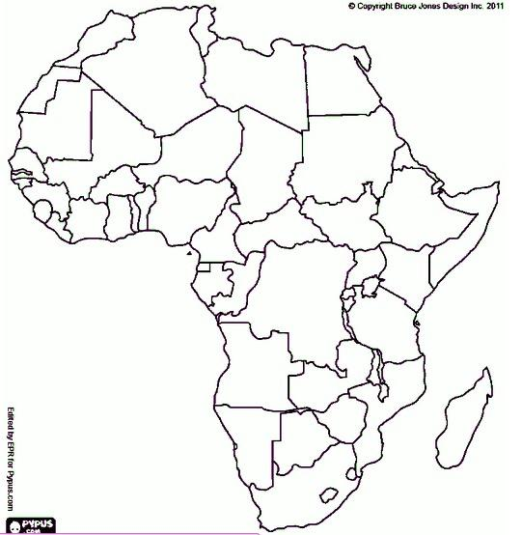
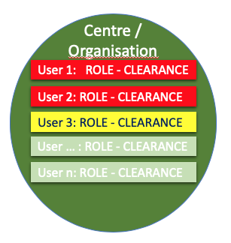
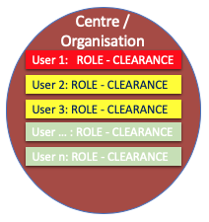
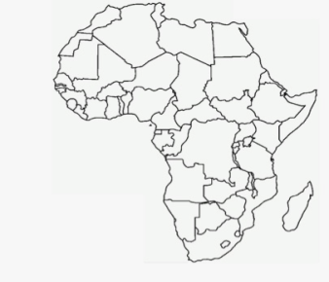

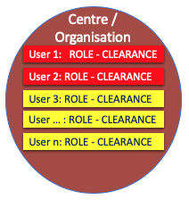

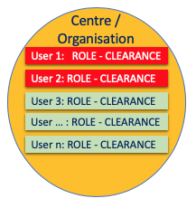
Users Organization
Settings
Auditor legal
Administrator
Local Adm
Decision maker
Supervisor
Operator
Invited
Public
Private
Secret
USER
ORG
ROLE
PERMISSION
  Organization
Belongs to a country.
  Role
What actions and features the user has access to.
  Permission
Defines the level of privacy that the user has access to.

Slide 12
LOG
ACCESS TO INFORMATION

Slide 13

Access to information
Level (Geographic
criteria)
Local
Users with the appropriate permission
National
Area
Regional
Interregional
International
Sensitivity of information
user permissions
Secret
Private
Public
Secret
Private
Public
Private
Public
Public

Slide 14
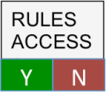

Access to information
Level criteria
Sensitivity criteria
Invitation
X
Not the right Org
Insufficient permission
Not invited
Situation
Level criteria
Sensitivity criteria
X
Not the right Org
Insufficient permission
Event
Level criteria
Sensitivity criteria
X
Not the right Org
Insufficient permission
Comment
Notes:
AT EACH LEVEL THE SYSTEM VERIFIES THAT ALL CRITERIA ARE FILLED

Slide 15
LOG
EVENT

Slide 16
Concept
An event is a crucial information for monitoring and / or developing a situation
Once registered it is no longer editable
There is always a sensitivity criterion and associated geographical level
These criteria only apply after checking the criteria for the situation
By default, the event inherits the situation criteria
The "creator" of the event and the time of the event are automatically linked by the system

Slide 17
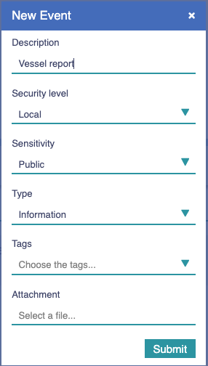
Create an event
1
Click on "New Event"
Either on the dedicated Log page or in the window at the bottom right of the general page of the situation
A "New Event" window appears
Fill out the form
  Description - Mandatory
  Level - inherits by default from situation
  Sensivity - inherits by default from situation
  Type - Decision or information
  Tag - Optional, from the labels in the specific situation
  Click
1
2
2
3
Submit
3

Slide 18
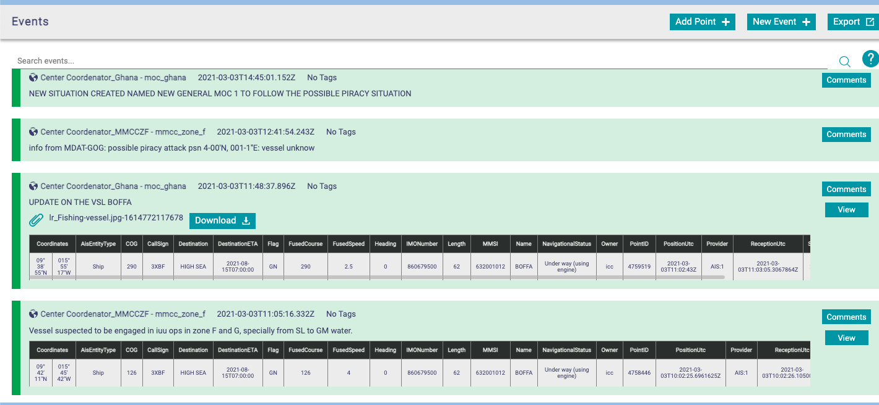
Search for an Event
Click on the box "Search events"
  Enter the first letters of a word from the text of an event
  The list of possible events appears
1
1
Notes:
To say: When there are many events, the "Search events" button allows you to search for a particular event, among all those related to the operational situation

Slide 19
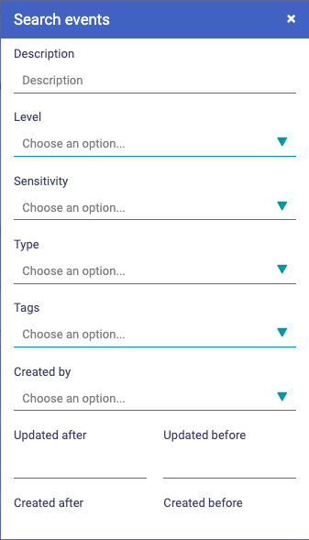

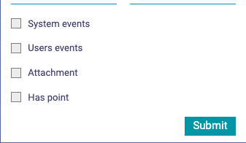
Search for an Event
A
Click on the box "Search events"
  Enter the first letters of a word from the text of an event
  The list of possible events appears
  Click on Advanced Search icon
  It opens a dedicated box
  Fulfil the relevant search fields
  Click on
1
2
1
2
A
B
Multi search criteria work in a logical and basis
B
Notes:
To say: When there are many events, the "Search events" button allows you to search for a particular event, among all those related to the operational situation

Slide 20
LOG
COMMENTS

Slide 21
Concept
A comment can be attached to an event to make it more explicit or to detail it
A comment is not intended to contain important information (if so, a new event must be created)
Comments have geographic criteria (level) and sensitivity.
By default, inherit the criteria of the associated event

Slide 22
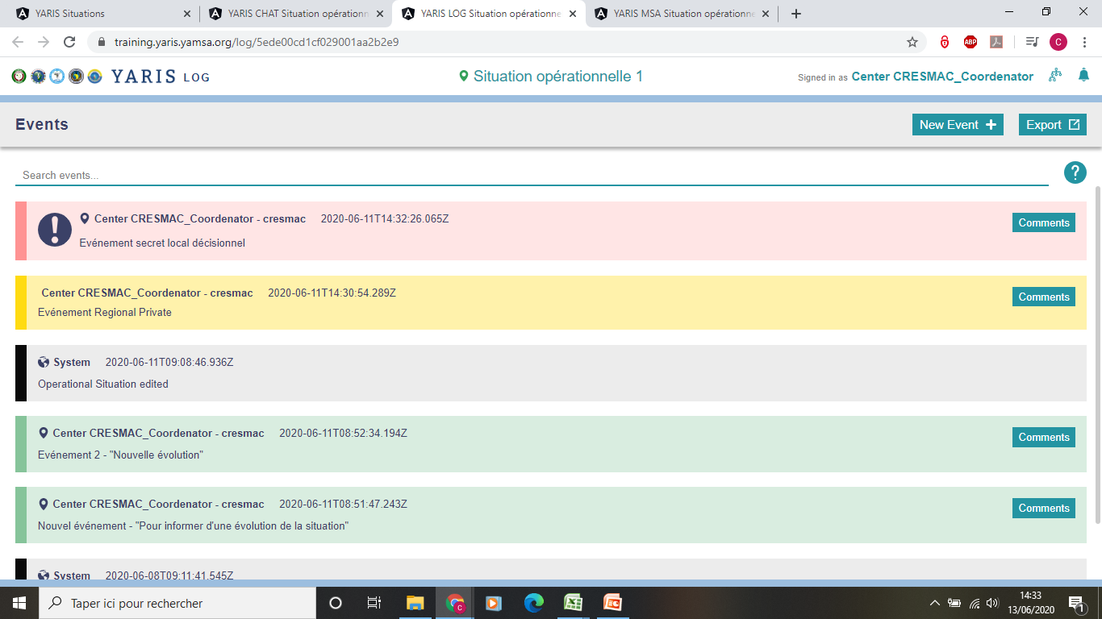
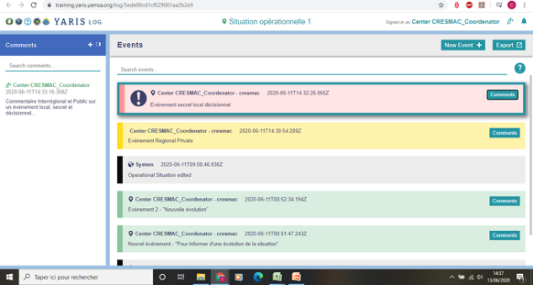
Access Comments
1
Click on "Comments", in relation to the event
A window "Comments" appears on the left.
The symbology of comments respects that of situations and events
Access to comments depends on permissions granted to the user
Search for comments in an event by free text
Type the first letters of a word in the comment text
Lists possible corresponding comments on the event
Indicates that there is at least one comment associated to this event
1
2
2

Slide 23
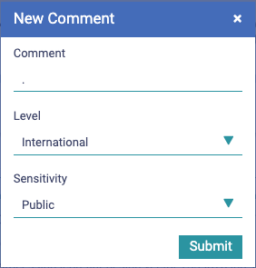
Create a comment
1
On the event, click on
It opens the comment pane
Click on
It opens the New Comment Box
Fulfil the fields
Comment
Level
Sensitivity
Click on
2
2
3
1
By default, inherits from the situation
4
By default, inherits from the situation
4
Notes:
Comments:
First point Users ... have automatic access to a Instant messaging environment, not at a Instant messaging
second point: within the this environment...

Slide 24
LOG
AUTOMATIC CREATION OF A EVENT

Slide 25
Concept
An event is automatically created by the system everytime a situation parameter changes
Events created automatically:
  are identified by is color in black
are international- public
always do reference to who, what and when

Slide 26
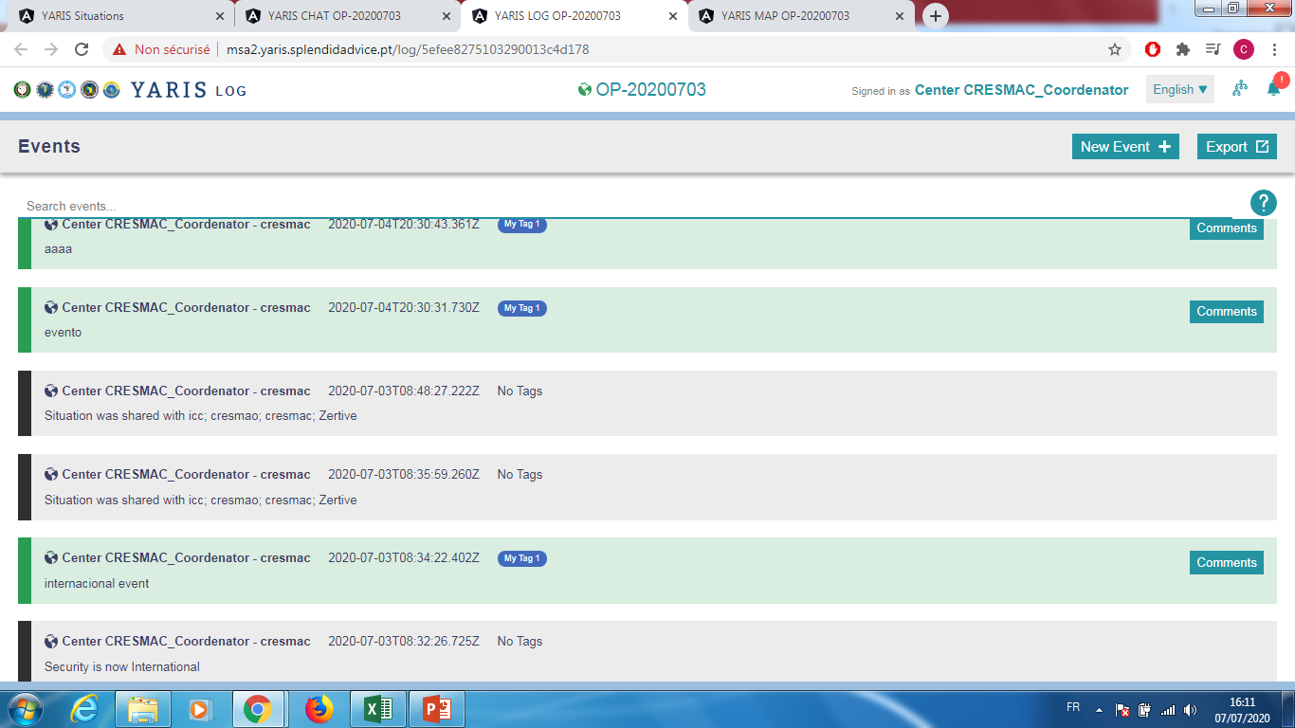
Automatic event creation (example)
Example 1:
The situation was shared with ICC by cresmac_ccoordinator at....
Example 2:
The sensititivity of the situation was changed by cresmac_ccoordinator at....
Notes:
Comments:
First point Users ... have automatic access to a Instant messaging environment, not at a Instant messaging
second point: within the this environment...

Slide 27
Log
CREATING AN EVENT FROM AN OBJECT

Slide 28
Purpose
Create an event ("Event") from an object in the MAP
eg, when there is an object of particular interest and deserves to be marked and enregistered (suspicious behaviour...)
Rules
The event thus created indicates must contain the available data related to the object MAP
Notes:
Comments:
First ball Users ... have automatic access to a Instant messaging environment, not at a Instant messaging
second ball: within the this environment...

Slide 29
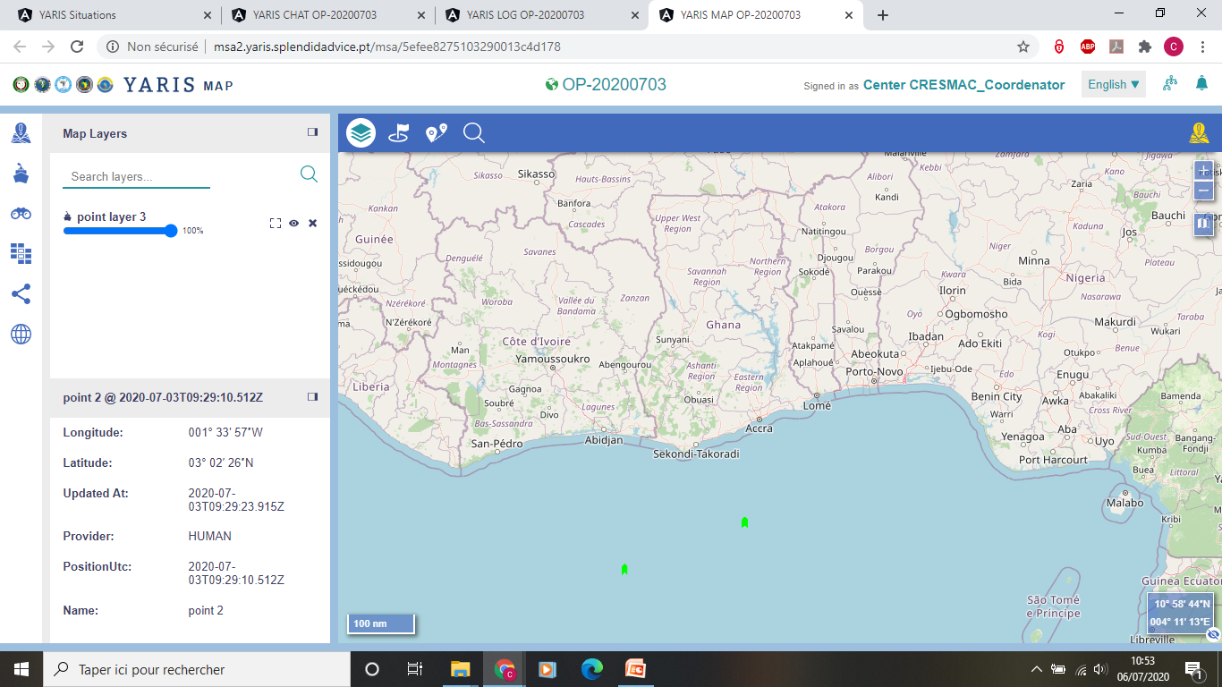

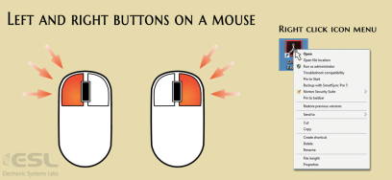
Right-Click on the Object-Point
Creating an event from an object
1
1

Slide 30
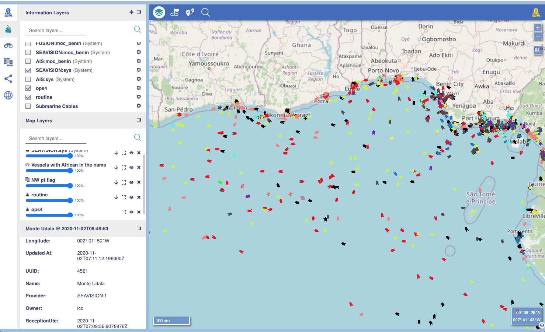

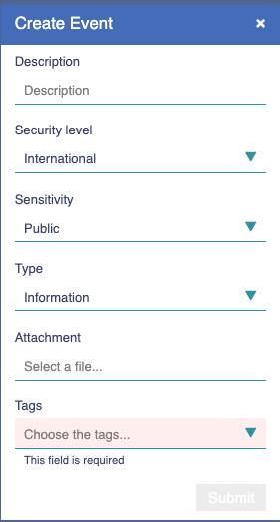
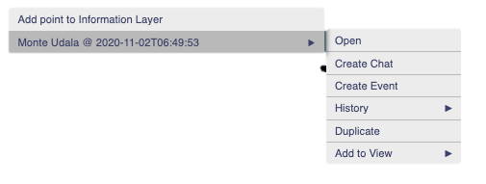

Creating an event from an object
Right-Click on the Object-Point
Open the Tool menu
Click on
It opens Create Event box
Fulfill the fileds
Description – Mandatory.
Level – by default International
Sensitivity – by default Public
Type - by default Information
Attachement – Option to attach documents
Tags - Mandatory
Click on
The new event is created
1
2
3
Mandatory
4
2
1
5
Mandatory
5

Slide 31
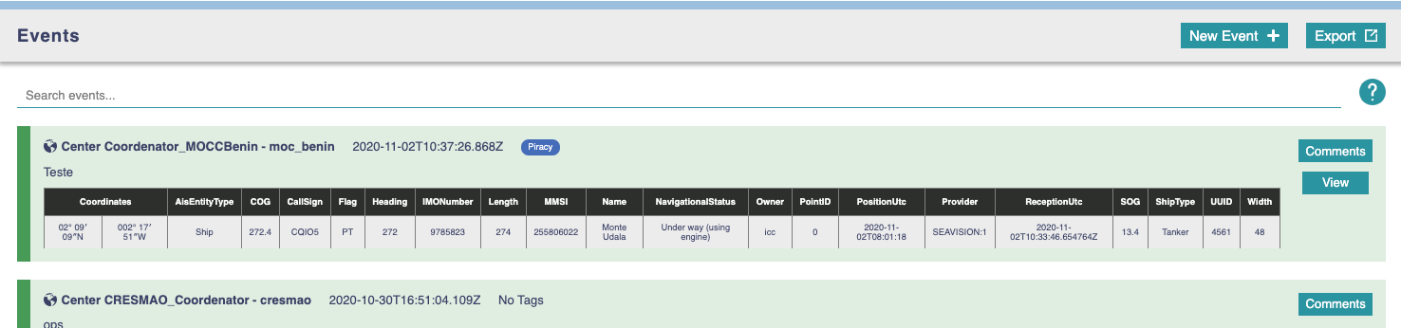
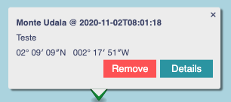
Creating an event from an object
Goes to MAP Window showing the event
Goes to Log Window

Slide 32
LOG
CREATING AN OBJECT FROM AN EVENT

Slide 33
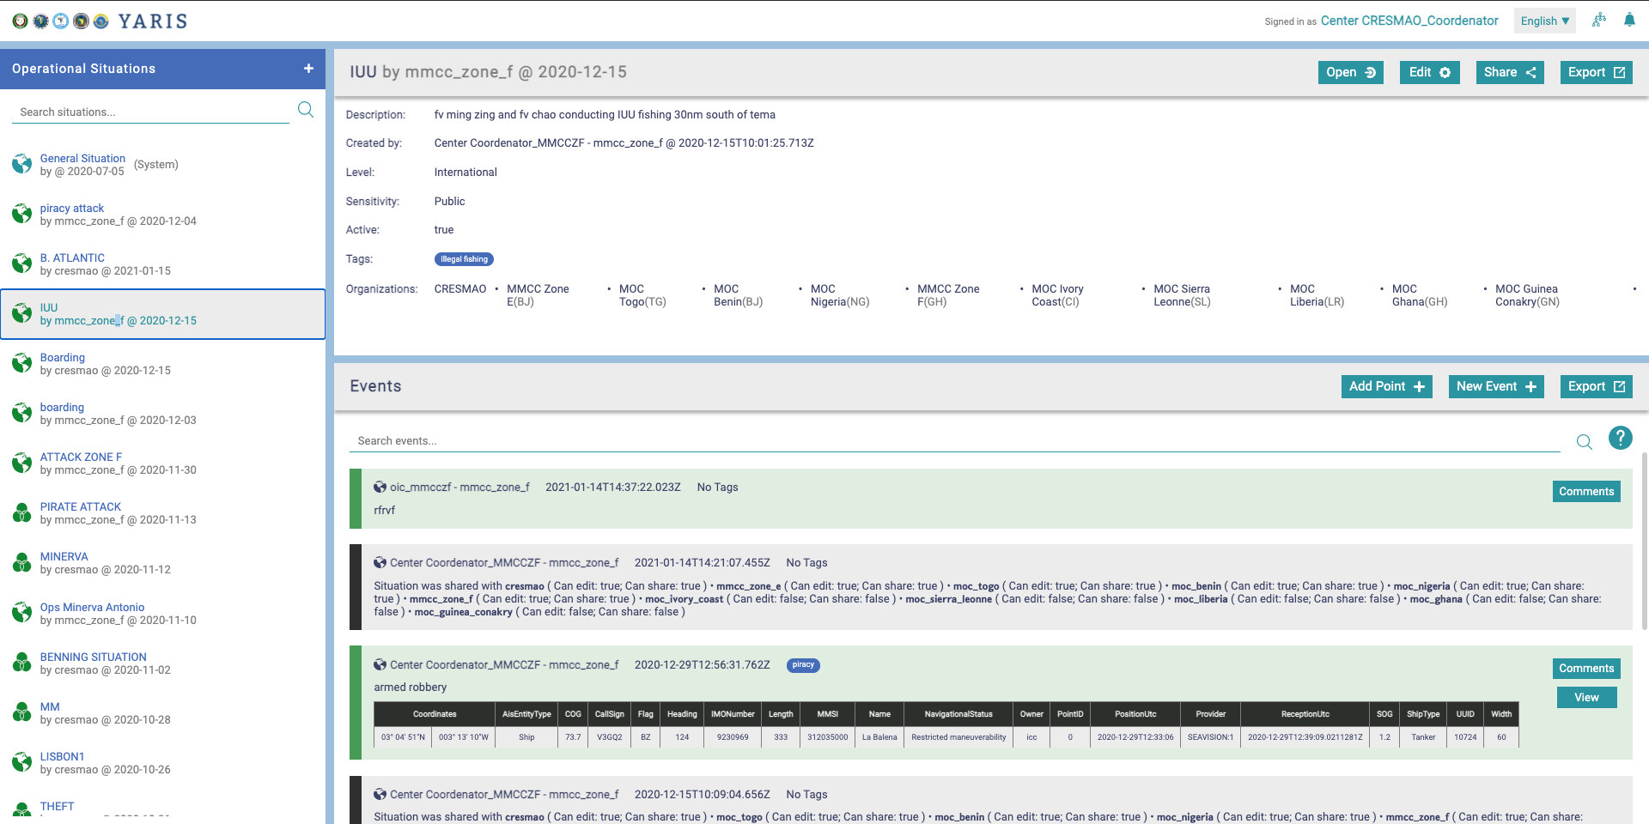
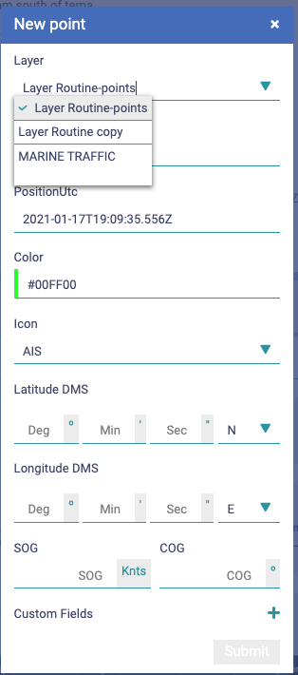

Creating an event from an object
2
Click on
      The New Point box opens
Fullfil the fields
  Layer - Select from the list
  Name - Mandatory
  PositionUTC –UTC Position Time
  Colour – Define the colour of the icon
  Icon – Define the symbol of the icon
  Position – Lat and Long
  Speed and course
  Custom fields – Add new fields
Click on
      The new related event box opens
1
Lists all possible active information layer
Mandatory
2
From the system by default, it can be changed
1
From the mouse position by defaul default, it can be changed
3
3

Slide 34
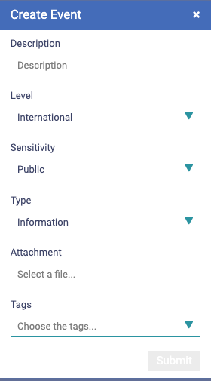
Creating an event from an object
4
Click on
Fulfil the fields
Click on
The new related event box opens
Fulfil the event box fields
Click on
1
2
3
4
5
5

Slide 35
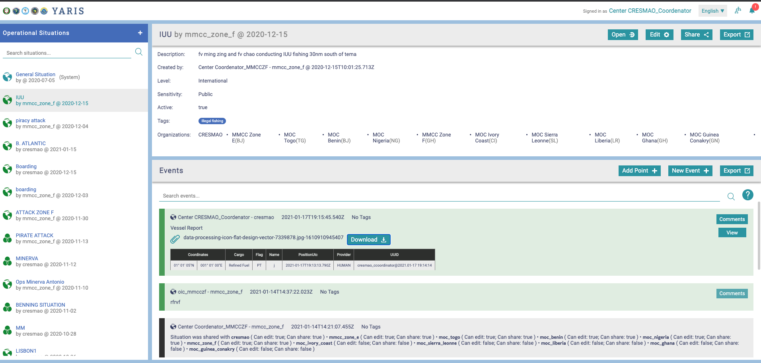
Creating an event from an object
Click on
Fulfil the fields
Click on
The new related event box opens
Fulfil the event box fields
Click on
Click on
The MAP opens and the respective marker is shown
1
2
3
4
5
6
6

Slide 36
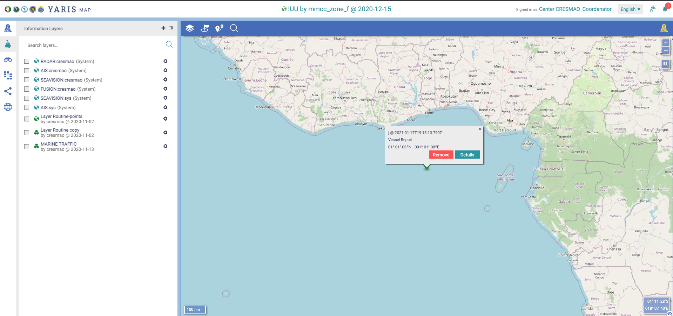
Creating an event from an object
Click on
Fulfil the fields
Click on
The new related event box opens
Fulfil the event box fields
Click on
Click on
The MAP opens and the respective marker is shown
1
2
3
4
5
NOTE:
This marker is not the exact position of the point.
The point can only be seen when the layer is active
6

Slide 37
LOG
EXPORTING THE LOG

Slide 38
Purpose
Export data from LOG as pdf
Rules
The pdf complies with the rules of access to information for the user who requests the export of the information
Notes:
Comments:
First ball Users ... have automatic access to a Instant messaging environment, not at a Instant messaging
second ball: within the this environment...

Slide 39
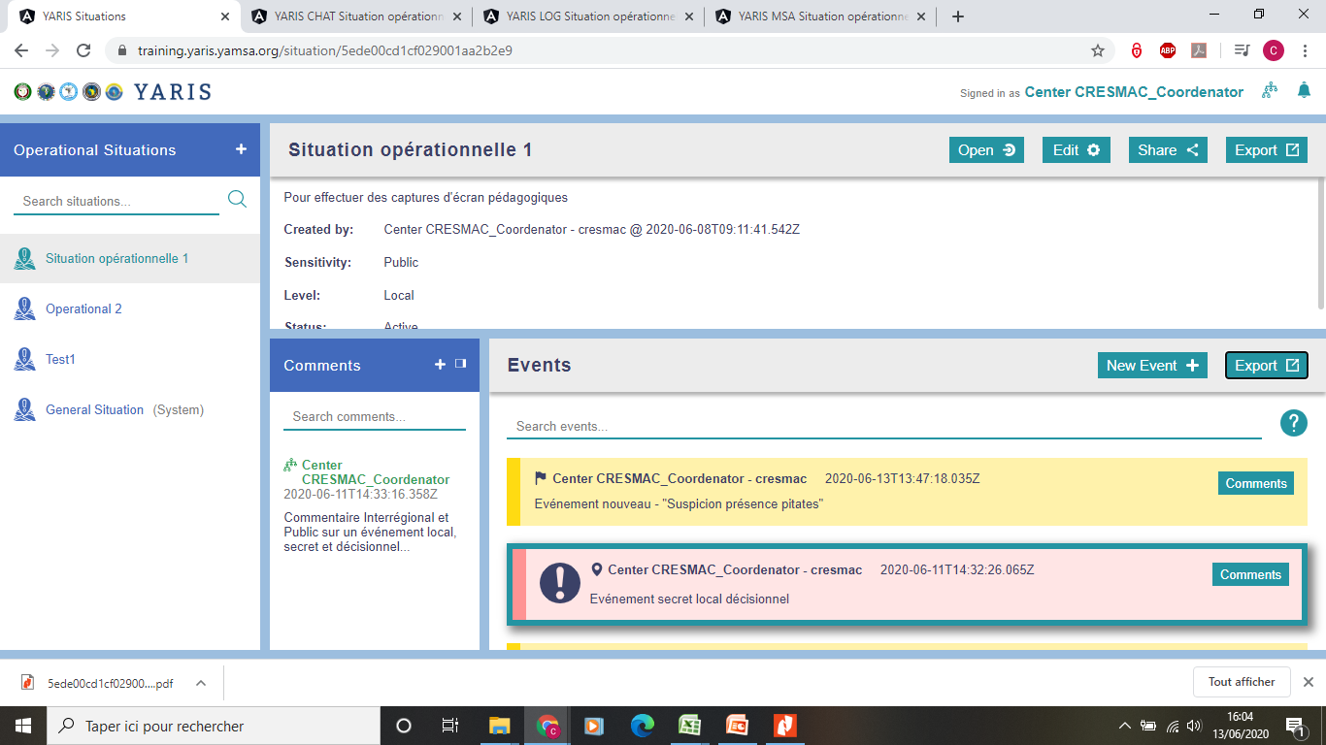
Exporting the Main Courante ("Log")
1
Click
A PDF file containing with the events received/ created by the user (and related comments) is created and downloaded
2
1
2
Notes:
Comments:
First ball Users ... have automatic access to a Instant messaging environment, not at a Instant messaging
second ball: within the this environment...

Slide 40
YARIS
Symbology

Slide 41
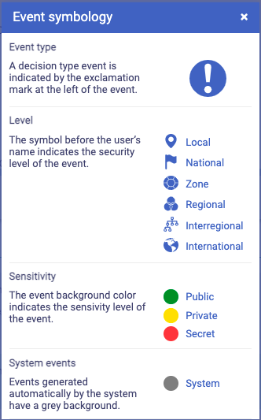
Symbology
1
2
3
4

Slide 42
Thank you for your attention

