Slide 1
YAOUNDE ARCHITECTURE REGIONAL INFORMATION SYSTEM

Slide 2
The MSA TOOL
MARITIME SITUATION AWARENESS

Slide 3
Plan
Overview
Accessing MSA & User preferences
General situation
Creating a Situation
Open CHAT, LOG and MAP pages
OPS situation window
Changing a Situation
Share an OPS situation
Search for a Situation

Slide 4
The MSA TOOL
OVERVIEW

Slide 5
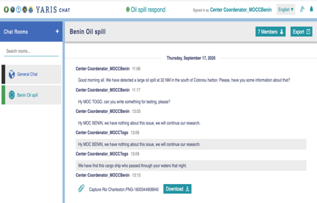
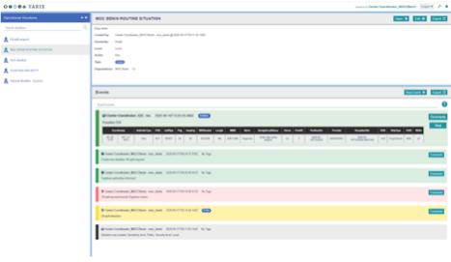
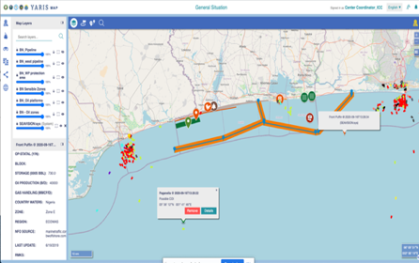

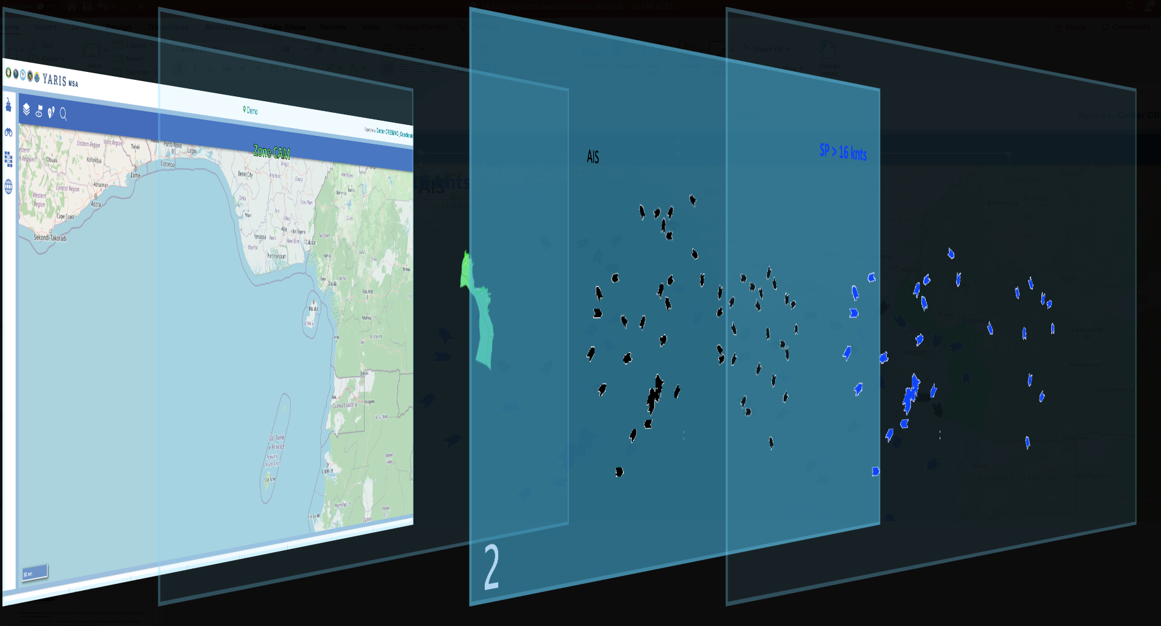
MSA
C
For each user of the Yaoundé architecture
MSA - Operational Situation
CHAT (CHAT)
2
B
LOG (LOG)
A
Monitoring the Operational Situation (MAP)

Slide 6
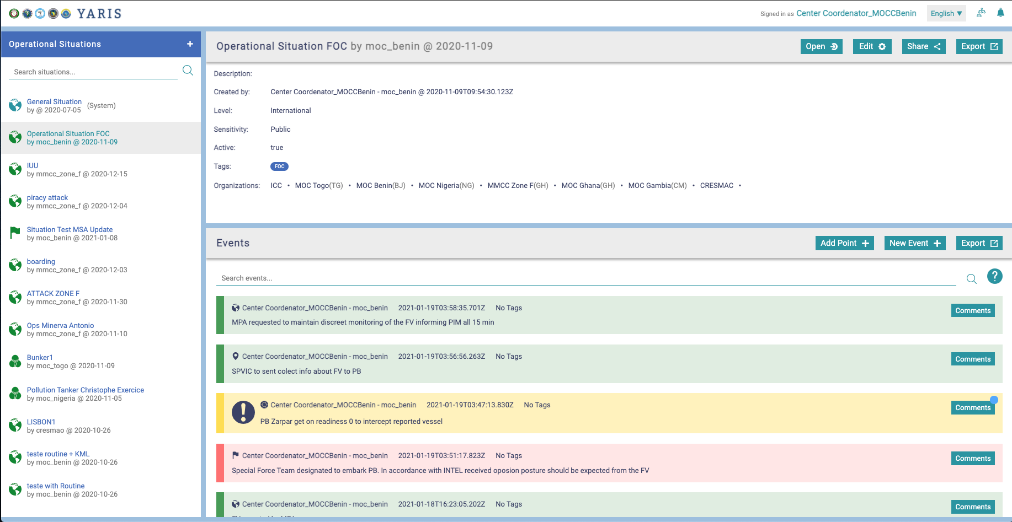
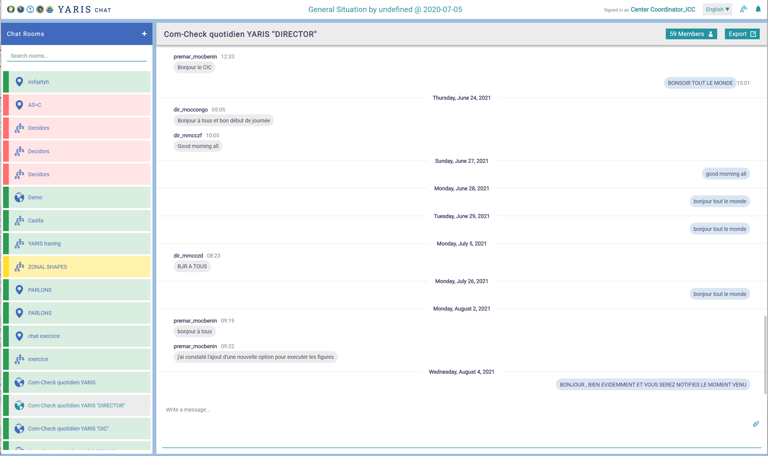
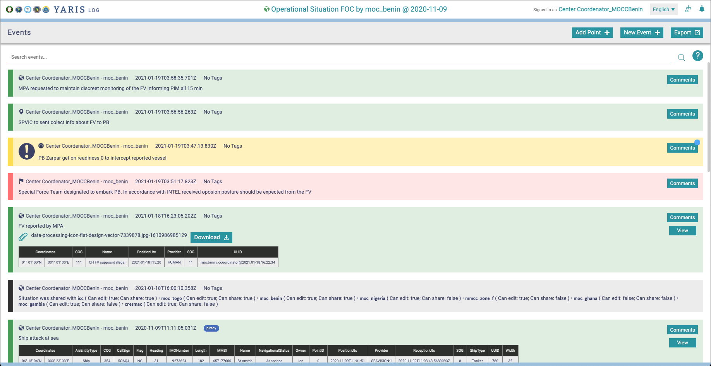
Based on the concept of operational situations.
An Operational Situation (SITOP) is an entity consisting of a map (MAP), an instant messaging space (CHAT) and a Log (LOG)
MSA
The MSA is an application for monitoring and managing operational situations in spaces maritime Gulf of Guinea

Slide 7
SITOP
(Within YARIS)
A situation is a whole set of common or related information about a particular subject or happening at sea (for example, a SAR situation):
General situation : routine situation in which all AY centers are involved - common outlook for the region. Always active
New situations: situations created by a center to manage a specific event at sea; which may involve one or more centers. Can be deactivated only by its owner

Slide 8
Purpose
Be able to ensure flexible management and monitoring of the operational situation in a center, whether from a post with a single display or a post with multi-view capability
NOTE
Always keeping in mind the development of situations
Support the authorities' decision

Slide 9
concept
Based on Operational Situations.
set of common or related information about a particular subject regarding an event at sea.
An Operational Situation (SITOP) is an entity consisting of a(n):
situation management page
instant messaging space (CHAT)
log (LOG)
map (MAP)

Slide 10
Rules
A common general situation is always active for all the YA operational centers
All owners
Only " deciders” or above can create new situations
A center may only view active situations where he is engaged
A situation has an owner, a sensitivity and a level criteria
Situations can be shared with other centers, according to their criteria and always by invitation, by the owner or by centers with permission to do so.
Notes:
It's not only the postponement of a maritime incident on the Platform Msa. This Allows The Followed management of the Crisis In Considering Location, location, ExchangesAnd A Putting To Day Automatic handrail.

Slide 11
The MSA TOOL
ACCESSING MSA
SET UP USERS PREFERENCES

Slide 12
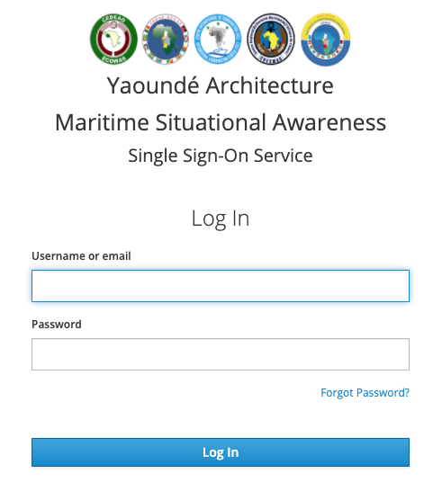
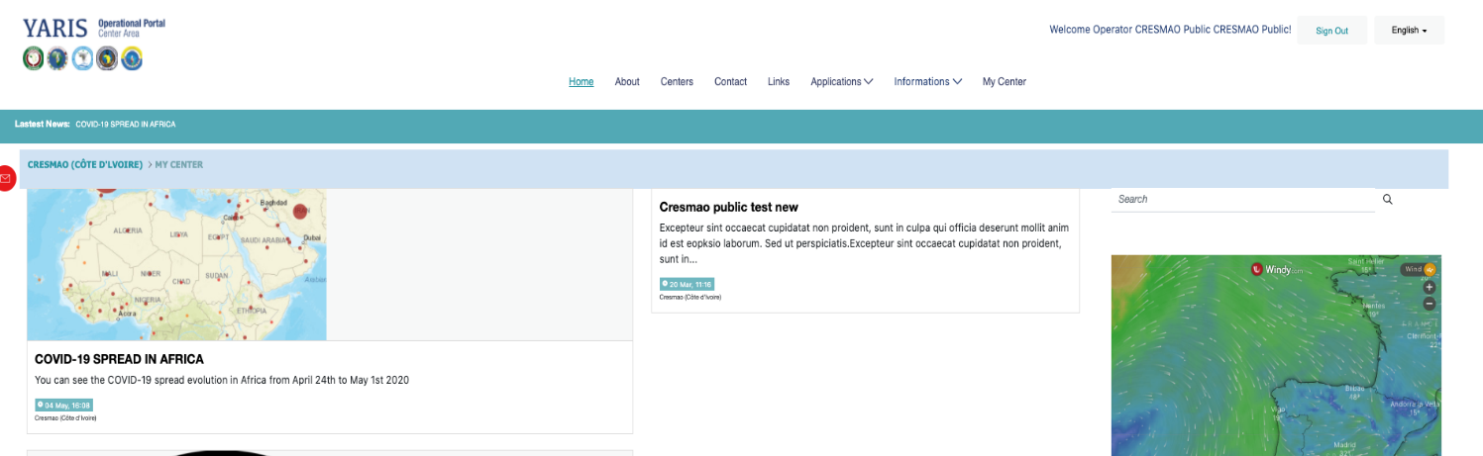
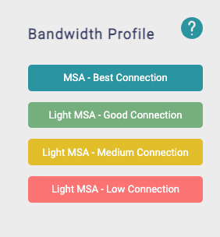
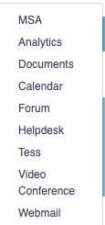
Accessing MSA
2
A
Applications
4
3
1
B
training.yaris.yamsa.org
3
1
2

Slide 13
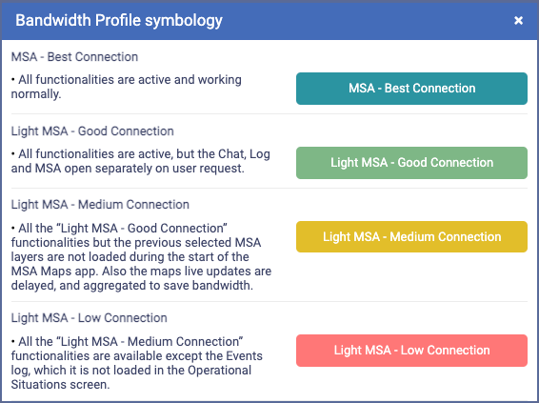

Accessing MSA
?

Slide 14
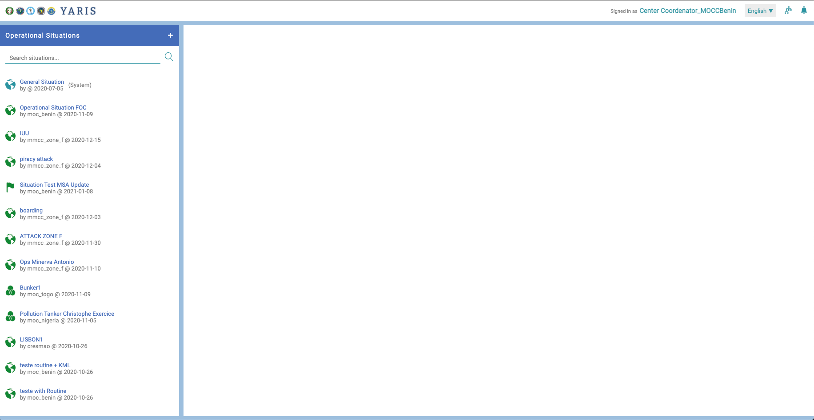
Accessing MSA
1
2
3
4
5
6
Page identification and link to return to the PORTAL
By clicking on YARIS, access to the Portal
Identifying the situation
Once selected
User identification and configuration
By clicking on his ID
Page language
Per session
Access to the state of the centres
Notification alert
1
2
3
4
5
6

Slide 15
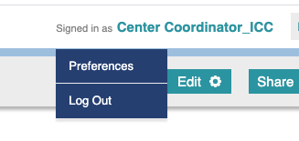
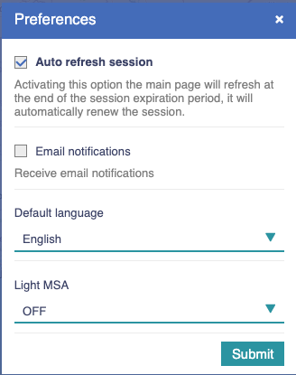


Accessing MSA
1
1
Click on the user
This opens up options
Click Preferences to access configuration settings
Filling the fields
  Refresh Session This permission automatically refreshes YARIS. Otherwise, for security reasons, if there is no interaction, the system will automatically shut down after 30 minutes.
  Email notification A file transposing system-managed notifications is sent at the end of the day (according to the predefined access rules to information)
  Default language For all pages and future accesses of this user
  Light MSA Choice of how the system performs based on the IT capabilities of the workstation
  Click
2
2
3
3
4
4

Slide 16
PAGE SITUATION
BASICS

Slide 17
Situation management page
Window dedicated to the situation management, where…
(recall)
a situation is a set of common or related information about a particular subject (e.g. a SAR situation) regarding an event at sea.

Slide 18
Purpose
Create a situation
See all the active situations where a center is engaged
Once a situation is selected:
  View and manage its parameters
  Share the situation with other centers
  Access to the related chat, log and map
View the last related events
Notes:
It's not only the postponement of a maritime incident on the Platform Msa. This Allows The Followed management of the Crisis In Considering Location, location, ExchangesAnd A Putting To Day Automatic handrail.

Slide 19
1
MASTERING THE PAGE
Header of the page
Create new situations
List of Situations in which a center is engaged
Parameters and options associated with the selected situation
Latest events related to the selected situation
In degraded mode configuration (MSA light - low connection) does not appear
2
1
4
2
3
3
4
5
5
Notes:
It's not only the postponement of a maritime incident on the Platform Msa. This Allows The Followed management of the Crisis In Considering Location, location, ExchangesAnd A Putting To Day Automatic handrail.

Slide 20
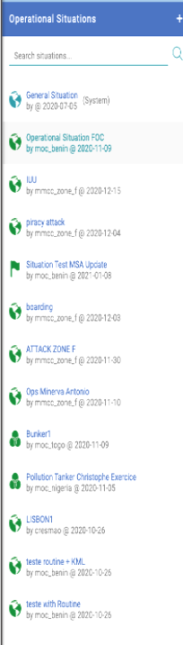
Rules for listing
For normal users, only the active ones should be visible
The data listed contains name, owner, creation date, level and sensitivity criteria
General situation always on top
Other situationsordered of the listed situations by the last update received
International
Public
General Situation always on top
Name
Owner
Creation Date
By the last updated ones by an event or comment

Slide 21




Settings a situation
Reminder
Settings
Local
National
Area
Regional
Interregional
International
Public
Private
Secret
+
OWNER
LEVEL
SENSITIVITY
TAG
SHARE
  Owner
The one who created the information: situation, event, layer...
  Level
Sets the geographic level at which information is accessible
  Sensitivity
Defines the level of confidentiality of information
  Tag
Information theme
  Share
Defines with whom and how to share
Notes:
All information has a cleanliness, a geography and sensitivity. Others

Slide 22
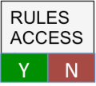

Access to a situation
Reminder
Geographic criteria - Level
Confidentielity criteria - Sensitivity
Invitation criteria - Share
X
Not the right Org
Permission Insufficient
Not Invitation
Situation

Slide 23
YARIS
GENERAL SITUATION

Slide 24
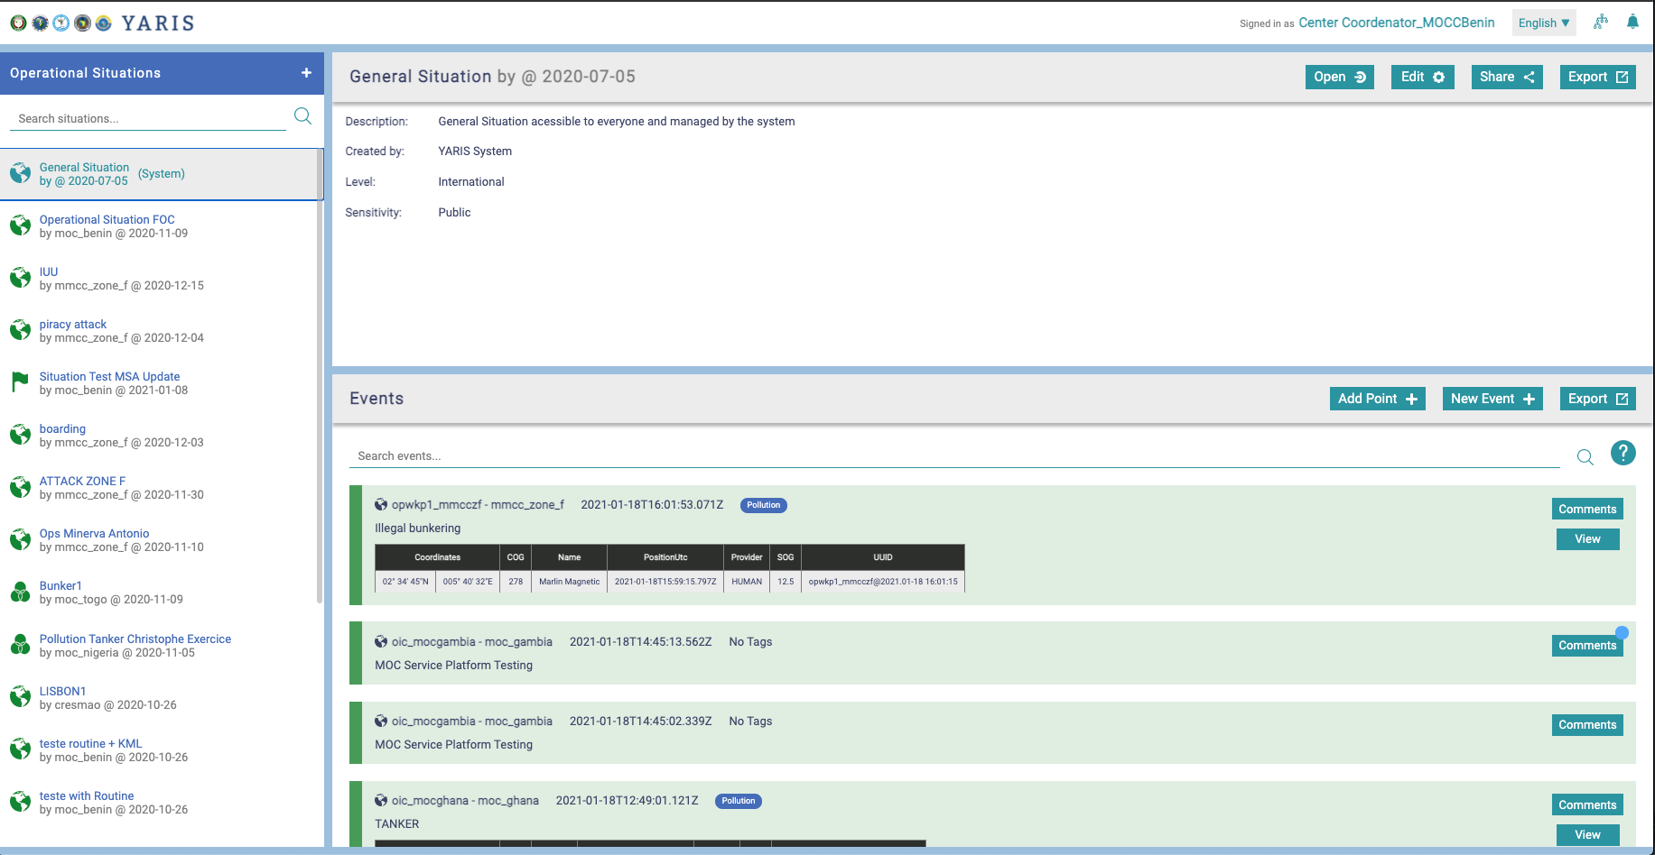
RULES
SITOP of the system for the AY that is always active
Situation where all AY centers are present
Public Sensitivity Situation, International Level; unalterable
Provides a common image for all YARIS users
Can be shared with other Organizations outside AY
(in development)
Notes:
Por defeito, o sistema fornece uma situação geral, com sensibilidade pública e nível internacional
Esta situação fornece uma imagem comum a todos os Utilizadores
Além disso, o sistema permite criar situações operacionais para serem utilizadas como grupo de áreas de trabalho para os Utilizadores de situações de trabalho operacionais específicos.

Slide 25
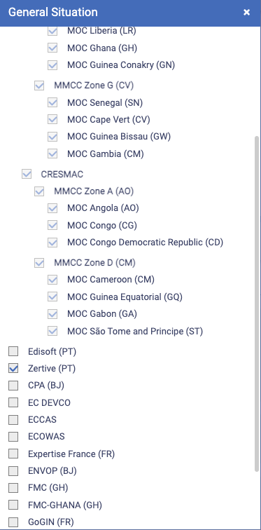

Slide 26
YARIS
CREATING A SITUATION

Slide 27
RULES
A new situation can be created from the SITOPs page or from the MAP application
Once created, only its owner will be able to disable it (decision maker or local administrator
Once deactivated:
only remains visible to administrators
can be reactivated by admins
after 30 days, the maritime objects are deleted from the operations environment, however the data is kept in the analytics environment
Information from the analytic environment cannot be imported into the operating environment
Purpose
A situation is a whole set of common, or related, information about a particular subject or event at sea

Slide 28
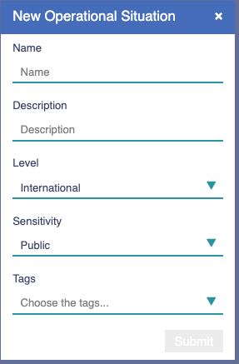
Creating a situation
Advisable to create YS procedures to designate the name of a situation
1
1
Click on
This opens a dedicated window
Filling the fields
Name
Description
Level
2
Mandatory
2
Level (geographic) - local by default
All centres can create a "local" situation*
Only the centers of a country can create "national" situations*
A National Center from YA can create all types situation
A Zone Center can create all types situation level except "national"
A Regional Center can only create "local," "regional", ’interregional’ and "international" situations.
A Inter-regional centre can only create 'local', 'inter-regional' and 'international' situation
* NOTA:
Para que os centros nacionais n-AY não possam criar novas situações, o perfil dos seus utilizadores deverão apenas de ser supervisor e operador
Notes:
Remarks:
Only centres in a country can create national situations
The

Slide 29
Creating a situation
Advisable to create YS procedures to designate the name of a situation
1
Click on
This opens a dedicated window
Filling the fields
Name
Description
Level
Sensitivity
2
2
Sensitivity - public by default
A Public user can only create Public situations
A Private user can only create Public and Private situations
A Secret user can create Public, Private and Secret situations
Submit
Notes:
Remarks:
Only centres in a country can create national situations
The

Slide 30
Creating a situation
Advisable to create YS procedures to designate the name of a situation
1
Click on
This opens a dedicated window
Filling the fields
Name
Description
Level
Sensitivity
Tags
Click
2
2
3
Submit
Optional
In Available list, choose one or many tags
3
Submit
Importance of TAGs (Situation + Events))
The recognition of a situation as an incident for the purposes of Analytics is made from the TAG of the events / situation
The event can only select a TAG that is selected for the situation
Notes:
Remarks:
Only centres in a country can create national situations
The

Slide 31
YARIS
OPEN CHAT, LOG AND MAP

Slide 32
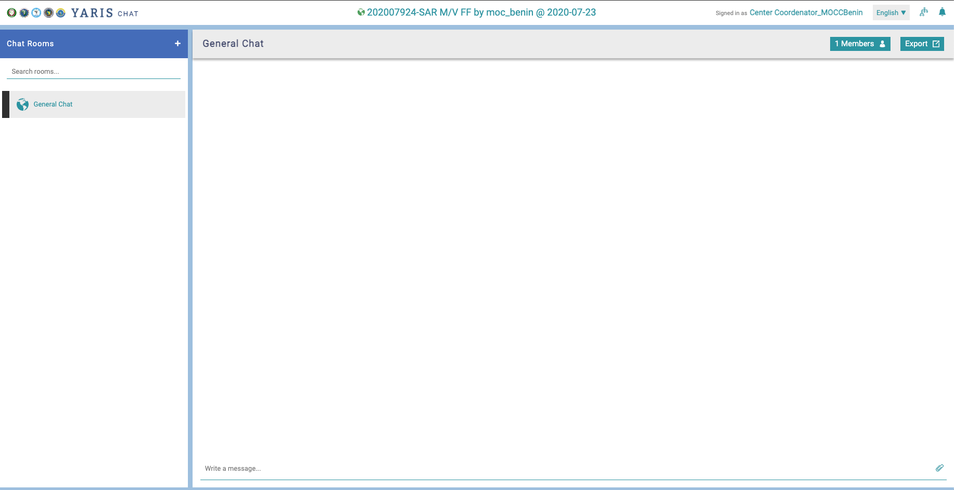
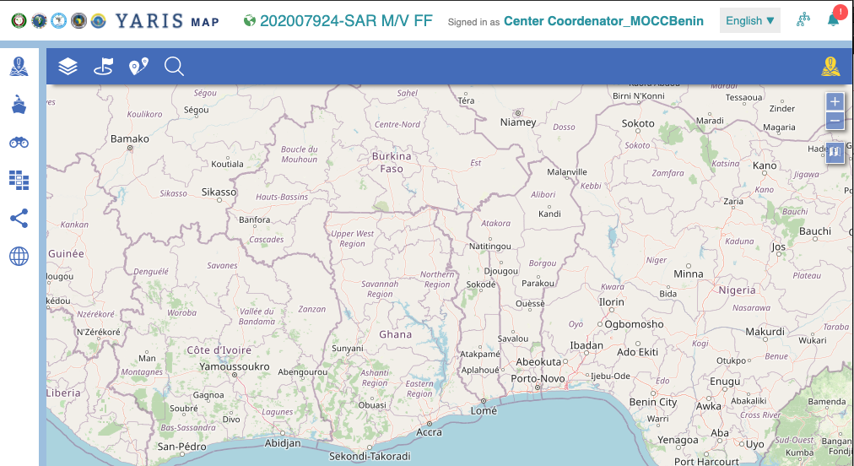
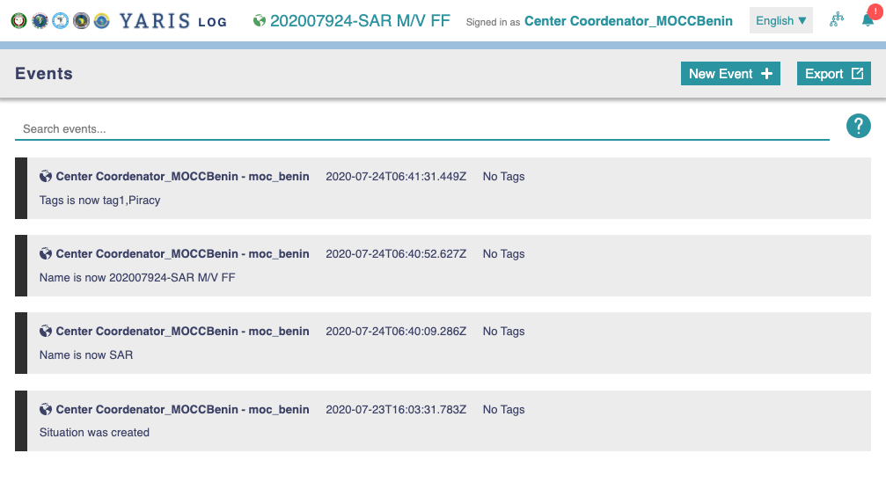
Open CHAT, LOG and MAP
2
1
Choosing the Situation
Click
It opens automatically* new tabs for the Chat, Log and Map functionalities
* opens automatically only if the internet configuration is the best (Light MSA OFF)
2
1
B
A
A
All the windows are related through the name Located on top of the windows,
All the windows are related through the name located on top of the windows, an icon indicates the level and color indicates the Sensitivity
B
Notes:
The app MSA To the basic concept of situations Operational.
A situation Operational Is A Entity Composed a year Map, a cat and a year Handrail
All The Windows Are Related The Each To Other, through the name Located on top of the Windows, A Icon Indicates The Level and color Indicates The Sensitivity.

Slide 33
YARIS
CHANGING A SITUATION PARAMETERS

Slide 34
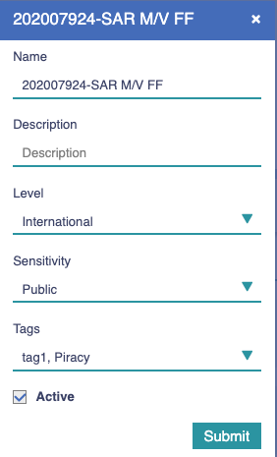
Changing a situation
Settings
The button edit can be invisible depending on the permissions
1
1
In the situation settings area, click
This opens the dedicated window
Closing a situation is a change to the state of the situation
Change as pretended
Click
2
2
3
Submit
D(e)select to close the situation
3
All changes are recorded in the LOG, identifying the author, the content and time of the change
34
Notes:
We Can Then, As At the time of His Creation, change the Criteria a year Situation Operational.
Be careful not to abuse it, because All The Elements Window Are Editable, including Got it The name of the situation, This That Risk de Create confusion.

Slide 35
YARIS
SHARE A SITUATION

Slide 36
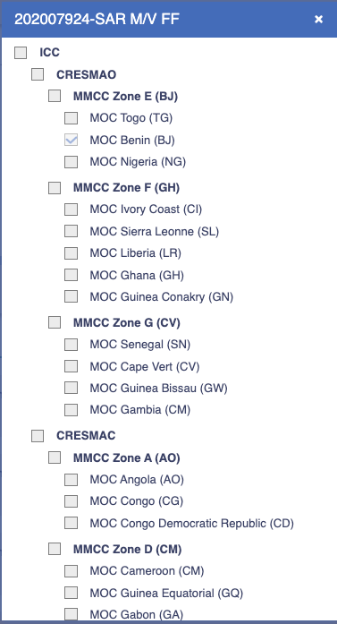
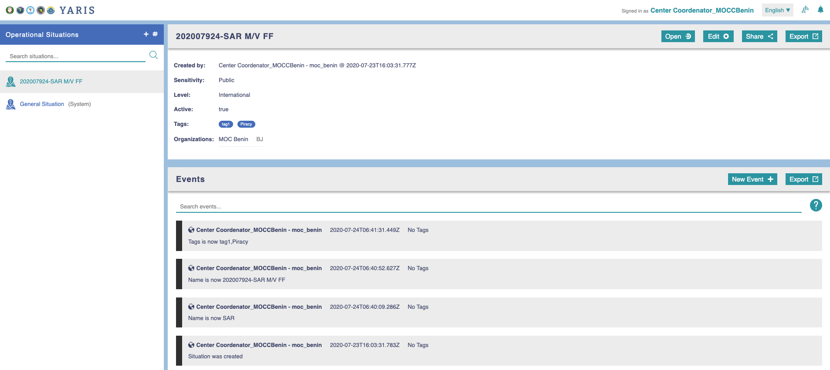
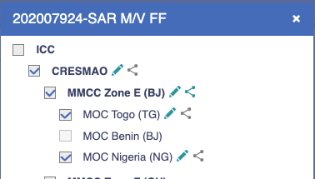
Share a situation
The button share can be invisible depending on the permissions
1
1
In the situation settings area, click
This opens the window of registered centres
Select the centres to share and what type of sharing
Select the centre
Click to change editing permissions
Click to change sharing permissions
Click
2
2
In green – Can share
In grey - Can't share
3
Submit
In green - permission to edit
In grey – Reading Only
3
Submit
All changes are recorded in the LOG, identifying the author, the content and time of the change
36

Slide 37
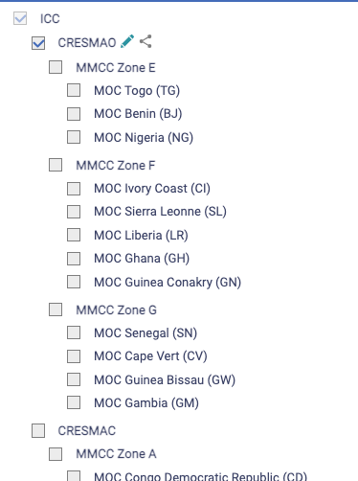

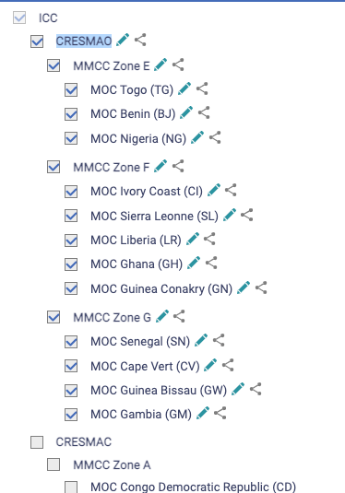
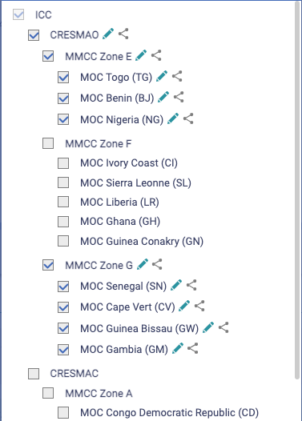

Share a SITOP
Group replication
1
Select and configure the center at the top of the level of the centers with whom you want to share a situation Ex: centers from ECOWAS region
Double-click on the name of the center
The configuration is automatically reproduced for all geographically coordinated centres
Deselect sharing with a group
Ex: Zona F
Deselect the top level center
Double-click on the name of the center
Deselection is automatically reproduced for all geographically coordinated centres
Click on
1
2
2
2x
3
A
3
B
2x
A
B
4
Submit
4
37

Slide 38
Yaris
LOOKING FOR A SITUATION

Slide 39
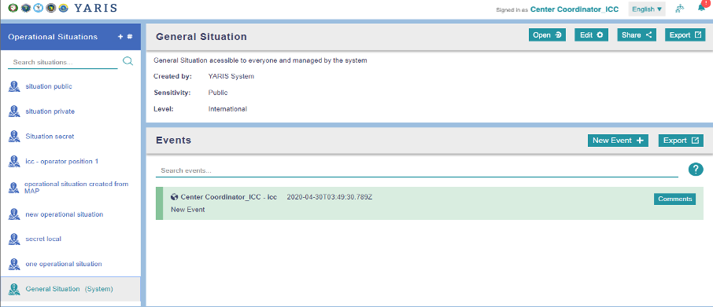
Searching for a situation
A
Search by the name
On Search situations type :
The SITOP’s name
Partial name
Sequence of letters from the name
A
1
1
Notes:
Os Utilizadores podem realizar um texto de pesquisa Completo básico por nome, digitando o nome da situação para pesquisar.
Os Utilizadores também podem realizar uma pesquisa para avançarEm na função de não importa qual situação de propriedade (por exemplo, tag -- "Teste")

Slide 40
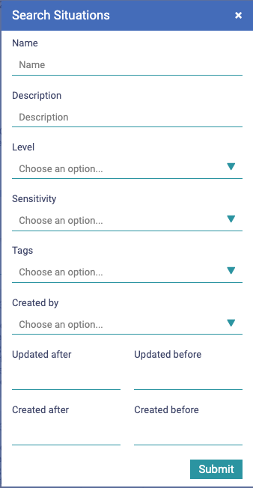
Searching for a situation
A
Search by the name
On Search situations type:
The SITOP’s name
Partial name
Sequence of letters from the name
Advanced search
Click on
It opens a dedicated box
Fulfil the search reference fields
A Multi-parameter search is based on a logical "e" operation
Cick on
1
B
1
B
B
1
2
B
3
Submit
3
Notes:
Os Utilizadores podem realizar um texto de pesquisa Completo básico por nome, digitando o nome da situação para pesquisar.
Os Utilizadores também podem realizar uma pesquisa para avançarEm na função de não importa qual situação de propriedade (por exemplo, tag -- "Teste")

Slide 41
Thank you for your attention

