Slide 1
MDA
From excel to kml
TP 1

Slide 2
Work proposal
TP 1
Discuss the structure of a database based on common tools
Create a geo-referenced table in Excel/WPS or similar spreadsheets
View information on Google Map
View information on Google Earth Pro
Complete with "drawn" information

Slide 3
Tools to be used
1
Google Sheet
Data sheets
(Excel, Google sheet, ....)
Excel
Gather information
Support some statistics and analysis
2
Free basic visualization tools
My Maps
Google Earth
.....
Visualization of the of the Data sheets information

Slide 4
Files Thematic
1 - Infrastructure
2 - Means and Services
3 - Areas / Areas
4 - Security Incidents
5 - Security Incidents
6 - Maritime Governance
7 - Operations

Slide 5
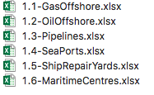
Files Thematic
MyMaps
GoogleEarth
Qgis
1 - Infrastructure
2 - Means and Services
3 - Areas / Areas
4 - Security Incidents
5 - Security Incidents
6 - Maritime Governance
7 - Operations

Slide 6
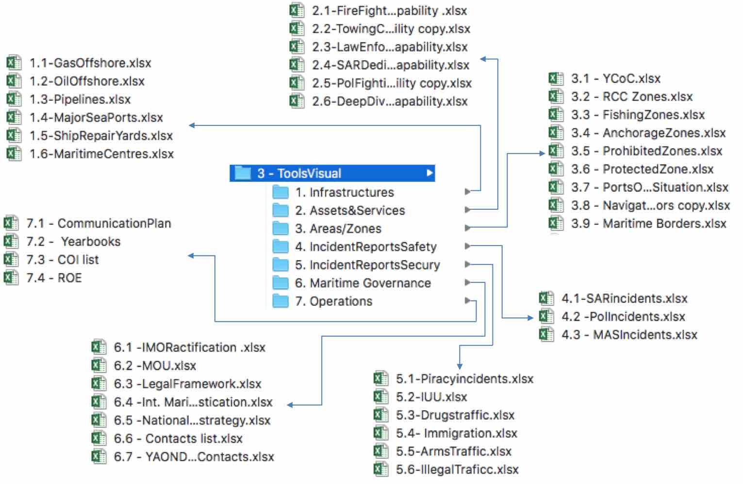
Files Thematic

Slide 7
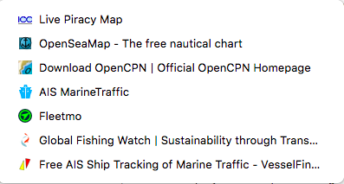
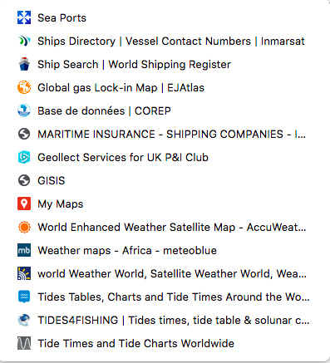
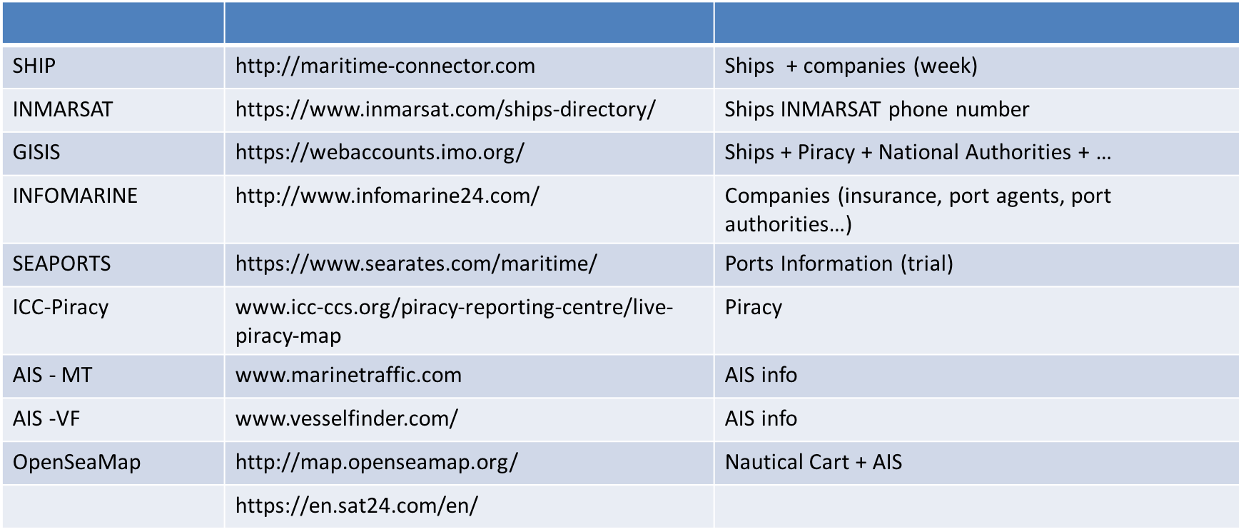
Some Web Open Sources

Slide 9
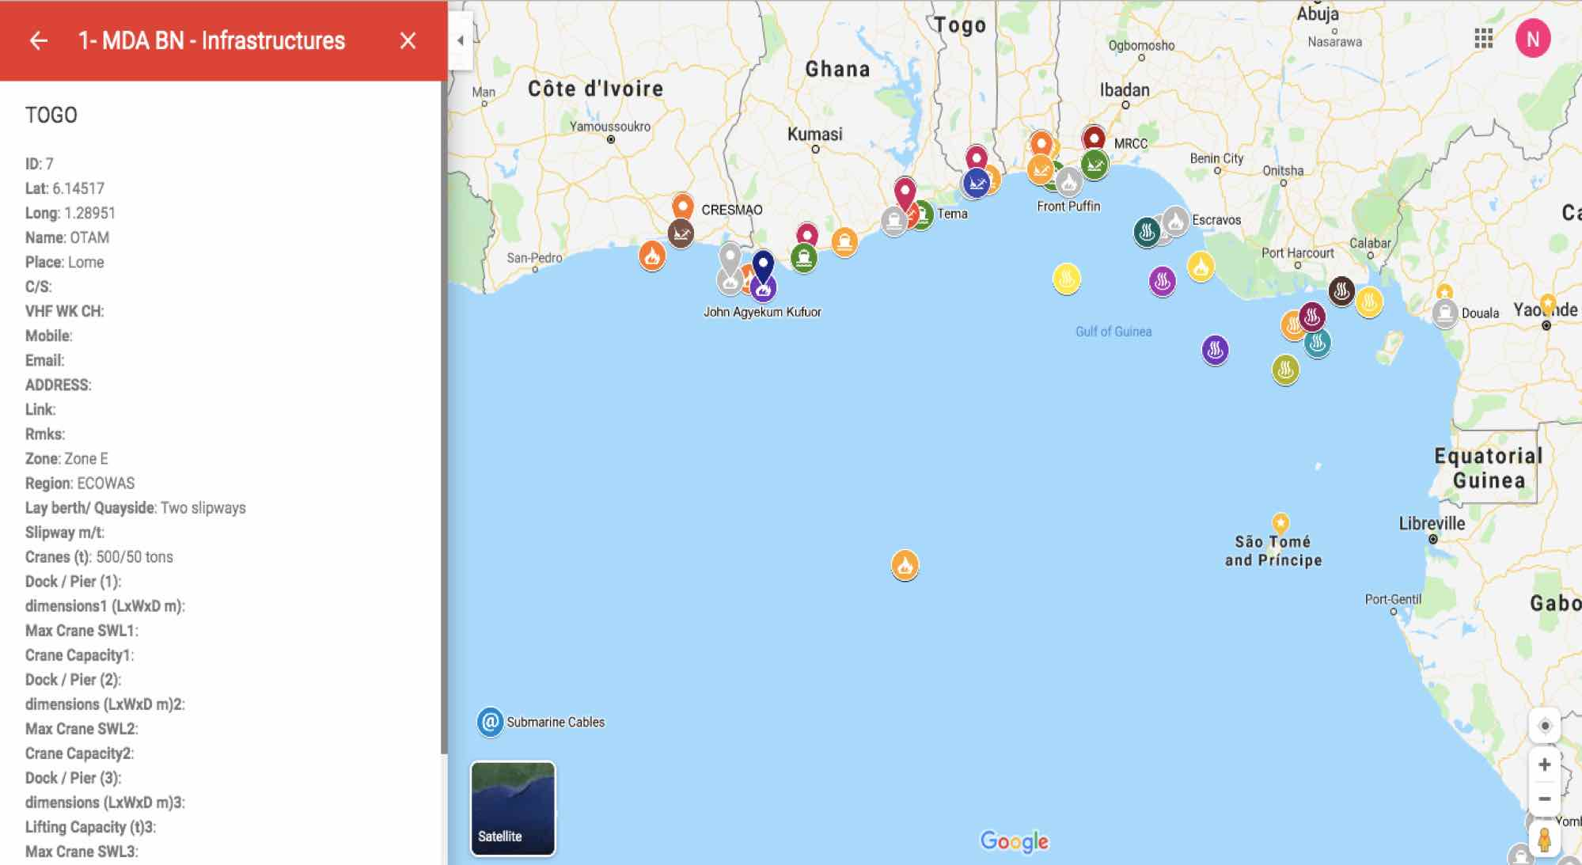

Slide 11
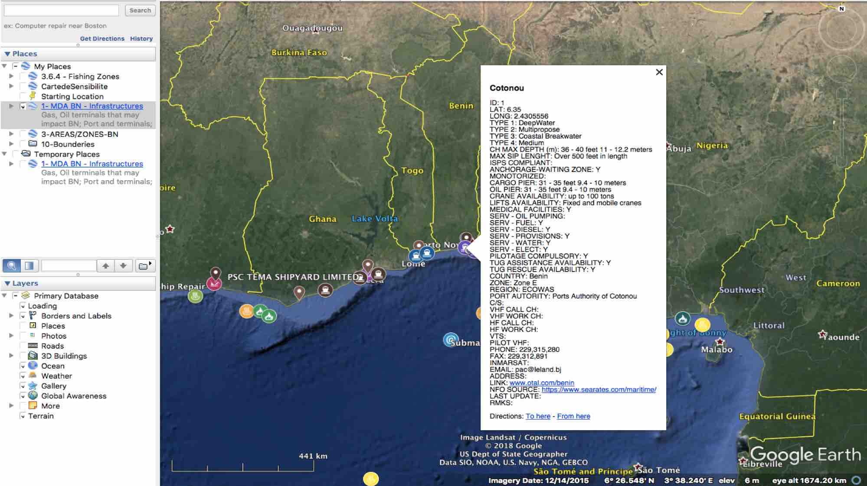

Slide 13
Excel
Data organisation

Slide 14
Working the tools Step 1 - Creating a painting
Create a new table
The workbook and the sheets
To be aware
Define what information
Important information
Format the information
Type of data
Validation List
Insert a formula
Copy from on cell to another
Some useful formulas
Build up basic graphics and statistical reports

Slide 15
Step 1 (t) Creation a painting
Excel -> creates a normal Excel table; one or two columns should be dedicated to the geographical position
Position format :
Lat : 41-24'12.2"N / 41 24.2028 N / 41.40338 [N /S -]
Long: 2-10'26.5" E / 2 10.4418 7 / 2.17403 [E /W -]
LatLong; 41-24'12.2"N , 2-10'26.5" E
Suggestion: Always use two columns for position (Lat, long): Rationale: future development of possible analyses
Automatic rules and lists can be used
Suggestion: on each new table, simply copy (format) the columns corresponding to the countries, areas or areas found in the sample tables: Rational: future development of possible analyses
Limitations: Because we don't pay for APIs:
There is a limit of 10 "tables" per card
There is no automatic update from the Excel table - GoogleMaps or GoogleMaps to the Excel table

Slide 16
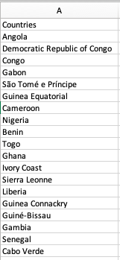
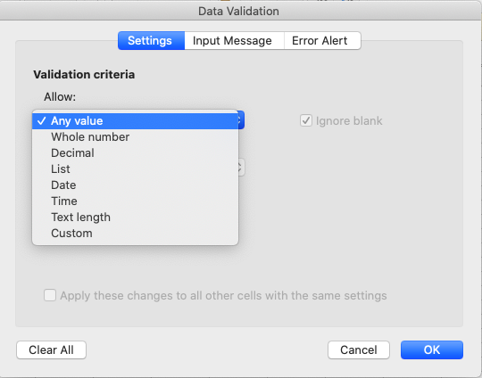
Automatic rules
OPTION A
Select Country from a list
( ex:V - Column Country ID)
1 – Create the a column in a another sheet with the list countries
2 – In the main sheet
select V column – go to Data – Validation
"IF (W2"""";I F (OR(W2"Zone A"; W2"Zone D");" ECCAS";" ECOWAS"))

Slide 17
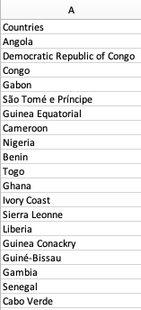
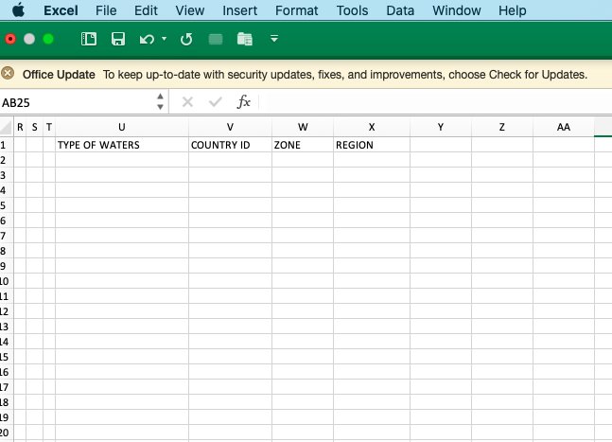
Automatic rules
2
Select Country from a list
( ex:V - Column Country ID)
1
A
B
A
Create the a column in a another sheet with the list countries
In the main sheet
Select V column
Select Data in the menu bar
Select Validation
A dedicated box opens
Choose List
1
3
B
1
2
3

Slide 18
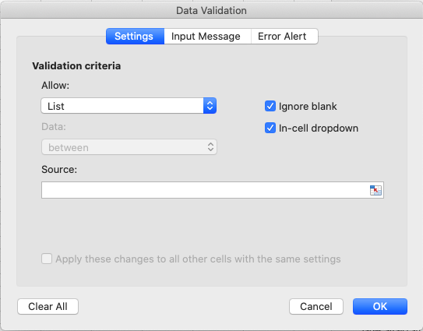
Automatic rules
Select Country from a list
( ex:V - Column Country ID)
1
A
Create the a column in a another sheet with the list countries
In the main sheet
Select V column
Select Data in the menu bar
Select Validation
A dedicated box opens
Choose List in the Validation Criteria Allow Field
Click on the field Source and select the Country List created on step
4
B
1
2
3
4
5
5
A

Slide 19
Automatic rules
OPTION A
Select Country from a list
( ex:V - Column Country ID)
1
2
Automatically display of the zone
Option A
In the cell W2 (Zone column) paste the expression showed on the left
In the cell X2 (Region column) paste the expression showed on the left
Select Data in the menu bar
A
2
A
1
1
=IF (V2="";IF(OR (V2="Angola"; V2=”Democratic Republic of Congo"; V2="Congo");" Zone A";IF (OR (V2="São Tome e Príncipe"; V2="Gabon"; V2="Guinea Equatorial"; V2="Cameroon");" Zone D";IF (OR (V2="Nigeria"; V2="Benin"; V="Togo");" Zone E";IF (OR (V2="Ghana"; V2=”Ivory Coast"; V2="Liberia"; V2="Sierra Leoa"; "Guinea Conakry");" Zone F";IF (OR (V2="Guiné Bissau"; V2="Gambia"; V2="Senegal"; V2="Cabo Verde");" Zone G";""))))))))))
2

Slide 20
Automatic rules
Select Country from a list
( ex:V - Column Country ID)
1
2
Automomatically display of the zone
Option A
In the cell W2 (Zone column) paste the expression showed on the left
In the cell X2 (Region column) paste the expression showed on the left
Select Data in the menu bar
A
2
A
2
1
=IF (W2="";IF(OR(W2="Zone A"; W2="Zone D");" ECCAS";" ECOWAS"))
2

Slide 21
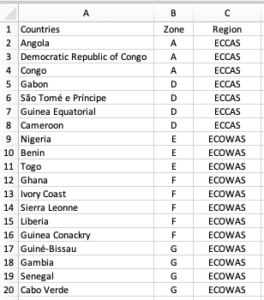
Automatic rules
2
B
1
Select Country from a list
( ex:V - Column Country ID)
1
2
Automatically display of the zone
Option B
Add an fulfil the columns Zone and Region on the sheet where the list of countries was created
In the cell X2 (Region column) paste the expression showed on the left
Select Data in the menu bar
A
1
2

Slide 22
Automatic rules
Select Country from a list
( ex:V - Column Country ID)
1
2
Automatically display of the zone
Option B
Add an fulfil the columns Zone and Region on the sheet where the list of countries was created
In the main sheet cell w2 (Region column) paste the expression showed on the left and copy it to the cells t
B
2
B
2
1
=VLOOKUP(A2;Sheet2!A2:C21;2;)
2

Slide 23
Automatic rules
Select Country from a list
( ex:V - Column Country ID)
1
2
Automatically display of the zone
Option B
Add an fulfil the columns Zone and Region on the sheet where the list of countries was created
In the main sheet cell w2 (Zone column) paste the expression showed on the left and drag it to the cells bellow
In the main sheet cell w2 (Region column) paste the expression showed on the left and dragt it into the cells bellow
B
2
B
3
1
=VLOOKUP(A2;Sheet2!A2:C21;3;)
2
3

Slide 24
Exercise
Create a Excel line for fishing inspections at sea - G1
Create a Excel queue for piracy incidents - G2

Slide 25
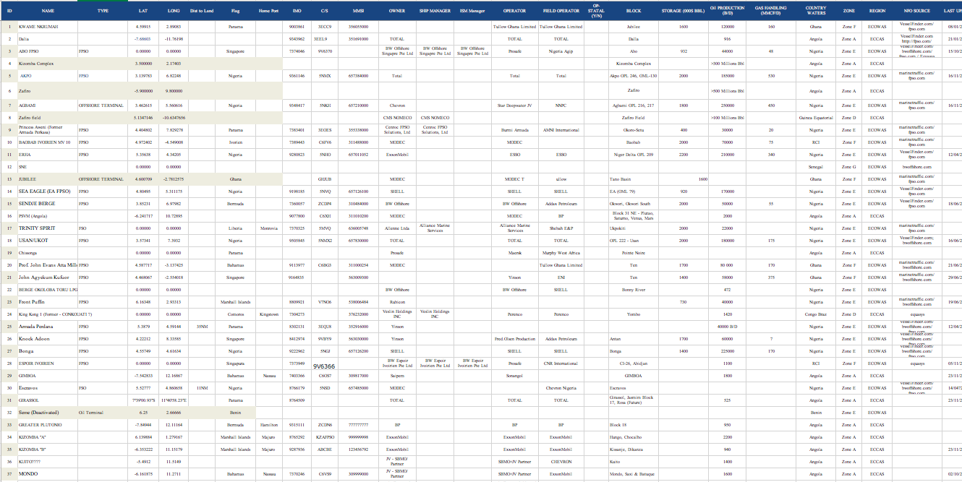

Slide 26
Google Maps

Slide 27
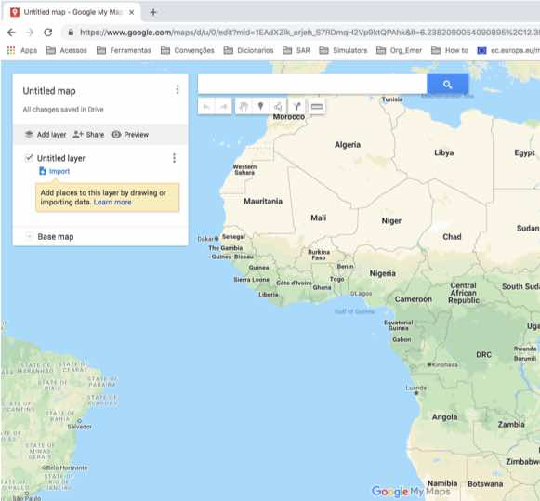
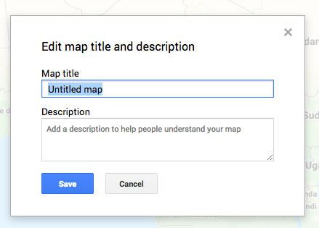
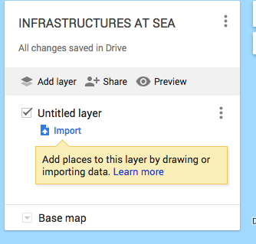
Creation View
1
2
Google My Maps:
Insert into the browser https://www.google.com/maps/d/
Press CREATE A NEW MAP
UNTITLED MAP Press give a name and description INFRASTRUCTURE AT SEA
IMPORT Press to select the table
Choosing the table
3
4

Slide 28
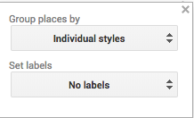
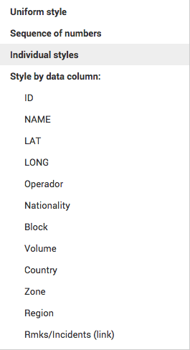
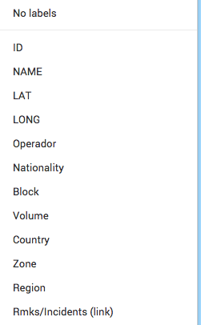
6
Changing style
Choosing the style Group
Choosing the label - what you see next to the symbol
7
8

Slide 29
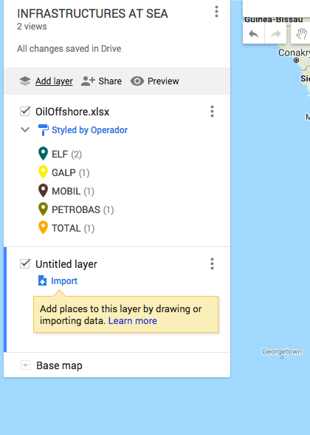
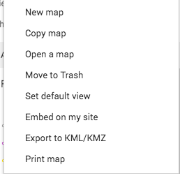
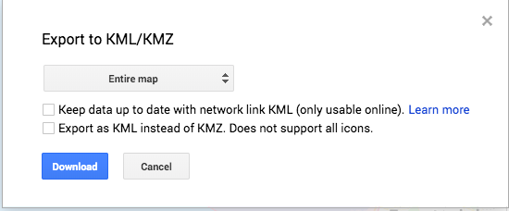
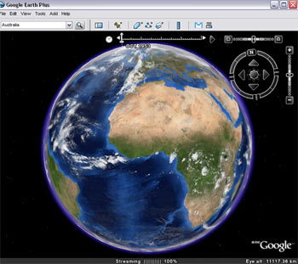
How to work with
10
8
PRESS ADD LAYER to add a new table
Repeat Procedures 4 and 5
Saving in format Kmz/Kml
(for viewing on other tools)
Press in front of the name of the map
Selects "Export to KML/KMZ" option
Selects the entire map or a single layer
Press download and retrieves the file from the documents downloaded
Open in YARIS / Goggle Earth Pro
11
9
OilOffshore
Untitled layer
12
13

Slide 30
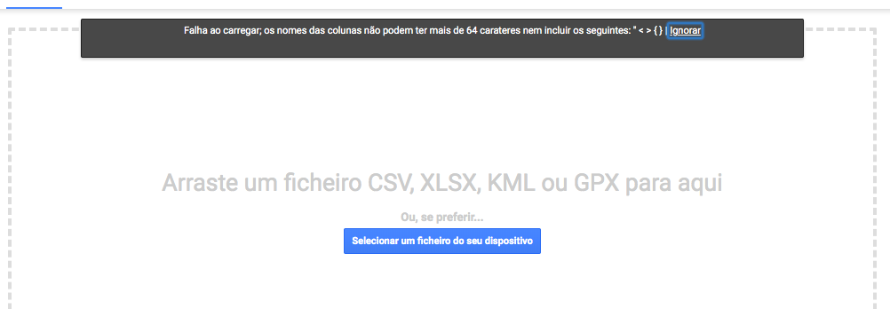
Limitation
Because that we don't Pay not for APIs:
There are a A Limit 10 "tables" per card
It There's no has no Putting To Day Automatic Excel table - Googlemaps Yes Googlemaps To Excel table
Other
If the message Following Appears, You Must Shorten The names of Columns. Try de Remove The Spaces and instead of "Type of Ship" Simplify with "T.Vessel" by Example

