Slide 1
YAOUNDÉ ARCHITECTURE REGIONAL INFORMATION SYSTEM

Slide 2
YARIS
THE TOOL ANALYTICS

Slide 3
Plan
Overview
Users profile in Analytics
Logging Analytics
Analytics Window Overview
Analytics - Dashboards

Slide 4
ANALYTICS
Overview

Slide 5
Overview
Review
Support prospective
Identification of threats and appropriated
responses in short and long time
Maritime strategic planning development
Support operational decision
• Identification of threats and situations
• Follow up the active situations
Aggregating Information
Information processing
Information dissemination
Analysis environment
Analysis and Stats
environment
(business intelligence)
Analysis
Permanent Analysis at user disposal
Maritime traffic by areas, type of
vessel, flag……
• Incidents by areas, type of incidents,
type of vessel, flag……
• System governance statistics
Advanced Analysis
Specific analysis to be developed
Develop new permanent analysis to be
at all users disposal
MSA
Analytics

Slide 6
Overview
Purpose
(1) Provide standard statistical data to YARIS users concerning:
Maritime Traffic
Maritime Incidents
Shared Activities
Data displayed aggregates both the information owned by a center and the one shared with him by other centers
(2) New queries may by developed on request for particular analysis
Notes:
Comments:
First point Users ... have automatic access to a Instant messaging environment, not at a Instant messaging
second point: within the this environment...

Slide 7
ANALYTICS
Organization of the user

Slide 8
Organization of the users
YARIS
Analytics
ANALYTICS MANAGER
STANDARD
Maritime Traffic
Incidents
Sharing
DEDICATED
OPERATOR
new queries
DECIDOR
ANALITYCS
OPERATOR
SUPERVISOR

Slide 9
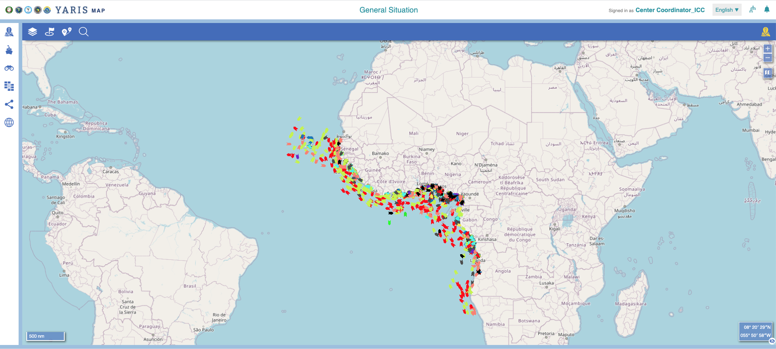
Organization of the users Permission to access the dashboards
To View Dashboards – Analytics operator
The user must have the role of view dashboard in the Single Sign On
1
DECIDOR
SUPERVISOR
MSA
and
OPERATOR
2
The dashboard must be shared individually with the one user by the Analytics Manager
ANALITYCS
OPERATOR
ANALYTICS

Slide 10
ANALYTICS
Accessing the toll
Mastering the entrance page

Slide 11
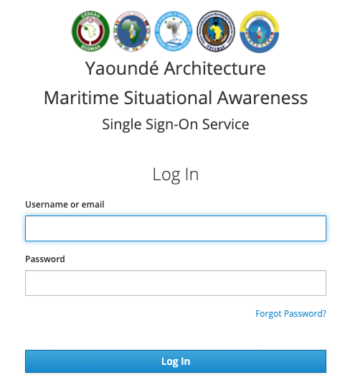
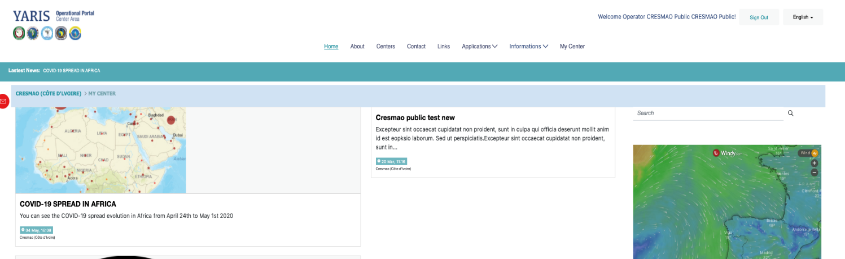
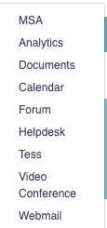
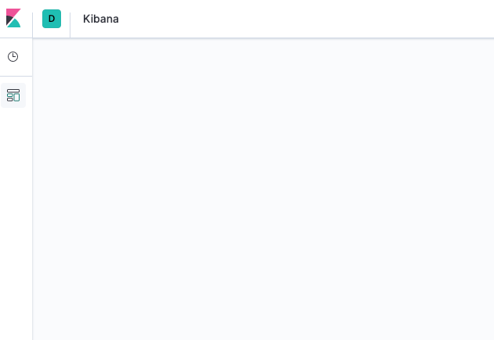
Accessing Analytics
A
Applications
B
training.analytics.yamsa.org

Slide 12
Accessing Analytics
The Entering Window Overview
1
Click on
It opens a board with the available dashboards
Menu Bar
Functionalities Vertical Bar
Data window
1
A
A
B
B
C
C

Slide 13
Accessing Analytics
The Entering Window Overview
1
Click on
It opens a board with the available dashboards
Choose the dashboard to access
1
2
2

Slide 14
ANALYTICS
The menu bar

Slide 15
Window Overview
A
A
Menu Bar
Functionalities Vertical Bar
Data window
B
B
C
C

Slide 16
Window Overview
The Menu Bar
1
2
3
1
Navigation Breadcum
Indicates the current navigation
Kibana App Help
User Data & Log out
It opens a dedicated box
Edit profile & Change Password
Log Out
2
3
A
A
B
B

Slide 17
Window Overview
The Vertical Functionalities Menu<
1
Recently viewed
List of Recent Items used by the user
Discover
Area to access all data in the analytics
Visualize
Area to use Widgets to create data visualization
Dashboards
Area to create and access dashboards available to the user
Maps
Area to create Map visualizations
Development Tools
Area for developers
Management
Area for the management of the application
1
Recently viewed
ANALYTICS OPERATOR
2
2
Discover
3
3
Visualize
4
ANALYTICS OPERATOR
Dashboards
4
5
Maps
6
Dev
5
7
Management
6
7
ANALYTICS
MANAGER

Slide 18
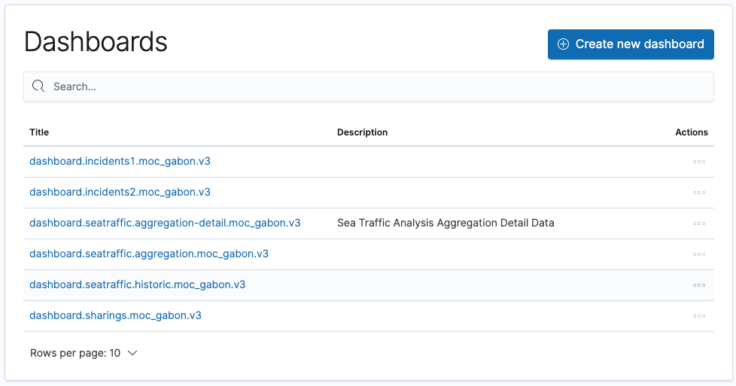
Window Overview
Data Window
Only available for authorized users
1
List of available Dashboards per center
3 related with Maritime Traffic
2 related with Maritime Incidents
1 related with activity sharing
To create new dashboards
Only for Analytics Managers
2
A
1
B
C
B
2
A
C

Slide 19
ANALYTICS
Maritime Traffic dashboards
Maritime Incidents dashboards
Sharing Activity dashboard

Slide 20
Maritime Traffic Dashboards
Sea traffic Analysis
Sea traffic Analysis - details
Sea traffic historical Data

Slide 21
Sea Traffic Analysis

Slide 22
Maritime Traffic Dashboards
Sea Traffic Analysis Overview
A
A
Filters
Identification
Default Indicatores
Map / Graphics
Tabular Map
B
B
C
C
D
D
E
E

Slide 23
Maritime Traffic Dashboards
Sea Traffic Analysis Filters
Purpose
Be able to select relevant data by category, time and space for a specific analytical objective Be able to select relevant data by category, time and space for a specific analytical objective

Slide 24
Maritime Traffic Dashboards
Sea Traffic Analysis Filters
1
1
3
Content Criteria Filter
Data filter based on specific attributes
Geographical Criteria Filter
Data filter based on specific areas
Time Criteria Filter
Data filtered based on the ReceptionUtc of the data
2
2
3

Slide 25
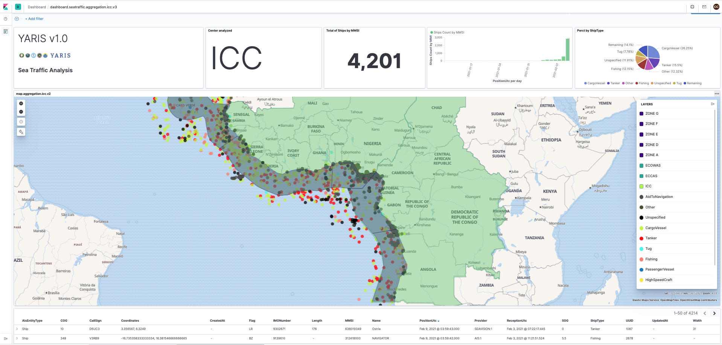
Maritime Traffic Dashboards
Sea Traffic Content Filters

Slide 26
Maritime Traffic Dashboards
Sea Traffic Analysis Filters
1
1
A
Content Criteria Filter
Data filtered based on specific attributes
Methode 1
Type on Search
It opens a pane with the available atributes
Select the content filter
1
A
1
2
For the same attribute, choose the one with .keyword if it exists
2

Slide 27
Maritime Traffic Dashboards
Sea Traffic Analysis Filters
1
1
A
Content Criteria Filter
Data filtered based on specific attributes
Methode 1
Type on Search
It opens a pane with the available atributes
Select the content filter
It opens the available criteria
Select the criteria
Insert the value
Click on
1
3
A
5
4
1
2
3
4
2
5

Slide 28
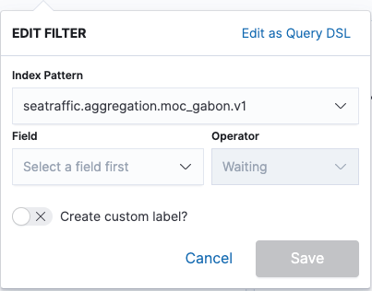
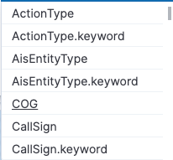
Maritime Traffic Dashboards
Sea Traffic Analysis Filters
1
1
Content Criteria Filter
Data filtered based on specific attributes
Methode 1
Methode 2
Cick on
It open the box Edit Filter
Select the attribute
Select the criteria
B
1
A
B
1
3
2
«
2
3

Slide 29
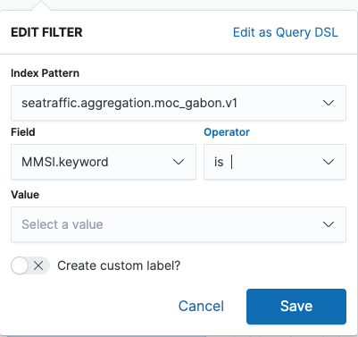
Maritime Traffic Dashboards
Sea Traffic Analysis Filters
1
1
Content Criteria Filter
Data filtered based on specific attributes
Methode 1
Methode 2
Cick on
It open the box Edit Filter
Select the attribute
Select the criteria
The field Value appears in the box
Insert the Value
Click on
B
1
A
B
1
3
2
2
4
3
5
4
5

Slide 30
Maritime Traffic Dashboards
Sea Traffic Geographical Filters – Delete Content filters

Slide 31
Maritime Traffic Dashboards
Sea Traffic Geographical Filters

Slide 32
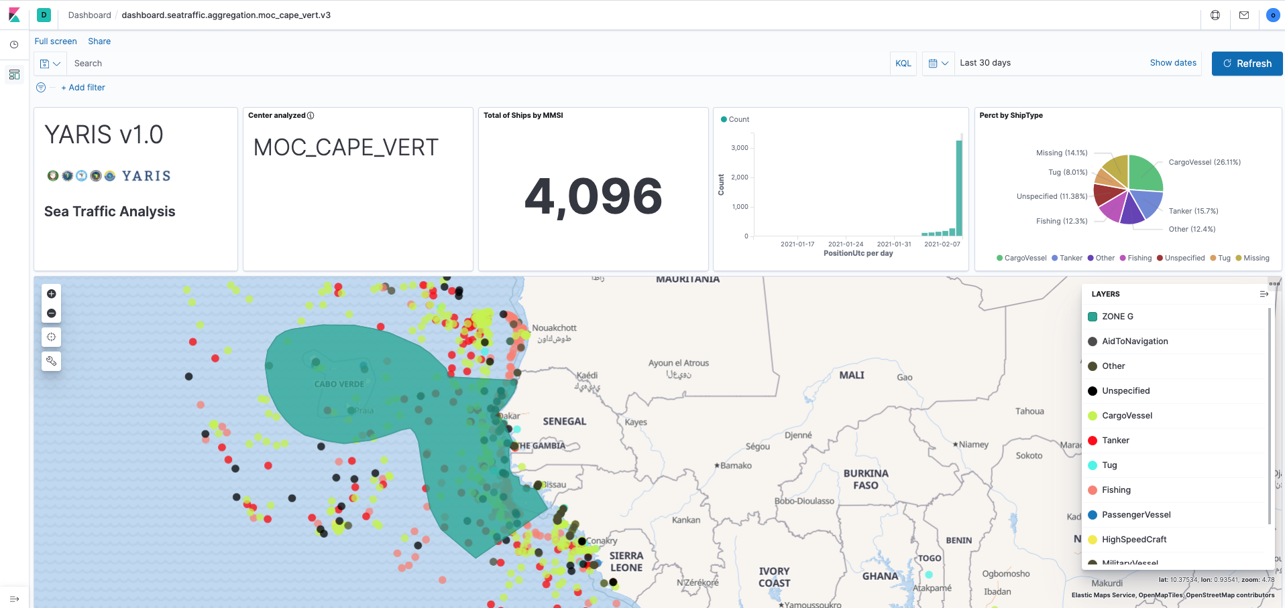
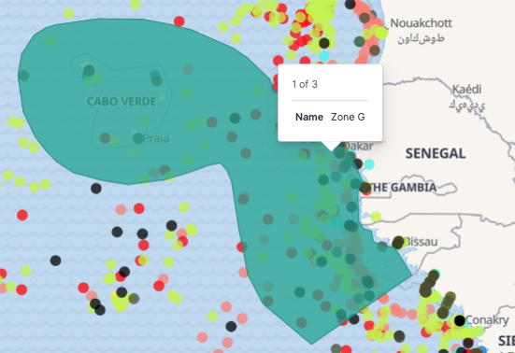
Maritime Traffic Dashboards
Sea Traffic Geographical Filters
2
Geographical Criteria Filter
Data filtered based on geographic attributes
Methode 1 (Pre-defined zones in the analytics)
Select the zone from available layers
If there are several layers overlayed you may have hide some of upper ones
Locate the mouse over the layer on the map
An identification box appears
A
1
1
2
2

Slide 33
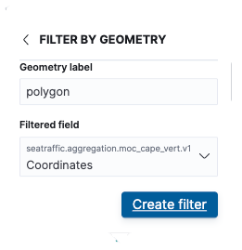
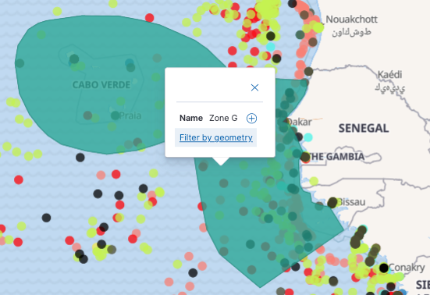
Maritime Traffic Dashboards
Sea Traffic Geographical Filters
2
Geographical Criteria Filter
Data filtered based on geographic attributes
Methode 1 (Pre-defined zones in the analytics)
Select the zone from available layers
If there are several layers overlayed you may have hide some of upper ones
Locate the mouse over the layer on the map
An identification box appears
Left click the layer
The option to filter by geometry is shown
Click on
It opens a dedicated box
Click on
A
1
2
2
3
5
3
4
4
5

Slide 34
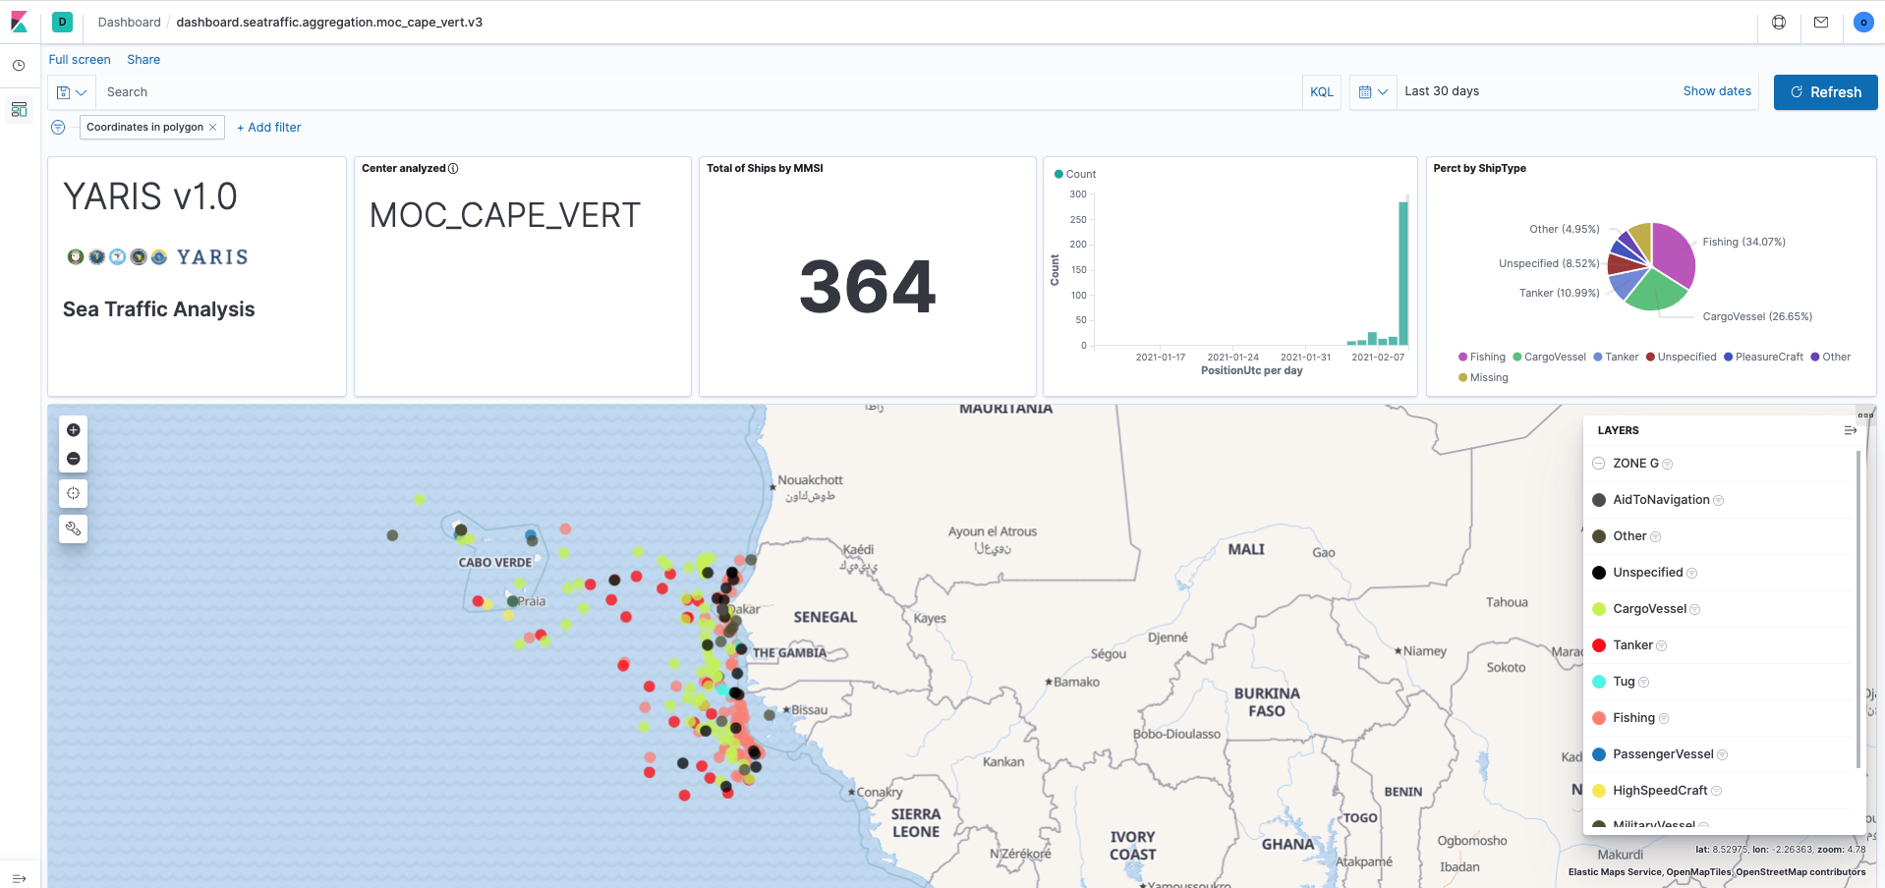
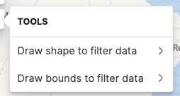
Maritime Traffic Dashboards
Sea Traffic Geographical Filters
2
Geographical Criteria Filter
Data filtered based on geographic attributes
Methode 1 (Pre-defined zones in the analytics)
Select the zone from available layers
If there are several layers overlayed you may have hide some of upper ones
Locate the mouse over the layer on the map
An identification box appears
Left click the layer
The option to filter by geometry is shown
Click on
It opens a dedicated box
Click on
A
1
2
3
4
5

Slide 35
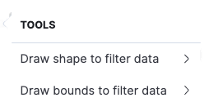
Maritime Traffic Dashboards
Sea Traffic Geographical Filters
2
Geographical Criteria Filter
Data filtered based on geographic attributes
Methode 1 (Pre-defined zones in the analytics)
Methode 2 (Customized Areas)
Click
It opens a tools box
Select
The Draw Shape box opens
Click on
It opens a dedicated box
A
B
1
2
1
2
3
3

Slide 36
Maritime Traffic Dashboards
Sea Traffic Geographical Filters
2
Geographical Criteria Filter
Data filtered based on geographic attributes
Methode 1 (Pre-defined zones in the analytics)
Methode 2 (Customized Areas)
Click
It opens a tools box
Select
The Draw Shape box opens
Click on
It opens a dedicated box
Define area in the map by clicking the boundary points
To finish double click in the map
A
B
1
2x
2
3
4

Slide 37
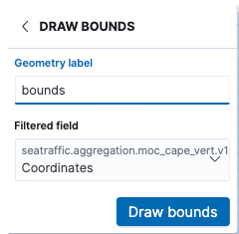
Maritime Traffic Dashboards
Sea Traffic Geographical Filters
2
Geographical Criteria Filter
Data filtered based on geographic attributes
Methode 1 (Pre-defined zones in the analytics)
Methode 2 (Customized Areas - A)
Methode 3 (Customized Areas - B)
Click
It opens a tools box
Select
The Draw bounds box opens
Click on
It opens a dedicated box
Define area on the map by clicking the Top-Left and Bottom-Right positions
A
B
1
2
C
1
3
2
3
4

Slide 38
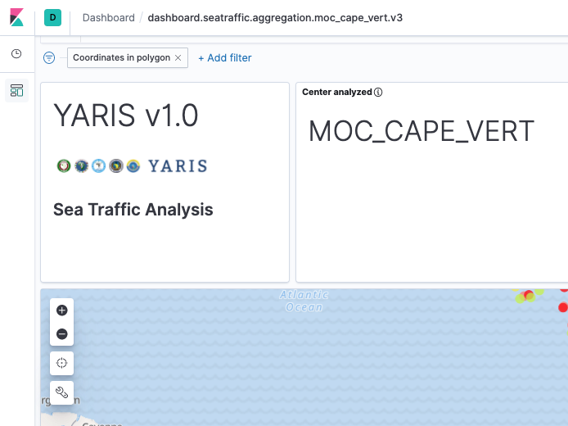
Maritime Traffic Dashboards
Sea Traffic Geographical Filters – Delete Geographical filters

Slide 39
Maritime Traffic Dashboards
Sea Traffic Geographical Filters

Slide 40
Maritime Traffic Dashboards
Sea Traffic Time Filters
3
Time Criteria Filter
Data filtered based on time attributes
Methode 1 (Pre-defined time periods)
Click on
It opens a option time period quick selection box
Select an option
The data will be selected in accordance with
A
A
1
Quickly select last 15 minutes data
2
Select data based on a longer period of time
Refresh data continuously

Slide 41
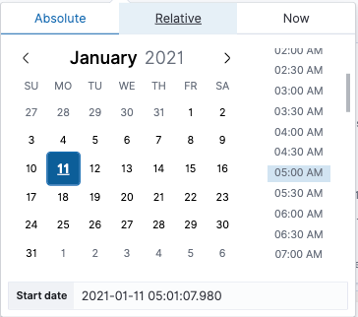
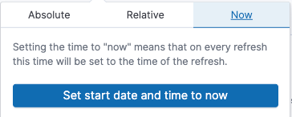
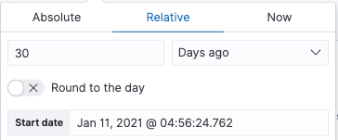
Maritime Traffic Dashboards
Sea Traffic Time Filters
3
Time Criteria Filter
Data filtered based on time attributes
Methode 1 (Pre-defined time periods)
Methode 2 (Customized time periods)
Click
It changes to a time frame indicator
Select the start date by clicking
It opens date selection box
Absolute option
Select from a calendar
Relative option
Related to today’s date
Now
Refresh data continuously
1
A
2
A
B
C
1
2
B
A
B
Define the time reference units
C

Slide 42
Maritime Traffic Dashboards
Sea Traffic Time Filters
3
Time Criteria Filter
Data filtered based on time attributes
Methode 1 (Pre-defined time periods)
Methode 2 (Customized time periods)
Click
It changes to a time frame indicator
Select the start date by clicking
Select the end date by clicking
Absolute option
Relative option
Now
Click on
4
A
3
A
B
C
1
2
3
B
A
B
Define the time reference units
C
4

Slide 43
Maritime Traffic Dashboards
Identification and Default indicators
Purpose
Identifies the data reference center and presents data for some default indicators according to the selected filters
Note: data includes that belonging to the center and that shared by others with the one

Slide 44
Maritime Traffic Dashboards
Identification and Default indicators
Time-Distribution of number of vessels in a period of time, based on unique MMSI
1
1
Indicators for default time filter
Data filtered based on time attributes
Center’s dashboard ID
Total number of vessels in a period of time (time filter), based on unique MMSI
Shiptype percentage in a period of time, based on unique MMSI

Slide 45
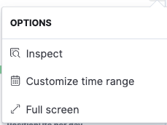
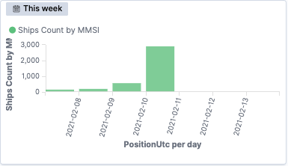
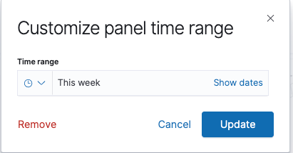
Maritime Traffic Dashboards
Identification and Default indicators
1
Indicators for default time filter
Data filtered based on time attributes
Customise time references for the Ship Count and Perct by ShipType
Place the mouse over the “panel” to be customized
The icon appears
Click on
A dedicated box appears
Select
A dedicated box appears
Define the time range and click
To clean up the customized time frame click on
2
A
2
B
A
C
B
C
D
D
E
Note that from now on the chart will have a different time reference from the general filter defined
E

Slide 46
Maritime Traffic Dashboards
Sea Traffic Analysis MAP
Purpose
Display of the maritime information according with the selected filters

Slide 47
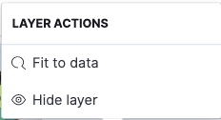
Maritime Traffic Dashboards
Sea Traffic Analysis MAP
1
1
Zoom in / out
Apply a customized geographical filter
Already covered in Filters Chapter
Pre-defined geographical area Layers
Used as selecting filters – already covered
Used as visibility only filter
Ship type layers
Used as visibility only filter
3
2
2
4
3
4

Slide 48
Maritime Traffic Dashboards
Sea Traffic Analysis – Tabular Data
Purpose
Display of the maritime information according to the selected filters in a tabular format

Slide 49
Maritime Traffic Dashboards
Sea Traffic Analysis – Tabular Data
1
Tabular data in accordance with the selected filters
In addition, filters may be added directly in the table, clicking on the column
1
Press
It opens a dedicated box
Full screen
Download
Users with the right permissions can export data to CSV. The others will receive an error message
A
A
B
B

Slide 50
Sea Traffic Analysis Details

Slide 51
Maritime Traffic Dashboards
Sea Traffic Analysis Overview
A
A
Filters (as explained for the sea traffic dashboard)
Vessel indicators
Heat Map - Density Map
B
B
C
C

Slide 52
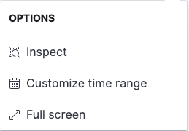
Maritime Traffic Dashboards
Sea Traffic Analysis details - exploitation
Select filters
Already covered
Press from the wanted box data
It opens a dedicated box
Select the period of time
Open in Full Screen mode
1
1
2
2
A
C
B

Slide 53
Maritime Traffic Dashboards
Sea Traffic Analysis Details - Heatmap
1
Zoom control of the map
Apply a user defined geographical criteria filter
Heat map content
1
2
3
2
3

Slide 54
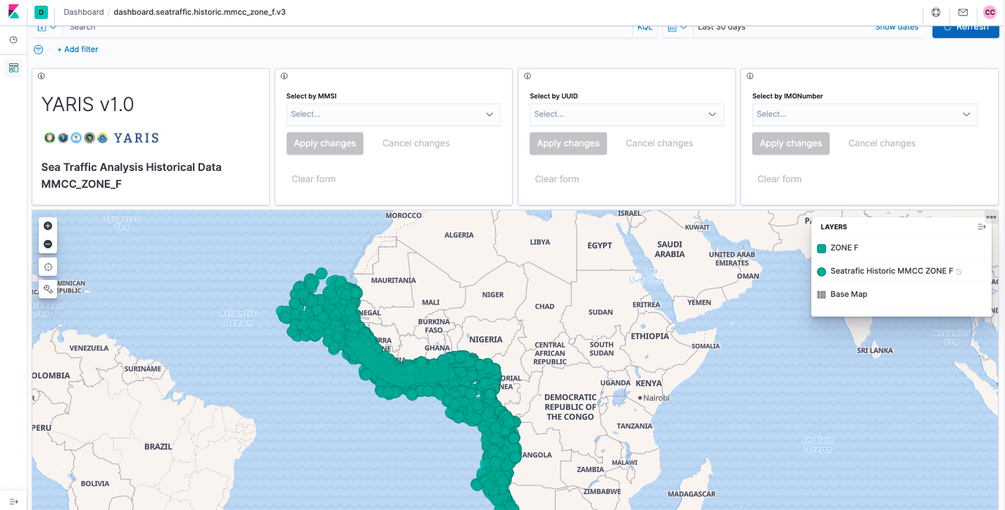
Sea Traffic History
Maritime traffic history by center and by ship
(source: data shared with, or belonging to a center)

Slide 55
Maritime Traffic Dashboards
Sea Traffic Historic - Organization
A
Select filters
Already covered
Select vessel by
MMSI
IMO
UUID – system number
Map – visualization and application of geographic filters
Already covered
Tabular data
Already covered
A
B
B
C
C
D
D

Slide 56
Maritime Traffic Dashboards
Sea Traffic Historic – Filter by vessel identification
1
Select vessel by
MMSI
IMO
UUID – system number
Press
Apply other content filters, geographic or temporary
Already covered
1
2
2
3
2
4
Note:
A warning sign means that not all data has been loaded in the checkbox.
The full search can be done in the general search area..
3

Slide 57
Maritime Traffic Dashboards
Sea Traffic Historic – Map
1
Zoom in / out
Define a geographical filter
Already covered
Apply a predefined geo-filter
Already covered
Date corresponding to the criteria applied
1
3
2
3
4
2
3
4

Slide 58
Maritime Traffic Dashboards
Sea Traffic Analysis – Tabular Data
1
Tabular data in accordance with the selected filters
In addition, filters may be added directly in the table, clicking on the column
1
Press
It opens a dedicated box
Full screen
Download
Users with the right permissions can export data to CSV. The others will receive an error message
A
A
B
B

Slide 59
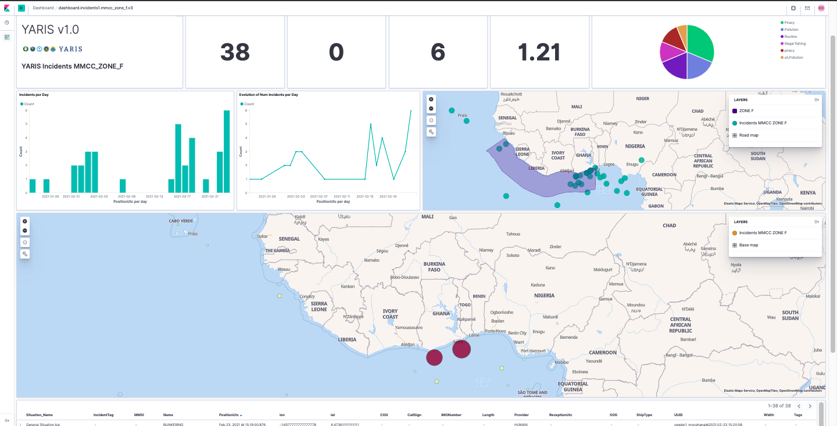
Incidents Analysis
Data on incidents in which a center was involved

Slide 60
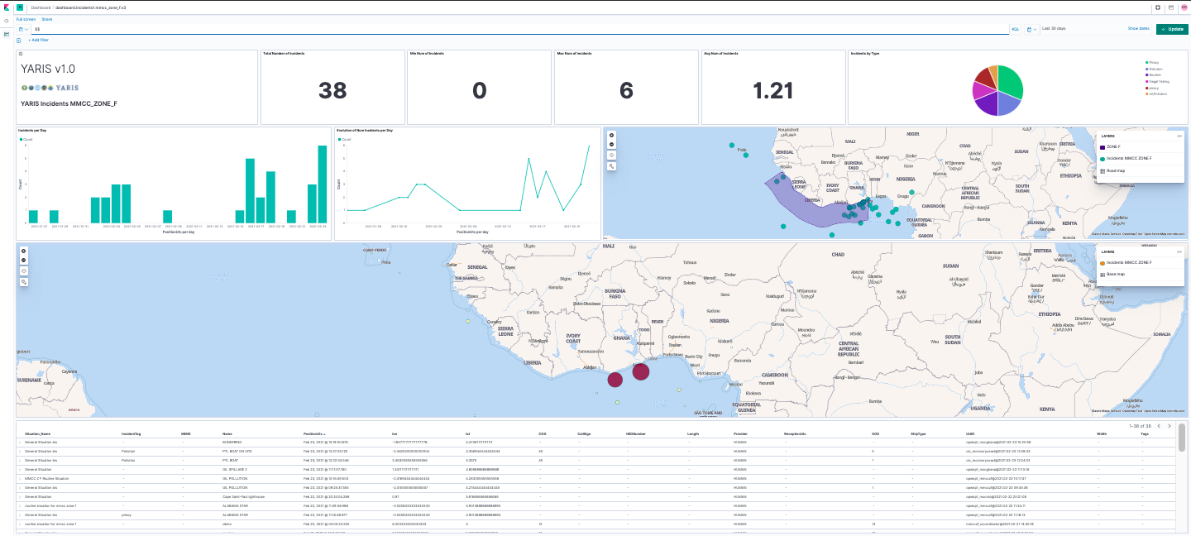
Maritime Incidents dashboards
Incidents Data 1 – Organization
A
A
Select filters
Already covered
Identification
Default indicators
Map Incidents
Heat-map incidents
Tabular data
B
C
B
D
C
D
E
E
F
F

Slide 61
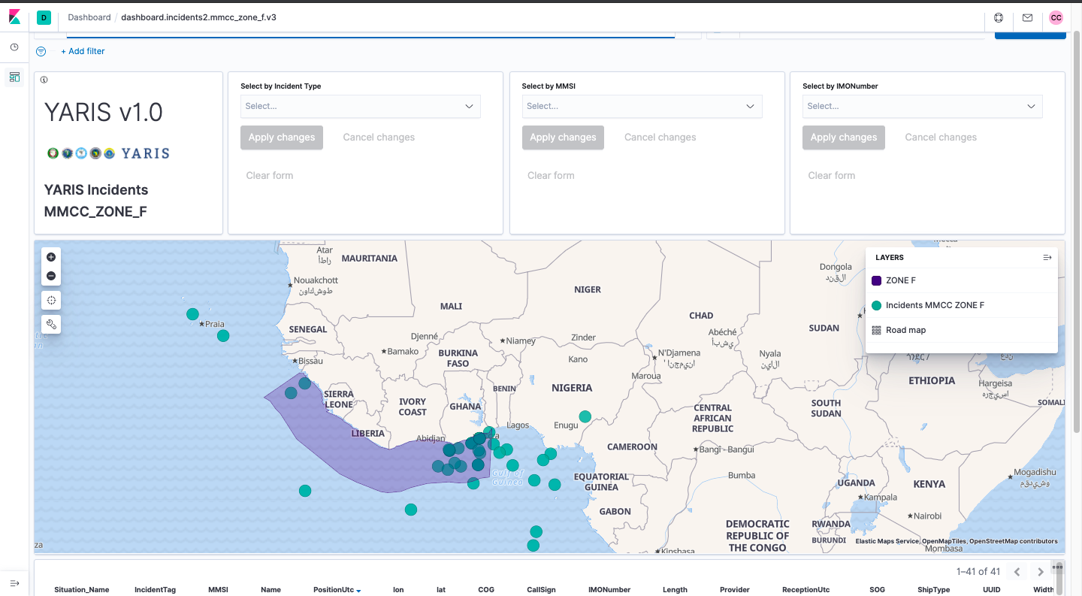
Incidents Analysis history
Incidents historical data by ship and by center

Slide 62
Maritime Incidents dashboards
Incidents Data 2 – Organization
A
A
Selecionar filtros
Já abordado
Identification
Filtrar por identificador de navio
MMSI
IMO
UUID – número interno de sistema
Mapa – visualização e aplicação de filtros geográficos
Já abordado
Informação tabular
Já abordado
B
C
B
C
D
D
E
E

Slide 63
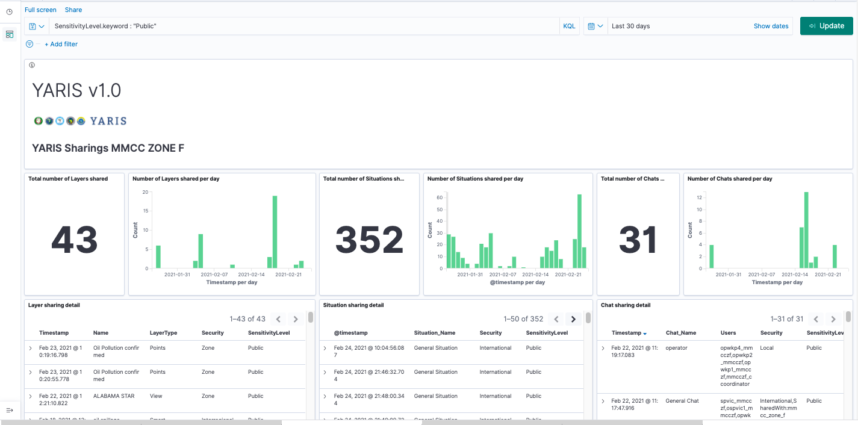
Sharing Analysis

Slide 64
Thank You for your attention

