Slide 1
MDA
WHY AND WHAT FOR

Slide 2
PLAN
Introduction - Some definition
MDA & Maritime Processes
MDA – The concept
What Information
Databases and Visualization – Basic tools

Slide 3
Introduction to MDA
Some definitions

Slide 4
Some definitions
Maritime Security
Maritime Domain
Maritime Domain Awareness

Slide 5
Some definitions
Maritime Security
environmental and safety regulation regarding marine pollution and health protection
Marine Environment
naval military power to defend commercial shipping lanes and the national territory
National
Security
interconnected
often transnational
cross-jurisdictional
Highly jurisdictional complex
Economical
Development
Includes trade by sea, the exploitation of oil and other non-living resources, as well as fisheries – connected to Blue economy
The absence of security (insecurity) of individuals, people in communities, or citizens of states
Human Security

Slide 6
Some definitions
Source: Forthcoming in Marine Policy, 2015, Christian Bueger Cardiff University
Translation Free
Maritime Security Matrix
Maritime Environment
Economic development
Maritime security
blue economy
Accidents
Pollution
Climate Change
Smuggling
Maritime
SECURITY
Terrorist Acts
Piracy
IUU Fishing
Proliferation of weapons
Human Trafficking
Inter- state Dispute
SEA power
Resilience
National security
Human SECURITY

Slide 7
Some definitions
Definition IMO for MDA
The effective understanding of anything associated with the maritime domain that could impact the security, safety, economy, or environment
[IAMSAR]

Slide 8
Some definitions
Definition IMO for MDA
The effective understanding of anything associated with the maritime domain that could impact the security, safety, economy, or environment
[IAMSAR]
The maritime domain is defined as all areas and things of, on, under, relating to, adjacent to, or bordering on a sea, ocean, or other navigable waterway, including all maritime-related activities, infrastructure, people, cargo, ships, and other conveyances.

Slide 9
Some definitions

Slide 10
MDA & MARITIME SECURITY PROCESS

Slide 11
Maritime Security Process
Legal Authority and Jurisdiction
Situation awareness
Information
Security
Surveillance
Decision Making
Fusion & Sharing
Analyzing
Locate
Intercept /Interdiction
Apprehend
Interagency
Yaoundé Architecture
International Cooperation
Prosecute
Interdiction Capabilities

Slide 12
ELEMENTS OF THE MSP
Strong knowledge over all activity in the maritime domain
Jurisdiction and laws $⟺$misconduct must be present
Jurisdiction and laws ⟺ misconduct must be present
Enhancing resources and legal competences to develop a high level of maritime security
Information available to the ones with authority to decide
Capability to locate and intercept the target
Enhanced Situation awareness
Effective Decision Making Organization
Ability to locate and intercept
Existence of appropriated authorities
Effective interagency / inter ministerial coordination

Slide 13
ELEMENTS OF THE MSP
Strong knowledge over all activity in the maritime domain
Jurisdiction and laws $⟺$misconduct must be present
Jurisdiction and laws ⟺ misconduct must be present
Enhancing resources and legal competences to develop a high level of maritime security
Information available to the ones with authority to decide
Capability to locate and intercept the target
Enhanced Situation awareness
MDA
Effective Decision Making Organization
Ability to locate and intercept
Existence of appropriated authorities
Effective interagency / inter ministerial coordination

Slide 14
MDA
The concept

Slide 15
The concept
IMO definition for MDA
Strong understanding of something associated with the marine domain that may affect safety, security, the economy or the environment.
[IAMSAR]

Slide 16
MDA
Observables
Ships
People
Cargo
Infrastructures
Areas
Alerts
Capacities
Weather
Operation related
1
Collecting
2
Fusing
MDA
3
Analyzing
4
Disseminating
Acting
Strategic
Operational
Tactical

Slide 17
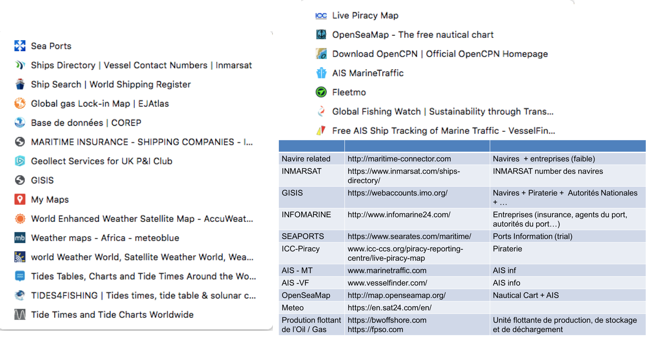
MDA
Observables
Sensors
INTEL – Operators
YS Centers
Non YS Centers
Private Entities
Field personal
1
Collecting
2
Fusing
3
Analyzing
4
Disseminating
Acting

Slide 18
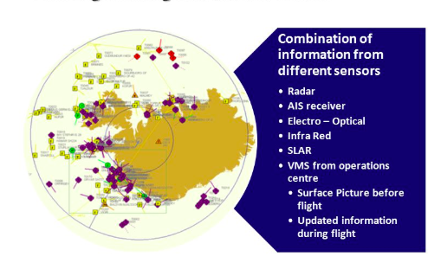
MDA
Observables
1
Collecting
2
Tracks with tracks
Data with Data
Data with tracks
Fusing
3
Analyzing
4
Disseminating
Acting

Slide 19
MDA
Observables
1
Collecting
2
Fusing
Anomaly detection
Patterns recognition
Compare with rules
Research tools
3
Analyzing
4
Disseminating
Acting

Slide 20
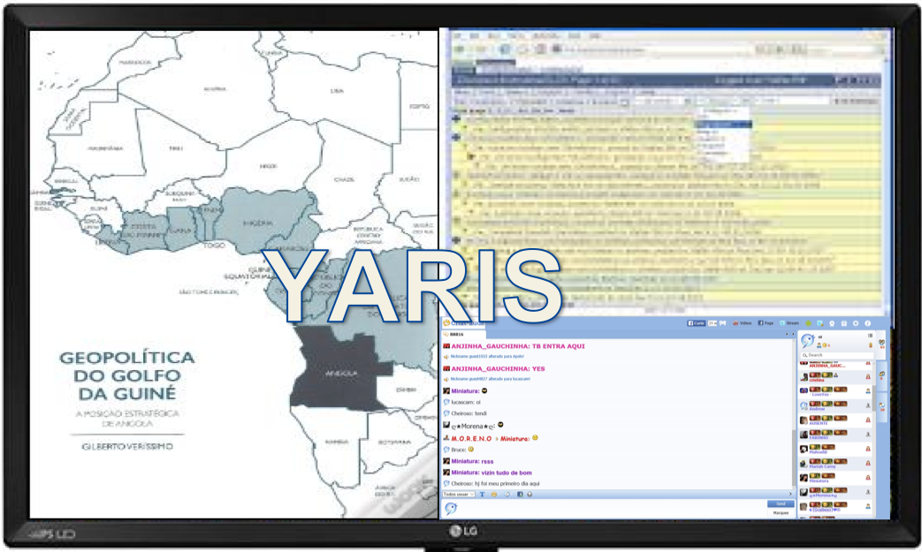
MDA
Observables
1
Collecting
2
Fusing
3
Analyzing
Web portal
Reports / email
Bulletins
YARIS
4
Disseminating
Acting

