Slide 1
Using GoogleMeet

Slide 2
MASTERING THE INVITATION

Slide 3
Mastering the invitation
To join a meeting, you must have an invitation or be the organizer
Once you are invited, you have 3 options to access the meeting:
Open the link on the invitation e-mail
Open the link from your calendar
Copy the link to the browser
Using the Google Meet / Meet application
As an organizer, you will automatically be a participant => create a meeting

Slide 4
Receiving the invitation

Slide 5
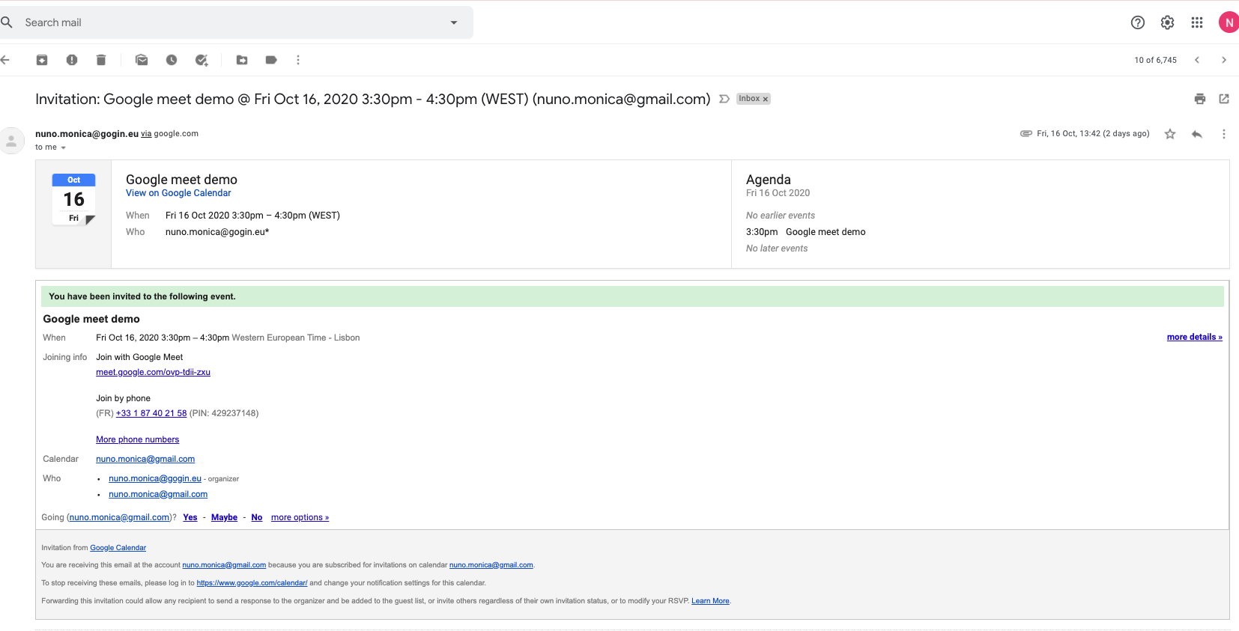
Receiving the invitation from the invitation mail
1
1
Open the invitation email
The subject of the email is the meeting’s name, and date-time of the event
It opens the event details
Event in the calendar and agenda
Link to the Google Meet
(phone number to join the meeting as option)
List of participants
To confirm the availability
2
2
3
3
4
4
5
5

Slide 6
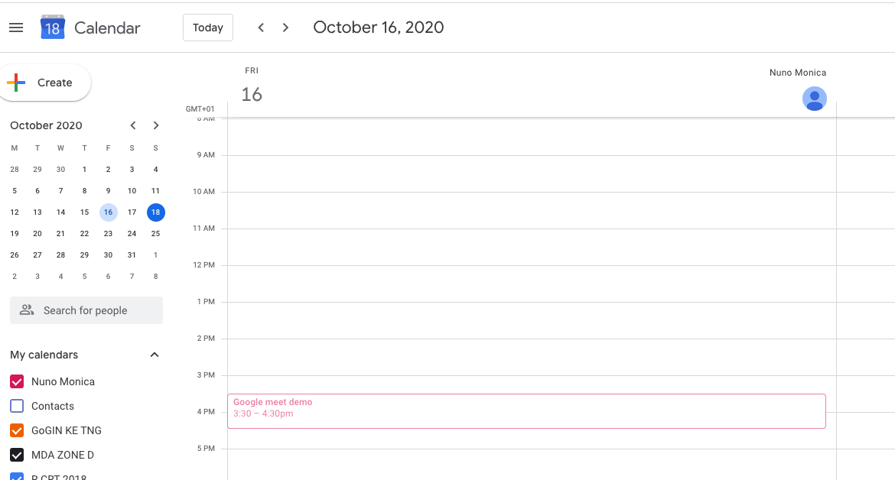
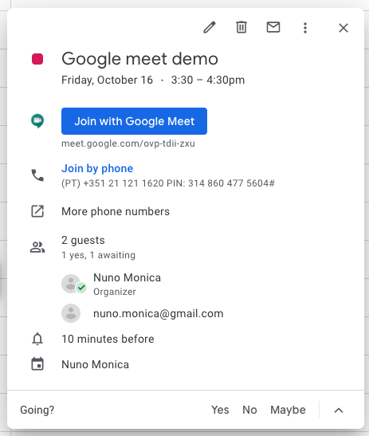
Receiving the invitation from the invitation mail
2
1
Open the calendar and select the meeting
Tools
Edit
Delete
Send invitation
More (namely to change the owner)
Events ID and date-time
Link to the Google Meet
(phone number to join the meeting as option)
List of participants and confirmed presences
Even alert
To confirm the availability
3
2
4
3
5
4
1
6
5
6
7
7

Slide 7
Creating a meeting

Slide 8
Creating a meeting
To create an instantaneous meeting, you may use the Google Meet / Meet application or create it from the Google Calendar
To create a schedule meeting, you should always use the google calendar

Slide 9
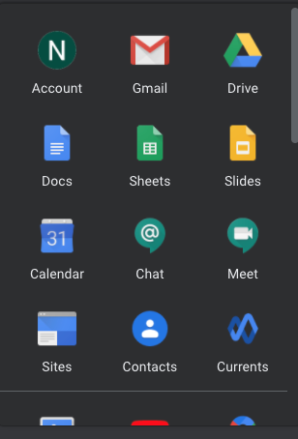
Create an instantaneous meeting From the application Meet
1
1
Click Google Applications
It opens the available applications
Click Google Meet
Add title
Day-time and Time zone validation
Add guests
Add Google Meet video conferencing
Add location
Add description or attachments
By clicking a link is created
Click on
If there are guests to be invited the system will ask permission to send the invitation mail and to add it to the calendar guests
2
2
3
4

Slide 10
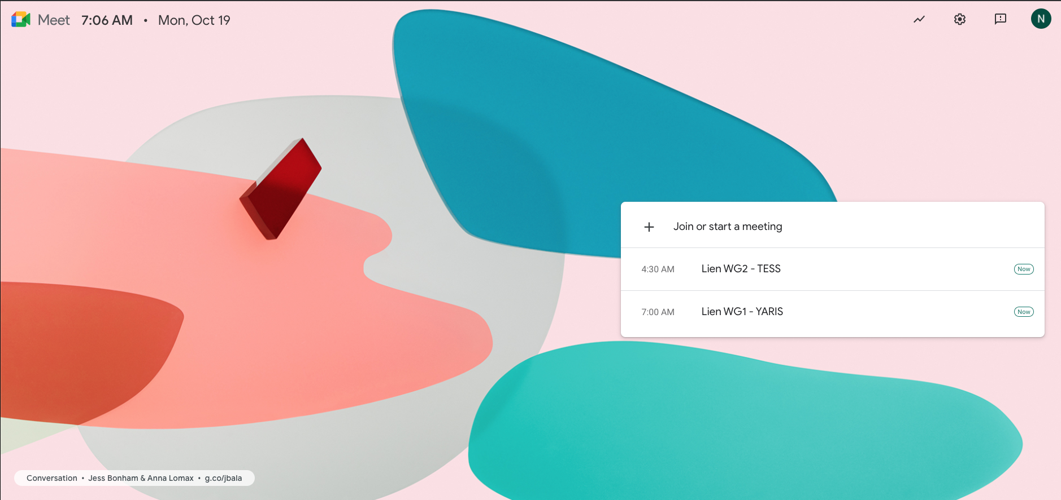
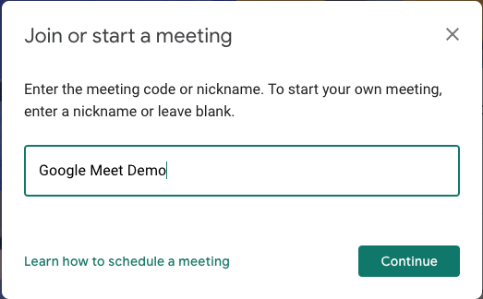
Create an instantaneous meeting From the application Meet
Fri, Oct 16
1
Click Google Applications
It opens the available applications
Click Google Meet
Click Join or start a meeting
It opens a dedicated box
Give a name
Click
It opens the meeting window
2
4
3
5
4
5

Slide 11
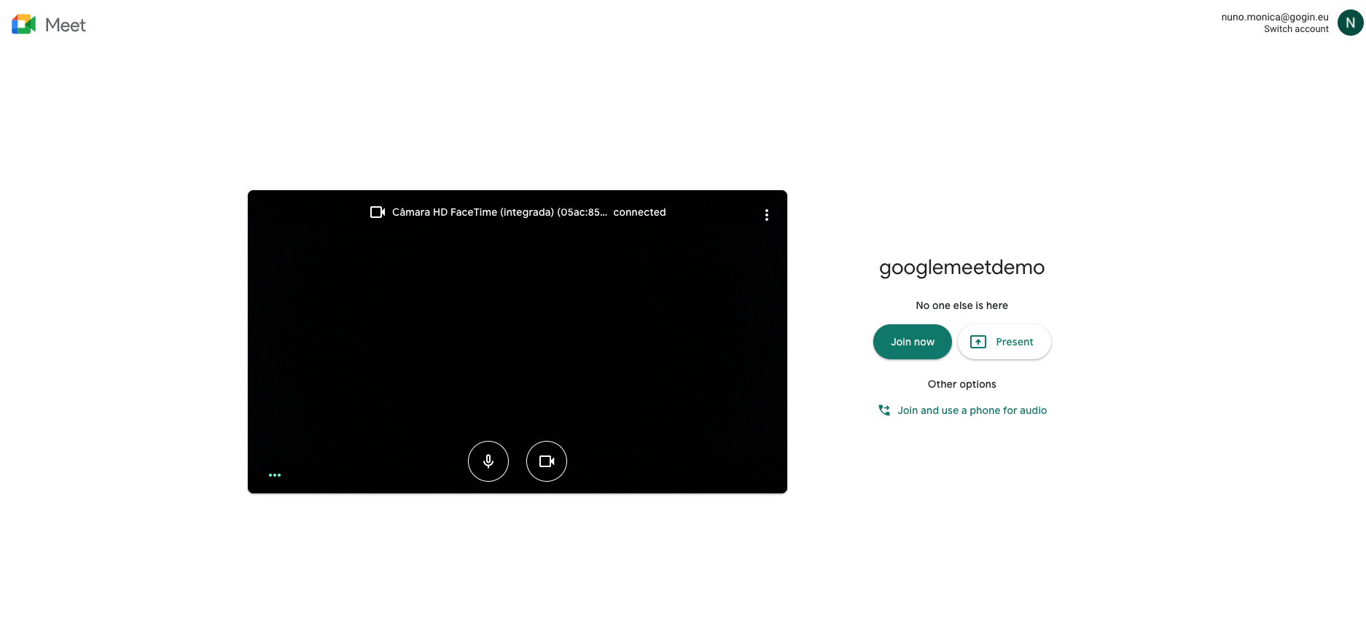
Create an instantaneous meeting From the application Meet
1
Click Google Applications
It opens the available applications
Click Google Meet
Click Join or start a meeting
It opens a dedicated box
Give a name
Click
It opens the meeting window
Click
2
3
4
6
5
6

Slide 12
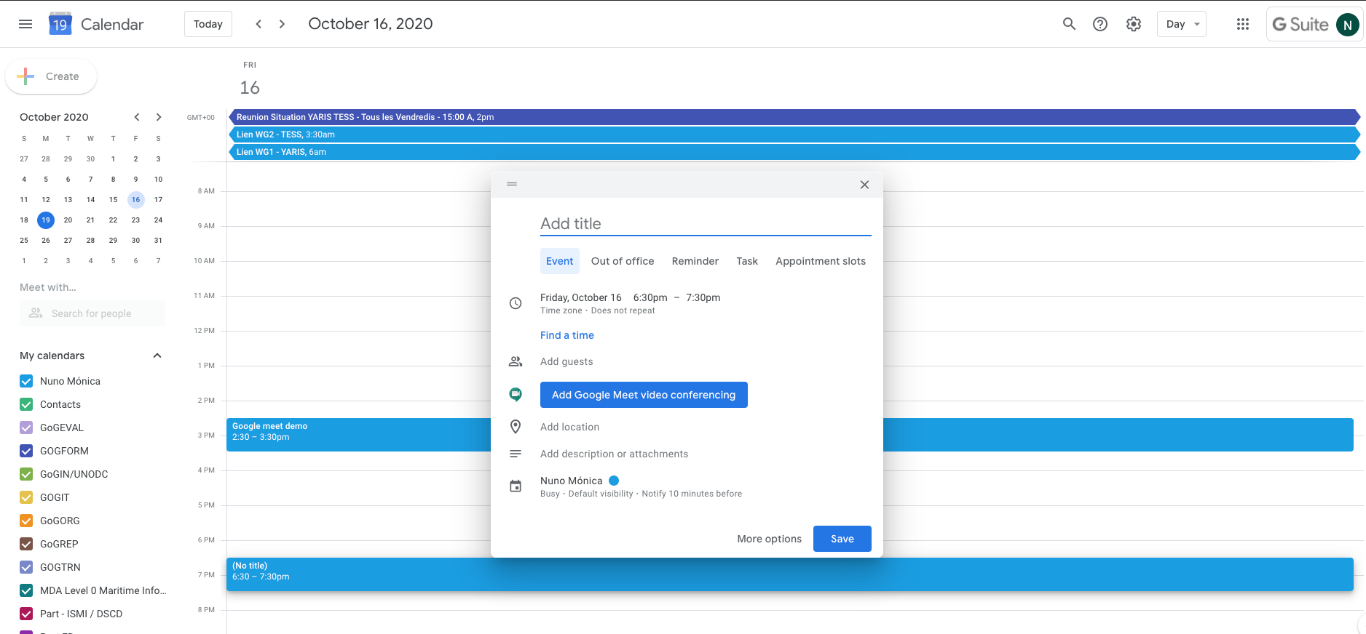
Create a scheduled meeting From the calendar
1
Select the start time
It opens the event box
The period time is 1 hour by default
Fill up the several field
Add title
Day-time and Time zone validation
Add guests
Add Google Meet video conferencing
Add location
Add description or attachments
By clicking a link is created
Click on
If there are guests to be invited the system will ask permission to send the invitation mail and to add it to the calendar guests
2
2
1
3
3
4
4

Slide 13
Mastering Google Meet

Slide 14
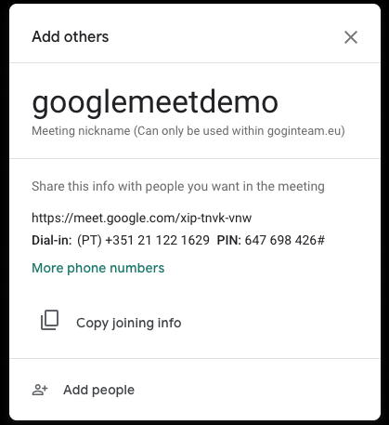
Adding Guests
If there are no other guests the system will open a specific box, before joining
You may copy the the joining info and send it by email
You may select from your contacts

Slide 15
Mastering GoogleMeet

Slide 16
Mastering GoogleMeet
Green circle means that you have received a chat
Visualization
People in the meeting

Slide 17
Mastering GoogleMeet
Chat
Note: those entering will not see previous messages
Customization and tools
Note:
If not shown, slide the mouse to the bottom of the window until it appears
Write and send a chat message

Slide 18
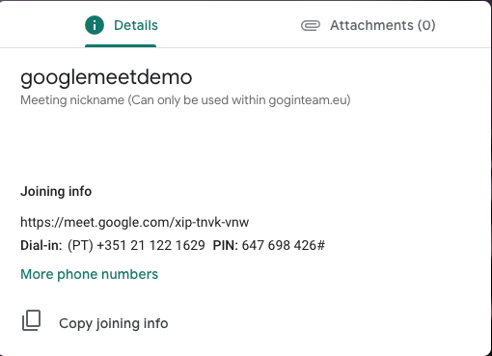
Mastering GoogleMeet
Access to the attachements sent in the google calendar

Slide 19
Changing Sound and Visuals Status
Click to end participation
Sound is mutted
Video is on
Click to change status
Click to change status

Slide 20
Captions
Turn on automatic captions

Slide 21
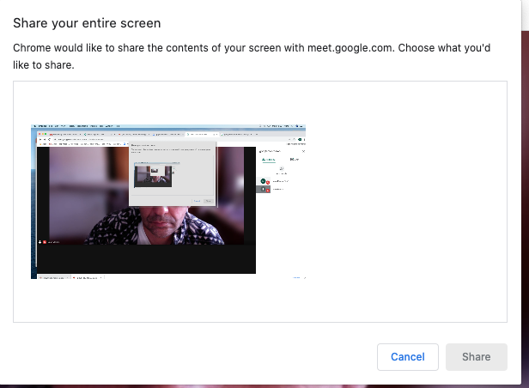
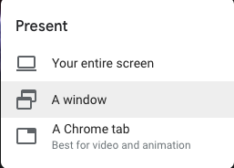
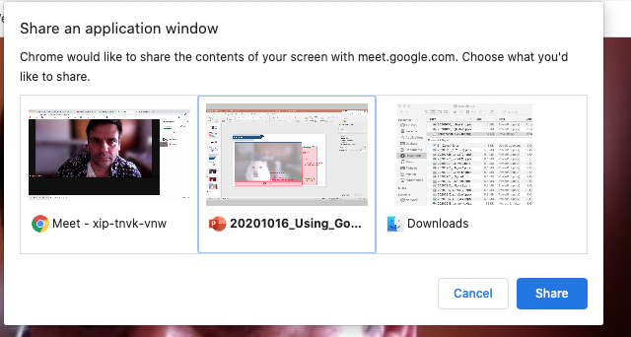
Sharing with the others
At you see is what you share
Click over the image and than Click Share
Select the window you wanna share and click Share
You only share the window you chose
To stop sharing

Slide 22
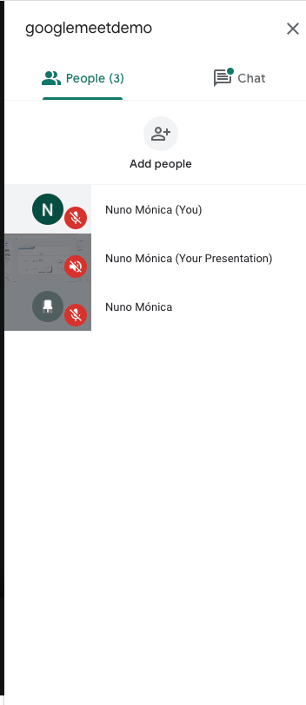
Choosing who to see
When someone is sharing something, it will be shown as different participant (name + Your presentation)
If the presentation is not automatically shown, or if you wanna change who you are seeing, just selected (3 options are available)

Slide 23
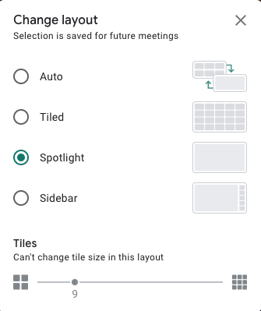
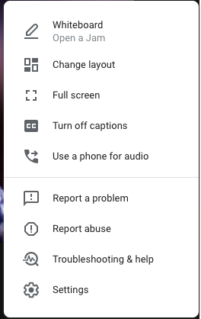
Change Layout and Visual/Sound Settings

