Slide 1
PREPARING THE COMPUTER FOR YARIS
BROWSER CONFIGURATION
INSTALLING THE VPN

Slide 2
BROWSER CONFIGURATION
POP-UPS PERMISSIONS

Slide 3
POP-UPS PERMISSIONS
Internet Browser should allow automatic pop-ups from Yaris
Different browsers and different browsers use different settings organization and different ways to do it. Even so the general approach is globally the same
The next slides show how to do it step-by-step for the following Browsers:
Mozilla Firefox (version 73.0.1)
Internet Explorer (Version:11.0.10240.10443)
Microsoft Edge (Version: 20.10240.17146.0)
Opera (version : 68.0.3618.63)
Chrome (version 87.0.4280)

Slide 4
BROWSER CONFIGURATION
Mozilla Firefox (version 73.0.1)

Slide 5
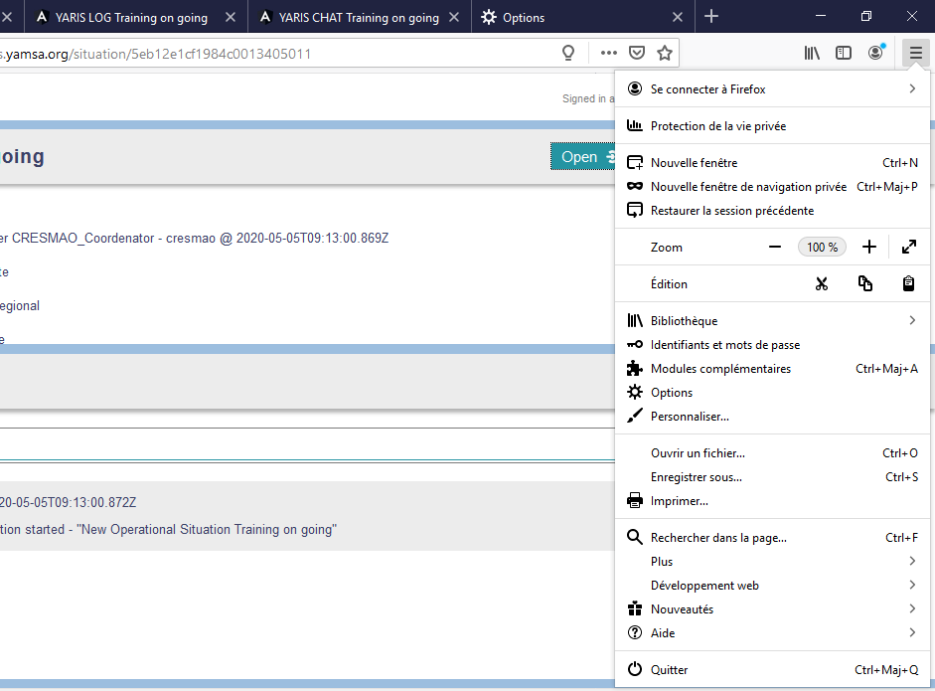
1
2

Slide 6
3
4

Slide 7
5
6
training.portal.yamsa.org
https://training.portal.yamsa.org
https://training.yaris.yamsa.org
7

Slide 8
BROWSER CONFIGURATION
Internet Explorer (Version:11.0.10240.10443)

Slide 9
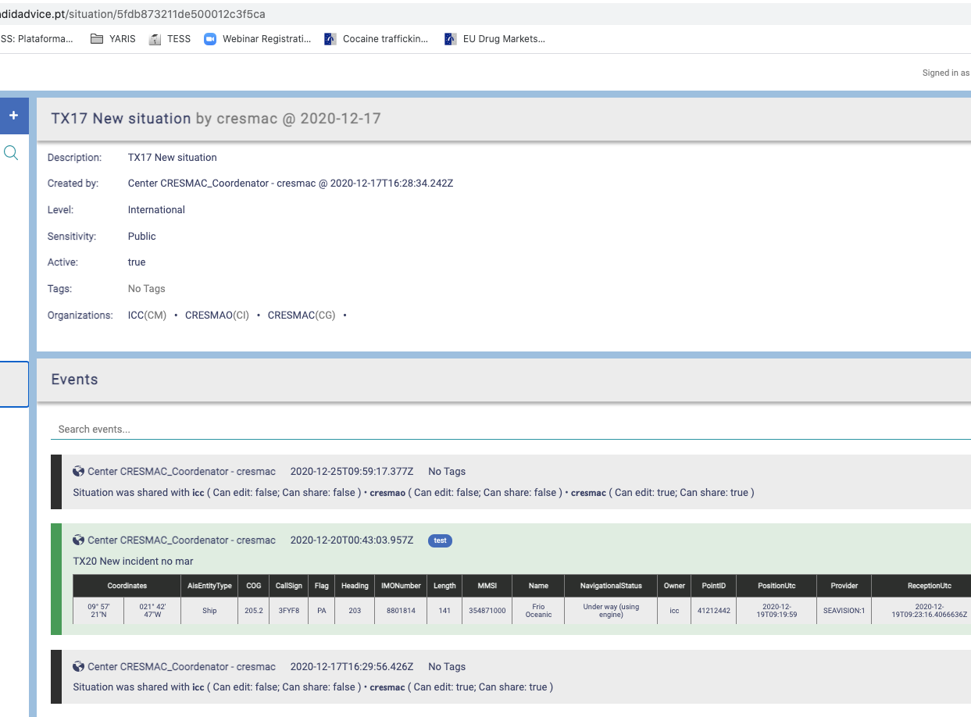
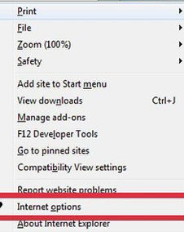
1
2

Slide 10
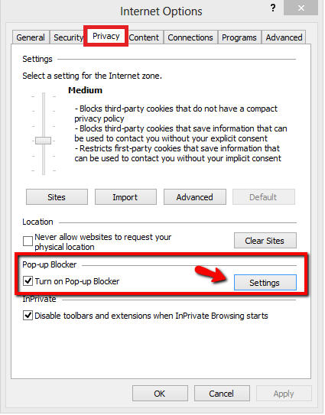
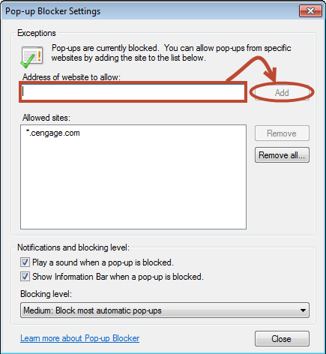
3
5
6
training.portal.yamsa.org
https://training.portal.yamsa.org
https://training.yaris.yamsa.org
4
7

Slide 11
BROWSER CONFIGURATION
Microsoft Edge (Version: 20.10240.17146.0)

Slide 12
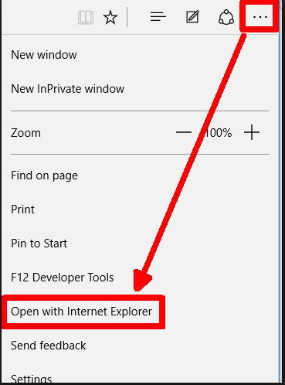
1
2

Slide 13
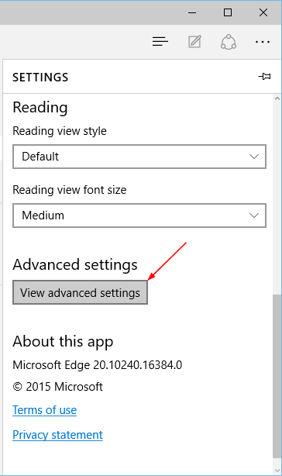
3
4
Turn it Off

Slide 14
BROWSER CONFIGURATION
Opera (version : 68.0.3618.63)

Slide 15
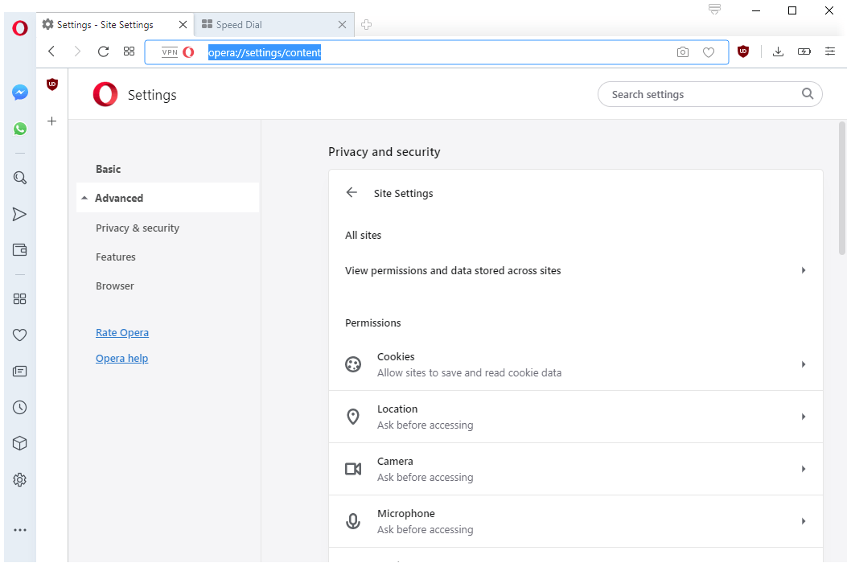
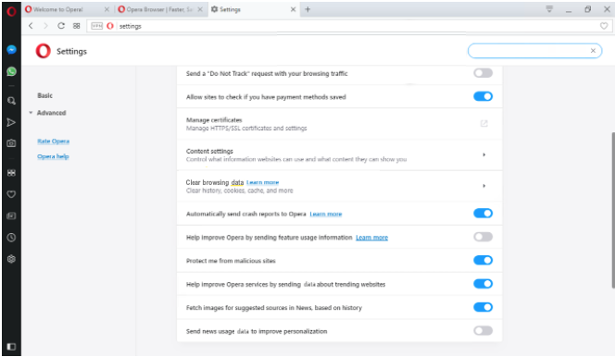
2
3
4
1

Slide 16
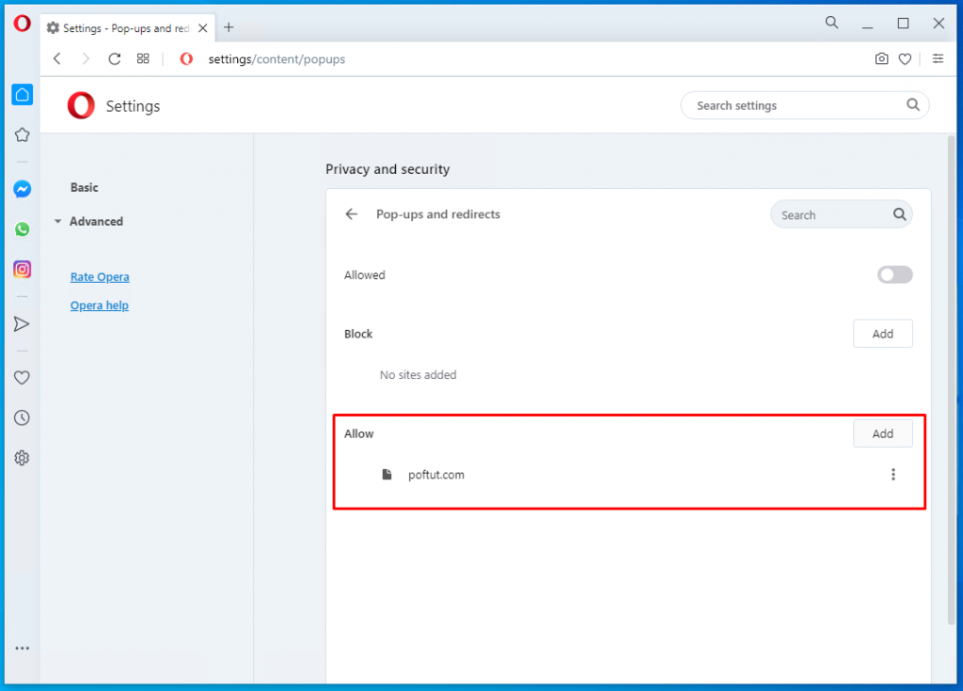
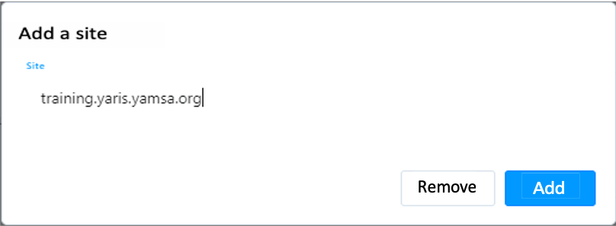
5
6
7
8

Slide 17
BROWSER CONFIGURATION
Chrome (version : 87.0.4280)

Slide 18
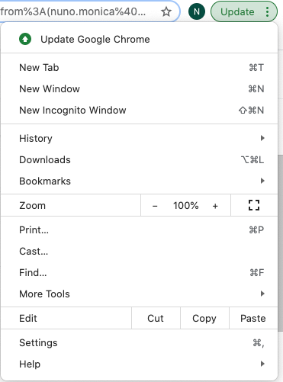
1
2

Slide 19
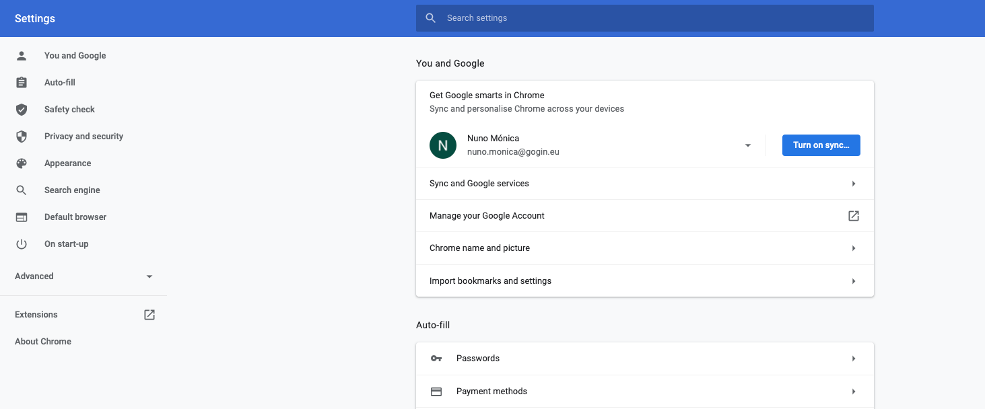
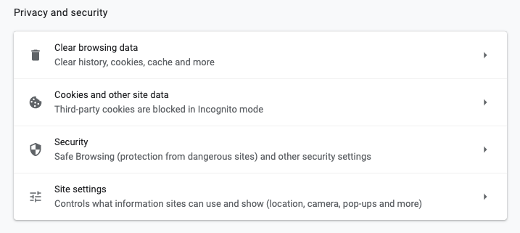
3
4

Slide 20
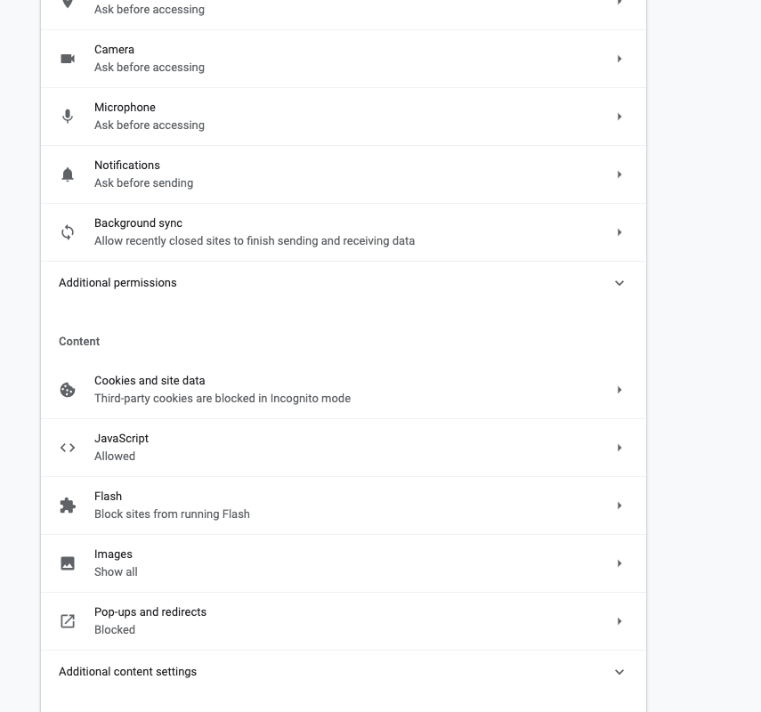
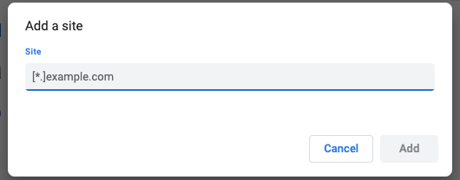
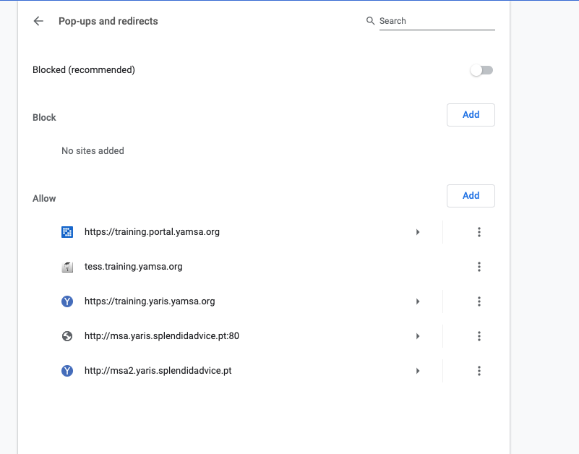
7
training.portal.yamsa.org
8
6
5

